Slide 1
Current Version:
Previous version link from Google Drive:
LXP Link:
Critical SME: Sukhpal TheraSingh
SME(s): Sukhpal TheraSingh
Sources:
Tool access (if applicable):
Update scope (if applicable):
Course Description:
Target Audience:
Voice talents (number, gender) - indicate if crucial:
Course number
MOTOTRBO Capacity Max System Design
Click the icon to test your audio settings.
Click the icon to learn about course navigation.

Slide 2
MOTOTRBO Capacity Max System Design
State the Objectives
Course Objectives
After completing this course, you will be able to:
Design a simple Capacity Max system.
Calculate Capacity Max capacity and bandwidth using a case scenario and system design tool.
Create an equipment list, licensing, frequency planning and IP network plan.

Slide 3
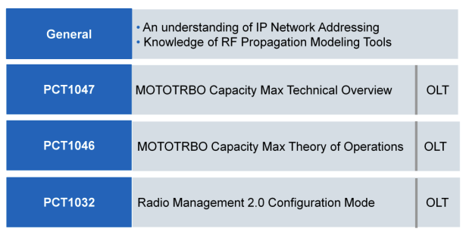
MOTOTRBO Capacity Max System Design
State the Objectives
Course Prerequisites

Slide 4
MOTOTRBO Capacity Max System Design
Provide the modules for the course
Course Map
1
Module 1
6
Module 6
2
Module 2
7
Module 7
3
Module 3
8
Final Assessment
4
Module 4
5
Module 5

Slide 5
1
MOTOTRBO Capacity Max System Design
Module 1: Capacity Max Review

Slide 6
Source:
Information for developer:
Section 1: Hardware and Software Requirements

Slide 7
MOTOTRBO Capacity Max System Design
Source:
Information for developer:
What is MOTOTRBOTM Capacity MAX?
Next generation trunked radio solution.
System control is centralized, traffic routing is optimized to minimize cost and maximize performance.
MOTOTRBO Capacity MAX systems are a next generation trunked radio solution built to provide coverage, capacity, and control of your voice and data communications. The system control is centralized but the traffic routing is optimized to minimize cost and maximize performance.

Slide 8
MOTOTRBO Capacity Max System Design
Source:
Information for developer:
Benefits of MOTOTRBOTM Capacity MAX Systems
Capacity MAX systems are:
Fully scalable for easy future growth.
DMR-TIER-III-compliant.
High performance, high availability, and high resiliency.
Easily transition from other MOTOTRBO systems, through a simple software upgrade.
The benefits of a MOTOTRBO Capacity MAX system features, a centralized control of everything you need to manage your system. All voice, data, and control traffic is encrypted within the IP network and all radios are securely authenticated. These benefits are what differentiate a Capacity MAX system from the other PCR system options or other manufacturers products.

Slide 9
MOTOTRBO Capacity Max System Design
Source:
Information for developer:
MOTOTRBOTM Capacity MAX Technical Summary
Support for up to 250 sites and 3000 users per site.
Dedicated control channel on every site and not required but supports optimal performance.
Options for a redundant server which can be geographically separated and one redundant switch per site.
A MOTOTRBO Capacity MAX system provides support for upto 250 sites with 3000 users per site.

Slide 10
MOTOTRBO Capacity Max System Design
Source:
Information for developer:
Hardware Components of a Capacity MAX System
A CMSS (Capacity MAX System Server) with a licensed trunking controller.
One RF site with at least one trunking repeater, with a Capacity MAX system license.
Radio Management to program equipment.
Switches and routers to connect equipment within the site or sites where the CMSS, repeaters, and Radio Management are located.
Radios for end users.
The following are mandatory hardware requirements that must be met in order to deploy a basic Capacity MAX system. Here are some supplemental requirements, additional RF sites can be added for wider area operations and additional trunking repeaters can be added at sites to support more users per site. Data Revert repeaters can be added to sites when higher location update rates are required or offload the data load from the trunking repeaters. Lastly, when more than one RF site is in the system, a Capacity MAX site license is required for each additional site beyond the first. The additional Data Revert repeaters will also require Capacity MAX system license.

Slide 11
MOTOTRBO Capacity Max System Design
Source:
Information for developer:
Software Components of a Capacity MAX System
Radio Management application to program the equipment.
Other software applications which may be needed depending on which Capacity MAX configuration is being deployed.
The System advisor which can be optionally added to monitor call activity and equipment status.
MNIS VRC Gateways and MNIS Data Gateways which can be added to support wire-line voice and data applications.
A Battery Management application to manage the health of the radio’s batteries in the system.
The following are some software requirements that must be met in order to deploy a basic Capacity MAX system. A Capacity MAX system must have the following.

Slide 12
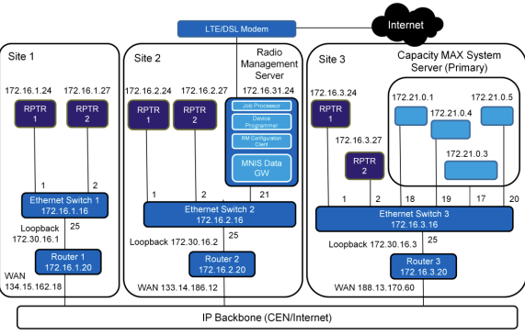
MOTOTRBO Capacity Max System Design
Source:
Information for developer:
We could turn this into a quick little activity, have learner fill in the blanks missing from the graphic.
Note: Number 17 represents iLo connection.
Capacity MAX Three Site System Example (1/2)
This is an example of a three site system with a single CMSS and two repeaters on each site. Can you identify the missing pieces?

Slide 13
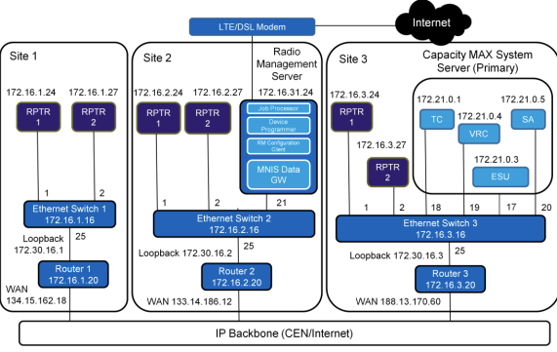
MOTOTRBO Capacity Max System Design
Source:
Information for developer:
Here is the correct answers
Note: Number 17 represents iLo connection.
Capacity MAX Three Site System Example (2/2)

Slide 14
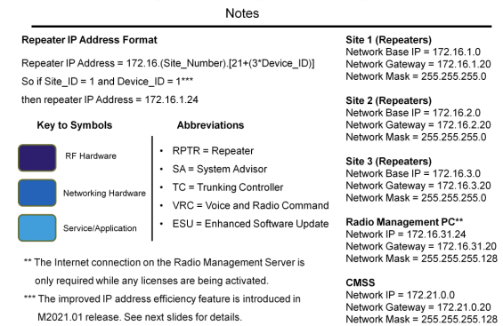
MOTOTRBO Capacity Max System Design
Source:
Information for developer:
Resign slide
Note: The improved IP address efficiency feature is introduced in M2021.01 release. Starting from M2021.01 release, the repeater IP address formula in this slide is only true for device ID 1 to 18.
MOTOTRBO Capacity MAX 3 Site System Summary- Example Details

Slide 15
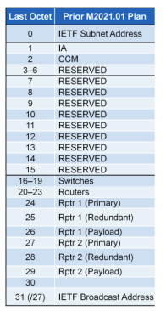
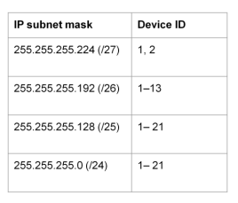
MOTOTRBO Capacity Max System Design
Source:
Information for developer:
Repeater Device ID and IP Addressing Prior to M2021.01
Table shows example of site with /27 IP subnet mask
Here are the following Device ID ranges that supported the Cap Max system release prior to the release of M2021.01.

Slide 16
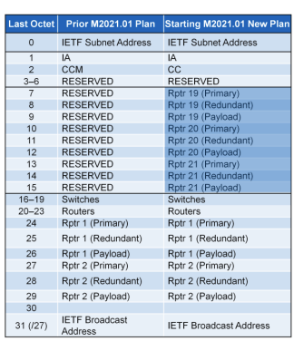
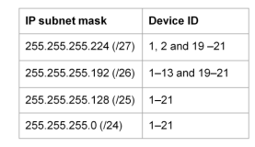
MOTOTRBO Capacity Max System Design
Source:
Information for developer:
Repeater Device ID and IP Addressing Prior to M2021.01
Table shows example of site with /27 IP subnet mask
Here are the following Device ID ranges that are supported for Cap Max system release starting at M2021.01. A benefit of the M2021.01 release is three more repeaters can be deployed in a subnet mask /26 and /27.

Slide 17
Source:
Information for developer:
Section 2: Supported Call Types

Slide 18
MOTOTRBO Capacity Max System Design
Source:
Information for developer:
Let’s make each bullet a hover over, to display text. Create an image, graphic or a box around the text.
Hover-over text
Multiple Group: Wide variety of call types to suit specific communication needs.
Call Preemption: Tear down a call in progress to allow a higher priority call to go through.
Voice Interrupt: Take control of a currently transmitting group or private call.
Call Alert: Alert a user that a communication is needed.
Site and Channel Extensibility: Add additional sites and channel without the need to reprogram radios.
Remote Monitor: Listen to what’s happening with another user’s radio.
Add at the bottom of screen Note: Refer to MOTOTRBO Feature Catalog and CEDMEL2000- MOTOTBRO Systems Introduction for Technicians
Call Types
Multiple Group and Private Call Types
Call Preemption
Voice Interrupt
Call Alert
Site and Channel Extensibility
Remote Monitor and Discreet Listening

Slide 19
MOTOTRBO Capacity Max System Design
Source:
Information for developer:
Let’s make each bullet a hover over, to display text. Create an image, graphic or a box around the text.
Hover-over text
Emergency Alarm: Alert users to a critical situation and preempt any other call if needed.
Enhanced Channel Access: Improve the reliability of voice transmissions by preventing talk-over.
Versatile All-Call: Use a high priority one-way call to all radios at a site, group of sites, or all sites in the system.
Enhanced Roaming: Radios automatically switch to a better site with no user intervention and minimal audio loss.
Radio Stun/Revive: Disable system services to a radio while keeping track of it on the system.
Dynamic Site Assignment: Only allocate a channel at sites where call participating radios are present.
Call Types
Emergency Alarm and Call
Enhanced Channel Access
Versatile All-Call
Enhanced Roaming
Radio Stun/Revive
Dynamic Site Assignment

Slide 20
MOTOTRBO Capacity Max System Design
Source:
Information for developer:
Let’s make each bullet a hover over, to display text. Create an image, graphic or a box around the text.
Hover-over text
Site Restriction: Limit radio users and talk groups to be allocated channels at allowed sites.
Late Entry: Allow users to join a call in progress with minimal delay.
Telephony Calls: Radio is able to receive calls and talkback even if the Phone Call capability is disabled. Telephony Calls- Enhanced/Proprietary DMR industry-standard telephone patch call capability.
Priority Call Queuing/Preemption: Handle calls in priority order if resources are not available immediately. If an idle channel is not available at one or more associated sites, a high priority call preempts and take over the trunking channel occupied by a normal priority call.
Call Types
Site Restriction
Late Entry
Telephony Calls
Priority Call Queuing/Preemption

Slide 21
MOTOTRBO Capacity Max System Design
Source:
Information for developer:
Let’s make each bullet a hover over, to display text. Create an image, graphic or a box around the text.
Hover-over text
Advanced Late Entry: Reduces the time required to late enter a call. Only available in Advantage Mode.
All Start and Critical Site Assignment: Makes sure users do not miss audio.
Mass Registration: Allows more radio registrations per minute whether from recovering from failure or all your employees powering on at the same time from a shift change.
Priority Monitor: Allows the system to make Priority announcements on traffic channels during Group Calls in progress. This allows a radio involved in a voice group call to join a higher priority group voice call.
Call Types
Advanced Late Entry
All Start and Critical Site Assignment
Mass Registration
Priority Monitor

Slide 22
MOTOTRBO Capacity Max System Design
Source:
Information for developer:
Let’s make each bullet a hover over, to display text. Create an image, graphic or a box around the text.
Hover-over text
Radio Kill/Un-kill: Supports the ability of a wireline console to kill a radio. Note: “Un-kill” can only be done by the Motorola Solutions Depot.
Registration and Access Control: Grant privileges to users/radio based on assigned profiles.
Dynamic Group Number Assignment: Allows a dispatcher to replace a radios currently selected talk group with a temporary talk group.
Confirmed Group Data Call: Data calls from a data application will be acknowledged by all group call members.
Status Call: Control channel-based status messaging, to/from radio and dispatcher.
Call Types
Radio Kill/Un-kill
Registration and Access Control
Dynamic Group Number Assignment
Confirmed Group Data Call
Status Call

Slide 23
MOTOTRBO Capacity Max System Design
Source:
Information for developer:
Let’s make each bullet a hover over, to display text. Create an image, graphic or a box around the text.
Hover-over text
Inband Location: Inband Location feature provides a solution for transmitting radio to send location updates during voice call. The Console is able to receive and display the updated location from the caller while in a call.
Inband Caller Alias: Inband Caller Alias feature provides a solution for users to configure an alias name which would be sent during voice all transmission, and be displayed on all receiving components (radio/console).
Dynamic Caller Alias: Dynamic Caller Alias feature allows the user to enter an alias name from the front panel that would associate the radio to an alias to be displayed on other receiving radios and consoles when the user is transmitting.
Call Types
Inband Location
Inband Caller Alias
Dynamic Caller Alias

Slide 24
Source:
Information for developer:
Section 3: Capacity MAX Call Processing

Slide 25
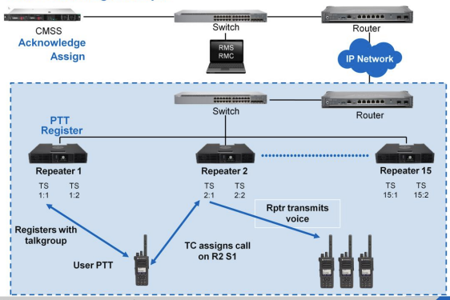
MOTOTRBO Capacity Max System Design
Source:
https://drive.google.com/drive/folders/1qoEplbfiicj4_q5REIDTP812jszwBBO1
Information for developer:
Animated Slide (Refer to PPT slide deck) slide 24
Call Processing: Example

Slide 26
2
MOTOTRBO Capacity Max System Design
Module 2: System Planning and Design

Slide 27
MOTOTRBO Capacity Max System Design
Source:
Information for developer:
High Level System Planning
Correctly sizing the Capacity Max system is an important part of the planning process.
The following items need to have the required quantities defined as a part of the planning process:
Radios
RF Sites
Trunked repeaters
Data revert repeaters
Voice gateway talk paths
This module will describe the key elements of how to plan a Capacity Max System.

Slide 28
MOTOTRBO Capacity Max System Design
Source:
Information for developer:
High Level System Planning
These are the tools in the MOTOTRBO SDT to assist you in:
Estimating the number of repeaters, trunked or data revert, needed at each Capacity Max site.
Estimating the site link bandwidth need for each site in the system.
Determining the number of MNIS VRC Gateways needed in the system.
Estimating the number of talkpath licenses needed for each MNIS VRC Gateway.
Motorola Solutions has create a group of software tools to assist in the planning for MOTOTRB systems called, MOTOTRBO System Design Tools (SDT).

Slide 29
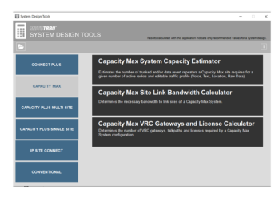
MOTOTRBO Capacity Max System Design
Source:
Information for developer:
Find a better screenshot of MOTOTRBO System Design Tools
High Level System Planning
In order to effectively use the MOTOTRBO System Design Tools (SDT), there are some basic planning considerations you must first understand. We will use the MOTOTRBO System Design Tools later in this module one we have reviewed the basic planning considerations for a Capacity Max System.

Slide 30
Source:
Information for developer:
Section 1: Planning Considerations

Slide 31
MOTOTRBO Capacity Max System Design
Source:
Information for developer:
Regulatory Licenses

Slide 32
3
Course title
Module 3

Slide 33
Course title
Source:
Information for developer:
Section 1

Slide 34
4
Course title
Module 4

Slide 35
Course title
Source:
Information for developer:
Section 1

Slide 36
5
Course title
Final Assessment

Slide 37
Course title
Source:
Information for developer:
Slide scope:
A quiz to test the student's knowledge (10 questions, 8+ correct = pass)
Assessment

