Slide 1
GRE Tunneling (Overlay Network)
Source:
Information for developer:
Customers may provide their own switch and router (for example Juniper), however, in this class we will exclusively work with the Motorola Solutions recommended equipment. For networking information on other vendor switch and routers, refer to the System Planner.
The case shown is an IP address for the repeater and an IP address for payload role (Data Revert Channel, or Payload Channel),
Discuss the physical interfaces and the tunnel interfaces. Discuss the need for the Static Routes to direct the desired traffic to the Tunnel Interfaces. May also discuss the concept of encapsulation in general, and the fact that the GRE tunnel can be further encapsulated into other tunnels such as IPSEC.

Slide 2
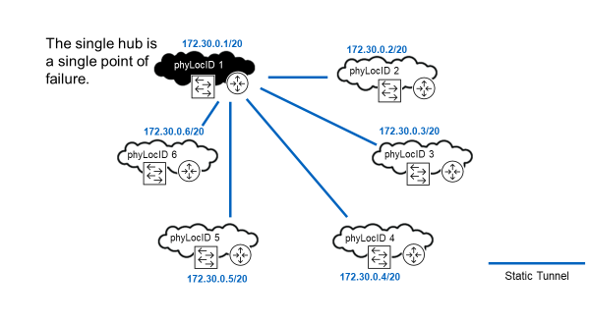
ADVPN - Single Hub Router
Source:
Information for developer:
Possibly remind students what a /20 subnet is.
Site 1 is a single point of failure for the overlay network. Sites 2-6 cannot discover each other without the assistance of the router at site 1 because dynamic WAN IP addresses are used at sites 2-6.
A Capacity Max network assumes that physical location 1 has a statically allocated IP address in the underlay network and therefore physical location 1 provides a hub router for the Capacity Plus network. A static IP address is needed at least at one site.
The hub router is a single point of failure for the initial creation of the overlay network; therefore, it is recommended to additionally request a static WAN IP address for physical location 2 from the ISP provider and config the router at physical location 2 as an alternate hub router.

Slide 3
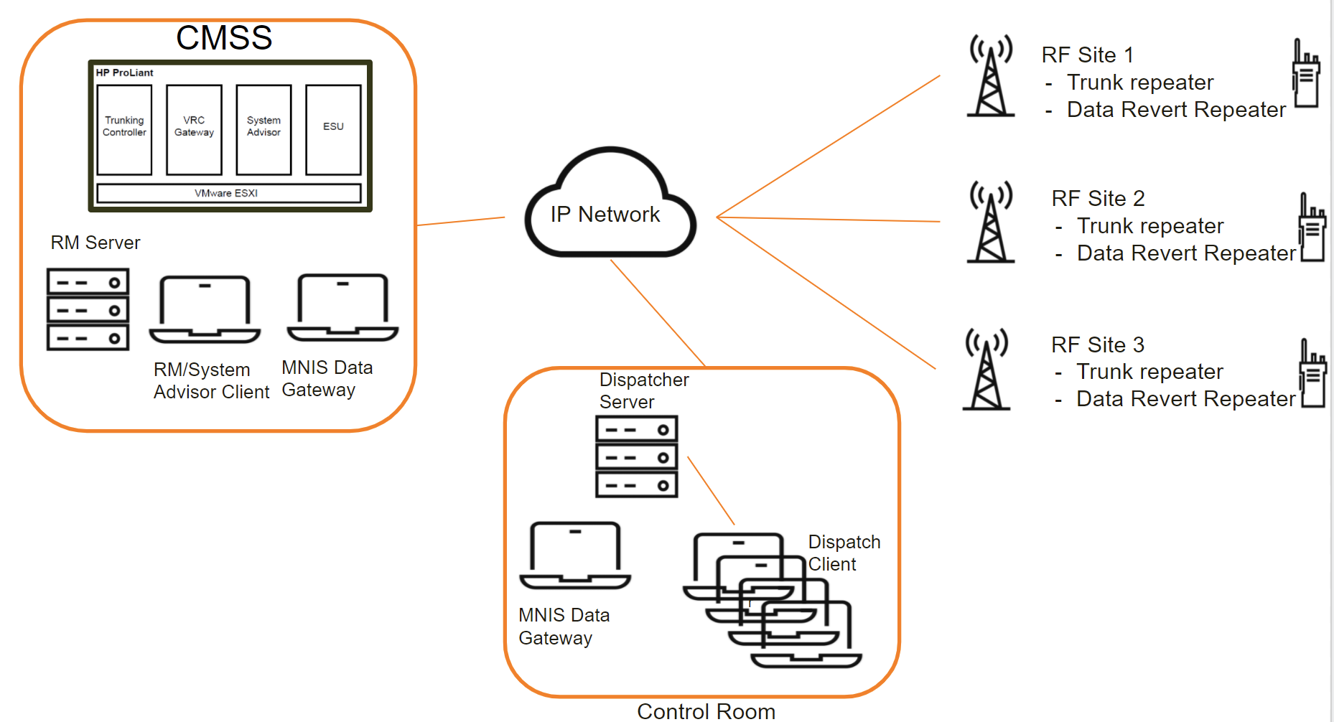
MOTOTRBO Capacity MAX High Level System Layout
Source:
Information for developer:

Slide 4
CAPACITY MAX - Mobility and Registration (1/2)
Source:
Information for developer:
Registration and Access Control
Grant privileges to users/radio based on assigned profiles.
Mass Registration
Allows more radio registrations per minute whether from recovering from failure or all your employees powering on at the same time from a shift change.
Enhanced Handover/Roaming
Radios automatically switch to a better site with no user intervention and minimal audio loss.
All Start and Critical Site Assignment
Makes sure users do not miss audio.
Cover this slide at a high level.

Slide 5
CAPACITY MAX - Mobility and Registration (2/2)
Source:
Information for developer:
Site Restriction
Limit radio users and talk groups to be allocated channels at allowed sites.
Dynamic Site Assignment
Only allocate a channel at sites where call participating radios are present.’
Late Entry
Allow users to join a call in progress with minimal delay.
Site and Channel Extensibility
Add additional sites and channel without the need to reprogram radios.
Cover this slide at a high level.

Slide 6
CAPACITY MAX - Radio System Features
Source:
Information for developer:
Call Preemption
Tear down a call in progress to allow a higher priority call to go through.
Priority Call Queuing/Preemption
Handle calls in priority order if resources are not available immediately. If an idle channel is not available at one or more associated sites, a high priority call preempts and takes over the trunking channel occupied by a normal priority call.
Emergency Alarm
and Call
Alert users to a critical situation and preempt any other call if needed.
Voice Interrupt
Take control of a currently transmitting group or private call.
Priority Monitor
Allows the system to make Priority announcements on traffic channels during Group Calls in progress. This allows a radio involved in a voice group call to join a higher priority group voice call.
Cover this slide at a high level.

Slide 7
CAPACITY MAX - Radio System Features
Source:
Information for developer:
Confirmed Group Data Call
Data calls from a data application will be acknowledged by all group call members.
Enhanced Channel Access
Improve the reliability of voice transmissions by preventing talk-over.
Status Call
Control channel-based status messaging, to/from radio and dispatcher.
Dynamic Group Number Assignment (DGNA)
Allows a dispatcher to replace a radios currently selected talk group with a temporary talk group.
Inband Location
Inband Location feature provides a solution for transmitting radio to send location updates during voice call. The Console is able to receive and display the updated location from the caller while in a call.
Inband Caller Alias
Inband Caller Alias feature provides a solution for users to configure an alias name which would be sent during voice call transmission, and be displayed on all receiving components (radio/console).
Cover this slide at a high level.

Slide 8
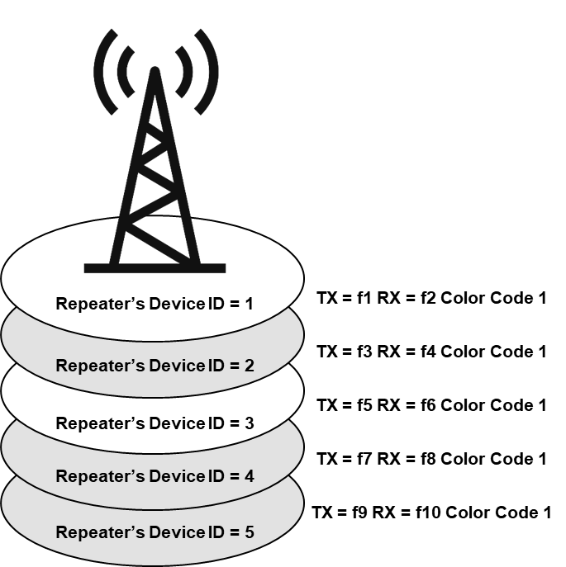
Single Site Considerations
Source:
Information for developer:
Site Considerations include the following:
Capacity Max systems support 15 trunked repeaters and 6 data revert repeaters per site.
Each repeater may have a backup repeater.
Normally, site frequencies must be in the same RF band.
In two RF band systems, the sites can be co-located but must have different site IDs.
All frequencies must be unique with no re-use in the same site.
Site repeaters must have the same coverage footprint.
Trunking repeaters must have the same color code within a site.
Review the site considerations. Mention that we will discuss color codes momentarily.

Slide 9
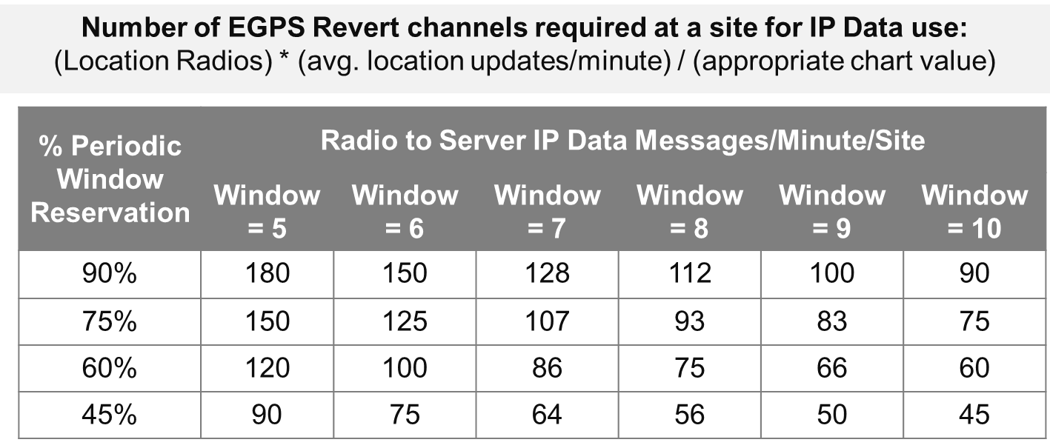
Enhanced GPS Revert (1/2)
Source:
Information for developer:
Enhanced GPS (EGPS) Revert Channel with IP Data
The table below illustrates the number of updates per minute a time slot supports for various Periodic Window Reservation and Window Size settings.
Enhanced GPS (EGPS) Revert Channel with IP Data supports a large number of location updates (both indoor and GNSS) with rich location parameters.

