Slide 1
Current Version: N/A
Previous version link from Google Drive: N/A
LXP Link: N/A
Critical SME: Ed Chang
SME(s): Tomek Warzecha
Sources: https://learning.motorolasolutions.com/installation-guide/6449enus
https://docs.google.com/document/d/1ahVzb-v5UsyRgXJHkIraLp-I0D6pgXvJDqLyfEzFkdc/edit?pli=1
https://docs.google.com/document/d/17_K_iFB_m3ZajSJkan4wMpsKIxljRaT2c2NvEXwzNY4/edit?pli=1
Tool access (if applicable):
Update scope (if applicable):
Course Description: Capacity Max System Server Upgrade will conduct a CMSS upgrade by preparing the ESU Launchpad software, set up virtual machines, and server components. This course will also cover a complete run of the CMSS upgrade process successfully from start to finish.
Target Audience: This training is intended for professional responsible for configuring the Capacity Max System Server upgrades. This would include, but is not limited to: communication system technicians, technical system managers, technical support personnel, and service technicians.
Voice talents (number, gender) - indicate if crucial:
PCT0147
Capacity Max System Server Upgrade
Click the icon to test your audio settings.
Click the icon to learn about course navigation.

Slide 2
Capacity Max System Server Upgrade
State the Objectives
Course Objectives
After completing this course, you will be able to:
Conduct a CMSS upgrade by preparing the ESU Launchpad software.
Execute using the ESU Launchpad software in the virtual machine, and the server and components.
Complete a run of the CMSS upgrade process successfully from start to finish.
Please familiarise yourself with the objectives of this course.

Slide 3
Capacity Max System Server Upgrade
Provide the modules for the course
Module 1: Prepare Software (ESU Launchpad)
Module 2: Using ESU Launchpad
Module 3: Run the CMSS Upgrade
Module 4: Basic Troubleshooting
Course Map
1
Module 1
2
Module 2
3
Module 3
4
Module 4
5
Final Assessment
Choose a module from the list or click Next to continue.

Slide 4
1
Capacity Max System Server Upgrade
Module 1: Prepare Software (ESU Launchpad)
Welcome to Module 1: Prepare Software (ESU Launchpad).

Slide 5
Capacity Max System Server Upgrade
Source:
Information for developer:
Introductory (Prerequisite for course)
Memory, HD Space, and PC to install Launchpad software.
Network Check (need to have a specific network card to run virtual machine).
Use the System Release Upgrade Guide as reference during installation.
Module 1: Chapter 8, 8.3.3.1,Steps 1-6, and 8.3.3.3, Steps 1-5
Module 2: Chapter 9, 9.3.3.1, IP Information: 9.3.3.3, Discovery process stops at Step 11.
Module 3: Chapter 9, 9.3.3.3, start at step 12.
Obtain ESU Launchpad (covered in later modules)
Install the ESU Launchpad
Setup Virtual Machine Settings
Start Launchpad
Obtain the Capacity Max System Server Application Software (covered in later modules)
Before taking this course you will need to obtain specific software needed prior to starting with the upgrade course.

Slide 6
Source:
Information for developer:
Add note below other two notes: Please note that ESU Launchpad versions are backwards compatible, but in case of several version upgrades only the latest version is required.
Capacity Max System Server Upgrade
Step 1: Obtain ESU Launchpad
Order MOTOTRBO Capacity Max System Server SW Update Launch Pad, which contains the new ESU LP software files on a DVD.
If you have the MSI MyView portal access, you can order MOTOTRBO Capacity Max System Server SW Update Launch Pad and receive an email with a unique link to access the ESU LP application files from the MyView portal. The T8483A requires an e-mail address at the time of order.
The first step to the Capacity Max System Server Upgrade is getting the necessary files need to be successfully with the upgrade. You need to obtain by ordering the MOTOTRBO Capacity Max System Server SW Update Launch Pad, which contains the new ESU LP software files on a DVD. If you have the MSI MyView portal access, then you can order the MOTOTRBO Capacity Max System Server SW Updated Launch Pad and receive an email with a unique link to access the files. Please note that ESU Launchpad versions are backwards compatible, but in case of several version upgrades only the latest version is required.

Slide 7
Source:
Information for developer:
Capacity Max System Server Upgrade
Step 2: Minimum System Requirements
Operating System: Windows 10
Processor: 64-bit x86 Intel Core i7-4800MQ or equivalent
8 GB RAM
80.5 GB of free disk space
1000 Mbps Ethernet adapter
Antivirus software
Antimalware software
Here are the minimum system requirements you need to be able to run the software on your PC.

Slide 8
Source:
Information for developer:
Add a note: To find out more information on how to disable hibernation and sleep mode, visit the support section on Microsoft’s website. https://support.microsoft.com/en-us
*Put in note, this could vary from PC to PC.
Capacity Max System Server Upgrade
Step 3: Disable Hibernation and Sleep Mode
Disable hibernation and sleep mode on the PC.
Note
Step 3 requires you to disable hibernation and sleep mode on the PC your installing the files to.

Slide 9
Source:
Information for developer:
VMware website link: https://kb.vmware.com/s/article/1003944
Capacity Max System Server Upgrade
Steps 4 & 5: ESU Launchpad and Virtualization Technology (VT)
Ensure that the ESU Launchpad user interface launches automatically in the default browser.
NOTE: The web browser must support HTML5 and File API. Use a version equal to or greater than Chrome 39, IE11, or Firefox 29.
Enable Virtualization Technology (VT) in the BIOS of your PC.
Disable Microsoft Hyper-V and make sure to turn Windows features On and Off.
NOTE: Running ESU Launchpad without VT enabled is not possible, as a 64-bit virtual machine cannot be powered on. For more information, see the VMware website. For instructions on how to enable the VT, see the vendor documentation.
Step 4 we need to ensure that the ESU Launchpad user interface launches automatically in your default browser. Make sure the web browser you are using supports HTML5 and File API. Step 5, make sure you enable Virtualization Technology (VT) within the BIOS of your PC. If your unsure how to do this, please consult your vendors documentation. Also, make sure to disabled Microsoft Hyper-V and to turn Microsoft Windows Features On and Off.

Slide 10
Source:
Information for developer:
ESU Launchpad (Install)

Slide 11
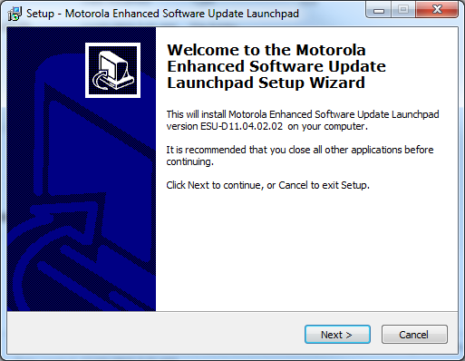
Capacity Max System Server Upgrade
Source:
Information for developer:
Step 2, When prompted…for image.
Steps 1-3: Insert DVD or Download ISO file
Perform one of the following actions:
Insert the ESU Launchpad media into the DVD drive and launch mysetup.exe.
Download the ISO file from MyView Portal on the laptop used to perform the CMSS upgrade, mount it as a virtual DVD or extract the ISO content, and launch mysetup.exe.
When Prompted, enable the VT, and click Next.
Install Motorola Solutions ESU Launchpad, click Install.
Once installed, VMware Workstation 15 Player Setup Wizard appears.
We are moving on to the Installation of the ESU Launchpad and the steps need to be completed. Step 1, we need to perform the following actions, insert the ESU Launchpad DVD and launch mysetup.exe, or download the ISO file from the MyView Portal on your computer to perform the CMSS upgrade. Step 2, when your prompted, go ahead and enable the VT, and click Next. Step 3, Install the Motorola Solutions ESU Launchpad, by clicking Install. Lastly, once everything is installed, the VMware Workstation 15 player Setup Wizard will appear.

Slide 12
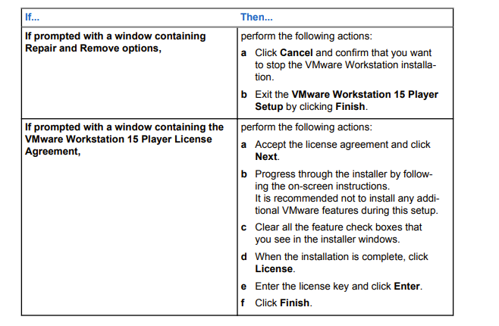
Capacity Max System Server Upgrade
Source:
Information for developer:
Recreate table image.
Step 4: VMware Workstation 15 Player Setup
In the VMware Workstation 15 Player Setup window, click Next and perform one of the following actions:
NOTE: If your OS does not contain the required version of Microsoft Visual C++, Microsoft Visual C++ Setup Wizard window will appear.
Step 4, within the VMware Workstation 15 Player setup window, go ahead and click Next to perform the following actions, please refer to the table image for the necessary steps.

Slide 13
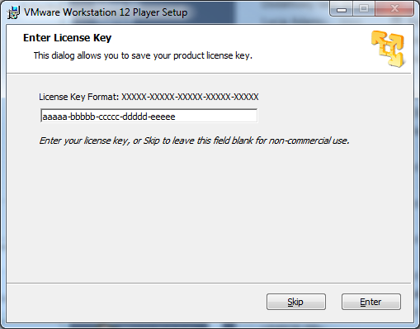
Source:
Information for developer:
Capacity Max System Server Upgrade
Steps 5: VMware Workstation Player
Step 6, we need to prepare the VMware Workstation Player commercial license key, please go ahead and find your information and enter it in the dialog box. To find this information, there are two ways. First if you ordered via MyView, you should receive a separate email with you information. Second, if you ordered a physical shipment, there is a separate CD that will be shipped to you.
Note: VMware Workstation Player will only need to be installed one time only.

Slide 14
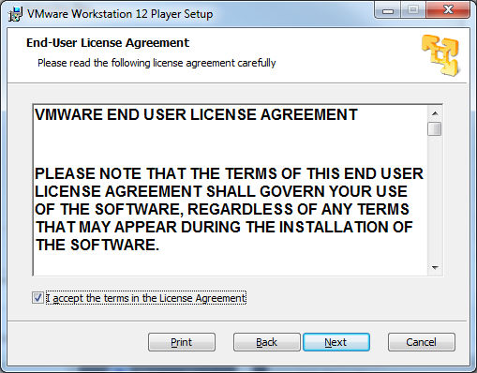
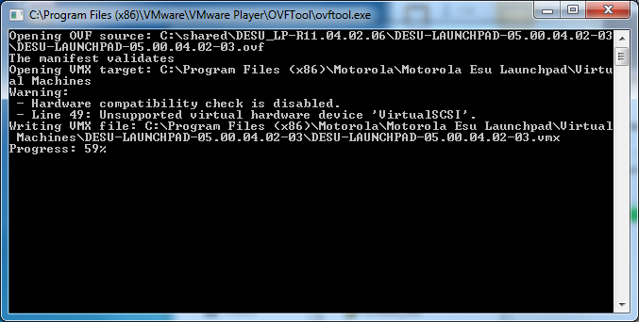
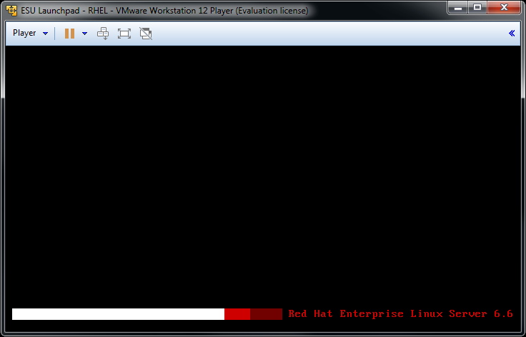
Capacity Max System Server Upgrade
Source:
Information for developer:
Recreate warning graphic.
Step 6: Accept License and OVFtool.exe
Accept the license conditions and click Install.
Wait for the ESU Launchpad to finish the installation process.
The OVFtool.exe command line window will appear, this is where you can view the progress of the ESU LP virtual machine deployment.
WARNING: Do not interrupt the virtual machine deployment process.
Step 5, we need to accept the license conditions and then click Install. Go ahead and wait for the ESU Launchpad to finish the installation, once the installation is complete the OVFtool.exe command line window will appear. This is where you can view the progress of the ESU Launchpad virtual machine deployment. Note, do not interrupt the virtual machine deployment process.

Slide 15
Capacity Max System Server Upgrade
Source:
Information for developer:
Step 7: Motorola Enhanced Software Update Launchpad Window
Step 6, go ahead and monitor the progress of the Setup- Motorola Enhanced Software Update Launchpad window, onces finished click Finish. A ESU Launchpad icon will be displayed on the desktop.

Slide 16
Source:
Information for developer:
Setup Virtual Machine Settings

Slide 17
Capacity Max System Server Upgrade
Source:
Information for developer:
Change numbers to 5-7.
Virtual Machine Settings Setup
Ensure that the connection is properly bridged by performing the following actions:
Ensure that the LAN connection of your physical Ethernet adapter is bridged and configured to properly access the upgraded CMSS.
Ensure that only one physical Ethernet adapter is used for the connection with CMSS.
Check ESU LP virtual machine network settings.
Under Hardware tab select Network Adapter 2 Configure Adapters
Under Automatic Bridging Settings ensure that only one physical Ethernet adapter used for connection with CMSS is selected. If there are other adapters present in the list, clear them.
Click Ok, and close.
We are going to setup the proper setting for the Virtual Machine. First, we need to ensure that the connection is properly bridged by performing the following actions. Ensure that the the LAN connection of your Ethernet adapter is bridged and configured correctly, which provides proper access to the CMSS upgrade. Next, we need to check to make sure that only one physical Ethernet adapter is being used for the connection to the CMSS. Check the ESU LP virtual machine network settings, under Hardware tab, go ahead and select Network Adapter 2, then Configure Adapters. Let’s check under Automatic Bridging Settings to make sure that only one physical Ethernet adapter is used for the connection and is selected. If there are other adapters present in the list, go ahead and clear them. Click ok and close.

Slide 18
Capacity Max System Server Upgrade
Source:
Information for developer:
Virtual Machine Settings Setup
Note: PC Settings might be different than what’s picture in the next section.

Slide 19
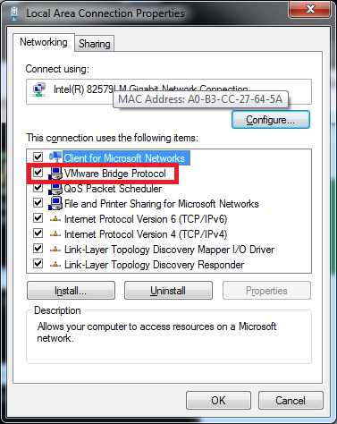
Capacity Max System Server Upgrade
Source:
Information for developer:
LAN Connection
LAN connection of your physical Ethernet adapter should be bridged and configured properly to have access to CMSS which should be upgraded.

Slide 20
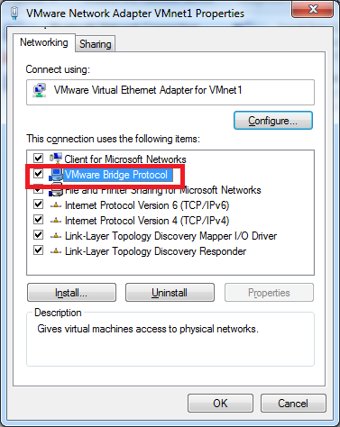
Capacity Max System Server Upgrade
Source:
Information for developer:
LAN Connection
VMnet1 LAN connection also should be bridged:

Slide 21
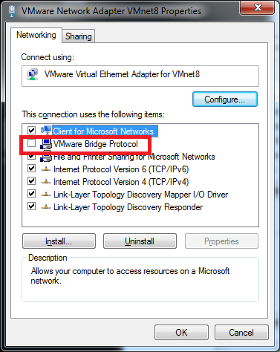
Capacity Max System Server Upgrade
Source:
Information for developer:
LAN Connection
VMnet8 LAN and all other available connections should NOT be bridged:

Slide 22
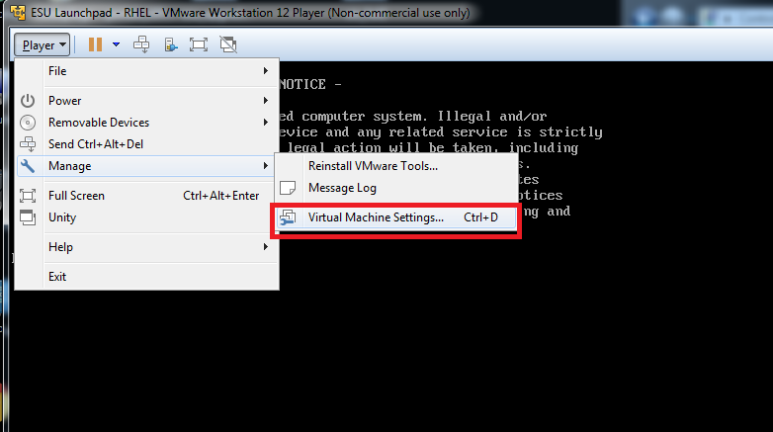
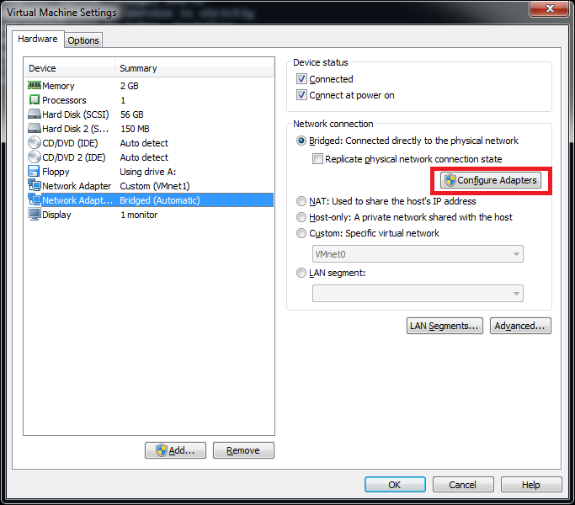
Capacity Max System Server Upgrade
Source:
Information for developer:
ESU LP Virtual Machine Network Settings
Please check the ESU LP virtual machine network settings.

Slide 23
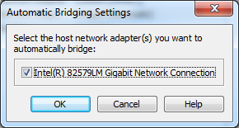
Capacity Max System Server Upgrade
Source:
Information for developer:
ESU LP Virtual Machine Network Settings
Only one physical Ethernet adapter which is used for connection with CMSS should be selected. If there are other adapters present in list they are should be unselected.

Slide 24
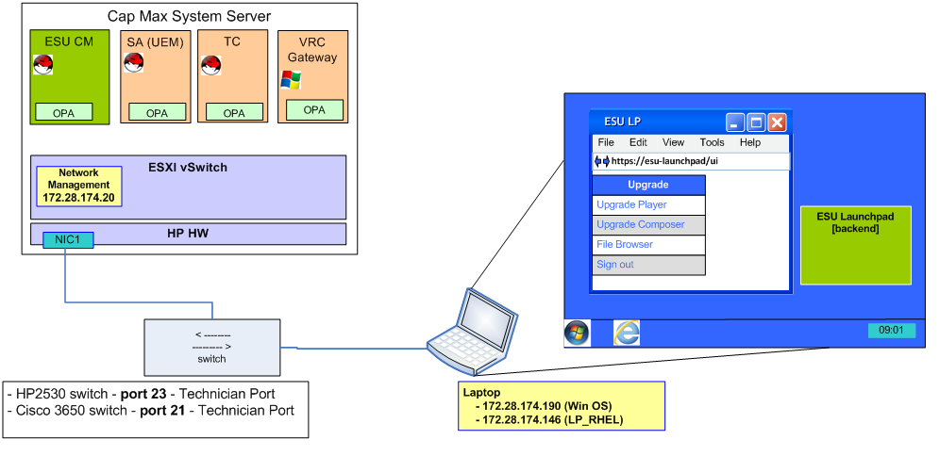
Capacity Max System Server Upgrade
Source:
Information for developer:
Add this to the image on left at the bottom: Juniper switch - Port 20 - Technician Port
ESU Launchpad - Connection to the PCR System
Note: Juniper is the recommended vendor to use for switches and routers.
PCR 2.8 reference transport network setup, the technician laptop should be connected to:
HP2530 switch - port 23 - Technician Port
Cisco 3650 switch - port 21 - Technician Port
Juniper switch - Port 20 - Technician Port
NOTE: Please check the following settings on your laptop:
LAN connection of your physical Ethernet adapter should be bridged and configured properly to have access to the CMSS, which should be upgraded.

Slide 25
2
Capacity Max System Server Upgrade
Module 2: Using ESU Launchpad
Welcome to Module 2: Using ESU Launchpad

Slide 26
Source:
Information for developer:
Start Launchpad

Slide 27
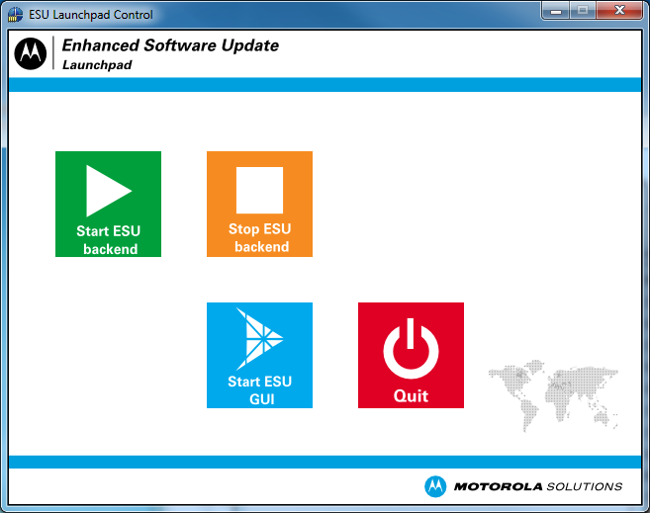
Capacity Max System Server Upgrade
Source:
https://docs.google.com/document/d/1ahVzb-v5UsyRgXJHkIraLp-I0D6pgXvJDqLyfEzFkdc/edit - Images
Information for developer:
Put a box around each of the steps, and make them a clickable object explaining what each button does:
ESU Launchpad Control Application Window
Button 1 (Start ESU Backend): will start virtual machine RHEL (this may take some time)
Button 2 (Stop ESU Backend): will stop the virtual machine
Button 3 (Start ESU GUI): will open ESU-Launchpad login page (in your default browser)
Button 4 (Quit): will close ESU-Launchpad Control application. (same as clicking “X” in the upper right corner) Note: If the virtual machines are running they will not be stopped!!!
Motorola Solutions ESU Launchpad Control Application Window
Here is the ESU Launchpad Control application window. Please go ahead and click each of the buttons to learn more.

Slide 28
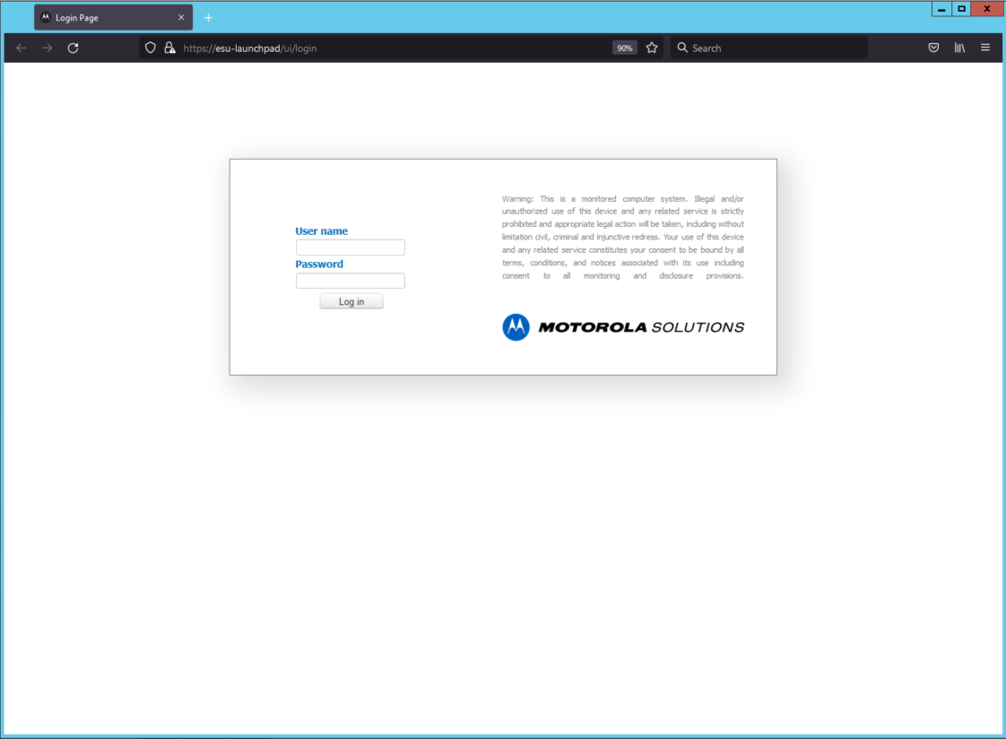
Capacity Max System Server Upgrade
Source:
Information for developer:
Steps 1-4: Start ESU Launchpad
Connect the laptop to a technician switch port.
Start the ESU Launchpad Control application, and run the ESU Launchpad tool by clicking the Start ESU backend.
When ESU Backend Status shows Started, click Start ESU GUI.
Log onto the ESU interface by using the upgrade role.
Username: upgrade
Password: upgrade
Lets go ahead and get started with getting the ESU Launchpad started. Step 1, go ahead and connect the PC/laptop to a technician switch port. Next, go ahead and start the ESU Launchpad Control application, run the ESU Launchpad tool by clicking on the Start ESU backend. Step 3, when the ESU backend status shows Started, go ahead and click Start ESU GUI. Step 4, log onto the ESU interface by using the upgrade roles, username upgrade and password upgrade.

Slide 29
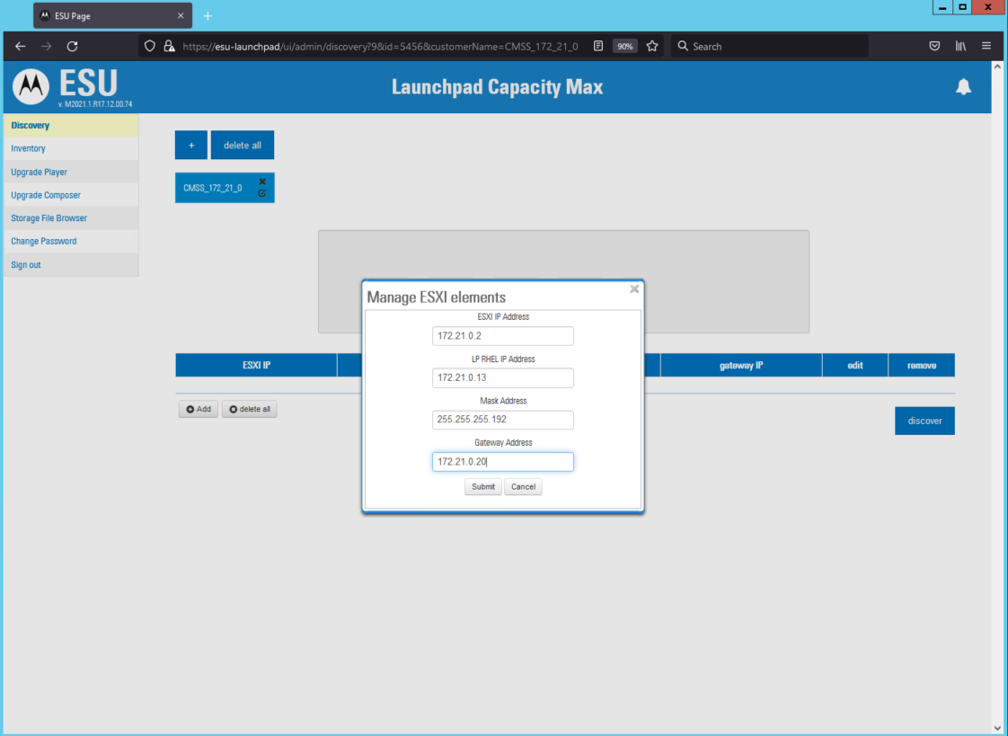
Capacity Max System Server Upgrade
Source:
Information for developer:
Step 8: ESXI IP Address
Click Add and perform the following actions:
Enter target ESXI IP Address Where target ESXI IP Address is the IP address of ESXI on the CMSS being upgraded. ESXI address follows the TC IP + 1 rule in the last octet. Step example: TC IP: 172.21.0.1 ESXI IP: 172.21.0.2
Let’s perform the following actions, click + to add a tab, enter target ESXI IP Address.

Slide 30
Capacity Max System Server Upgrade
Source:
Information for developer:
Change 1 to b.
Might be able to break this up into two slides or two separate screens in Storyline.
Add a new step after C, and Move step D to E.
C Validate you can ping all IP addresses, which include RHEL IP, Laptop IP, and all CMSS VM’s.
Step 8b: Enter the ESU LP RHEL IP Address
Click Add and perform the following actions:
Enter the ESU LP RHEL IP address
IMPORTANT: This address should belong to the same subnet as the laptop on which the ESU LP is installed. The address is assigned to the LP RHEL virtual machine during the discovery process. Example: Laptop: 172.21.0.38 LP RHEL: 172.21.0.39
NOTE: If you want to upgrade several CMSSs in the network, the IP should be unique for each CMSS. This is to avoid conflict between OPA agents from VMs on different CMSSs during discovery and upgrade processes. If some CMSSs were previously upgraded by using LP, perform a re-discovery process for all CMSSs with the new IP addresses for each CMSS before upgrading them, to avoid conflicts with OPA agents.
Lets click the + again to add the following actions. Enter the ESU LP RHEL IP address. Next, enter the Netmask/Gateway for the ESU LP address that was in the previous step. Let’s check and see if we can pin all IP addresses that include RHEL IP, Laptop IP, and all CMSS VM’s. Click Submit.

Slide 31
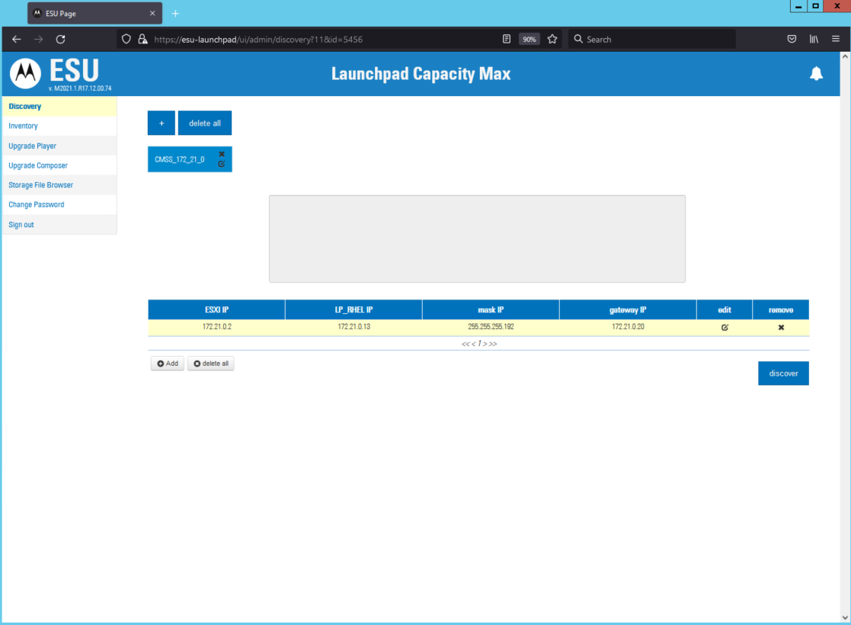
Capacity Max System Server Upgrade
Source:
Information for developer:
Step 9 and 10: CMSS Instance Discover
Select the CMSS instance to be discovered, and click Discover.
When the Confirm Discovery Configuration screen appears, click Yes.
Let’s go ahead and try to find the CMSS instance that we installed. First click, Discover and when the Confirm Discovery Configuration screen appears, click Yes.

Slide 32
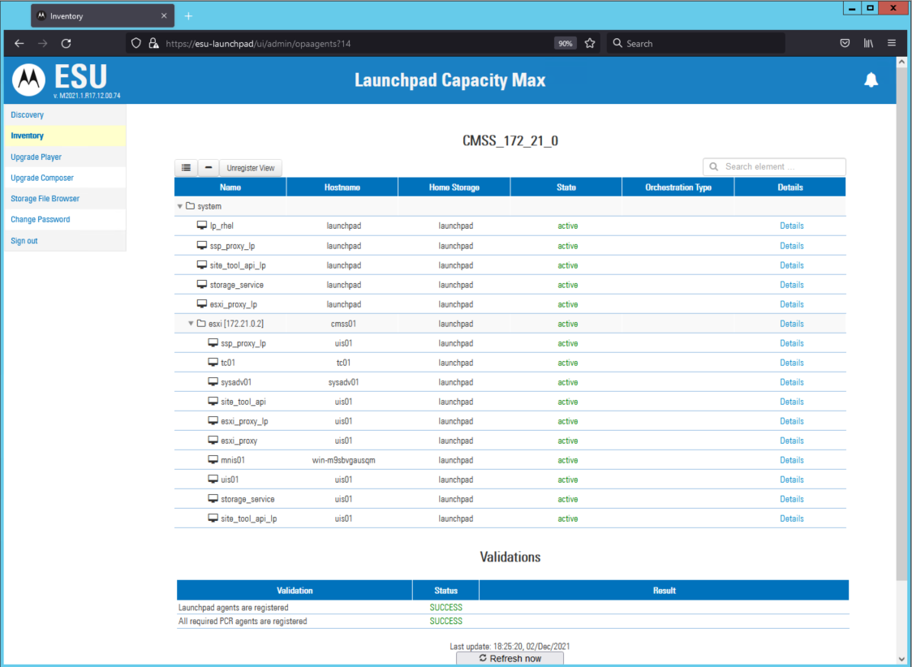
Capacity Max System Server Upgrade
Source:
Information for developer:
Step 11: Inventory Screen
Verify the registered agents by performing the following actions:
Navigate to the Inventory screen.
Verify that all the agents (uis01, sysadv01, tc01, and mnis01) are registered and showing active under the ESXi folder.
Verify that the validation status is Success.
NOTE: If the status of discovery is FAILED or non_opa do not proceed with the upgrade. If you would like to get the details for why the failure occurred, go to the far right column to see details.
Next, let’s verify the registered agents by performing the following actions. Navigate to the Inventory screen. Then, let’s verify that all agents uis01, sysadv01, and mnis01 are all registered and showing active under the ESXi folder. Lastly, let’s go ahead and verify that the validation status is Success.

Slide 33
3
Capacity Max System Server Upgrade
Module 3: Run the CMSS Upgrade

Slide 34
Capacity Max System Server Upgrade
Source:
Information for developer:
Prerequisites
Obtain software from Motorola Solutions:
Physical USB or Software download (customer needs to order, or myportal).
Extract the zip file and store it on the computer, which is used to perform Capacity Max System Server (CMSS) upgrade.
Obtain the Capacity Max System Server Application SW (Part Number for release you need to upgrade to) which contains the upgrade software files on an USB flash drive.
If you have the MSI MyView portal access, you can order MOTOTRBO M2021.01 Capacity Max System Server Application SW (Part Number for release you need to upgrade to) and receive an email with a unique link to access the file from the MyView portal which contains cmss_upgrade_M20xx.xx.x.zip
Extract the zip file and store it on the laptop used to perform the Capacity Max System Server (CMSS) upgrade. All files from the extracted location are referenced to perform the upgrade of the system.
Here are the prerequisites required before you continue the upgrade process.

Slide 35
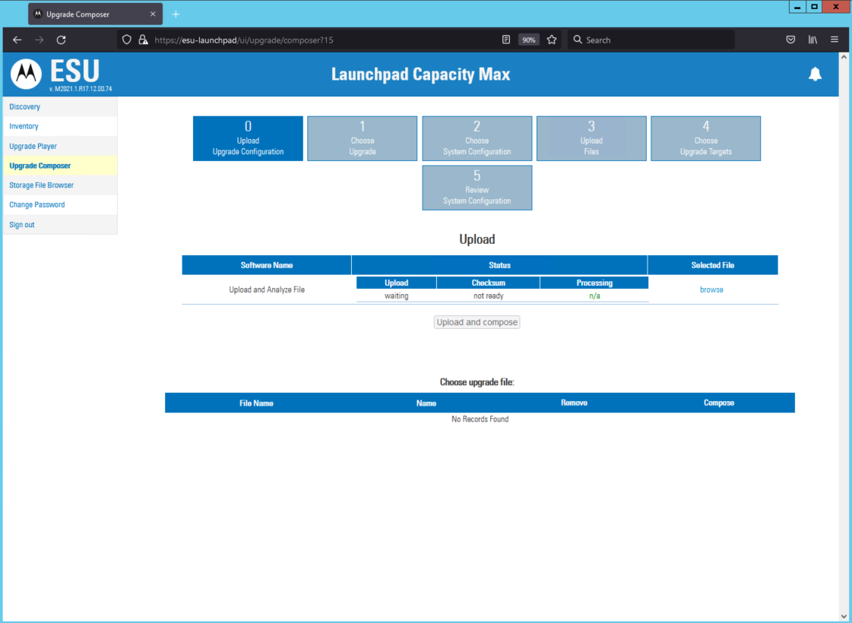
Capacity Max System Server Upgrade
Source:
https://docs.google.com/document/d/1ahVzb-v5UsyRgXJHkIraLp-I0D6pgXvJDqLyfEzFkdc/edit
Information for developer:
Step 12: Upgrade Composer Tab
Let’s go ahead and navigate to the Upgrade Composer tab on the left hand side of the menu.

Slide 36
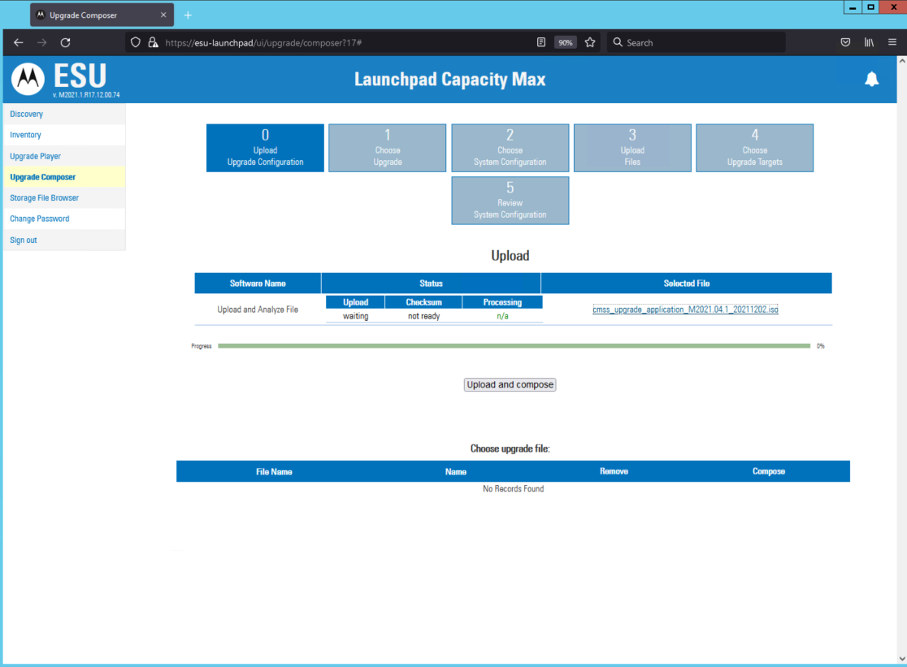
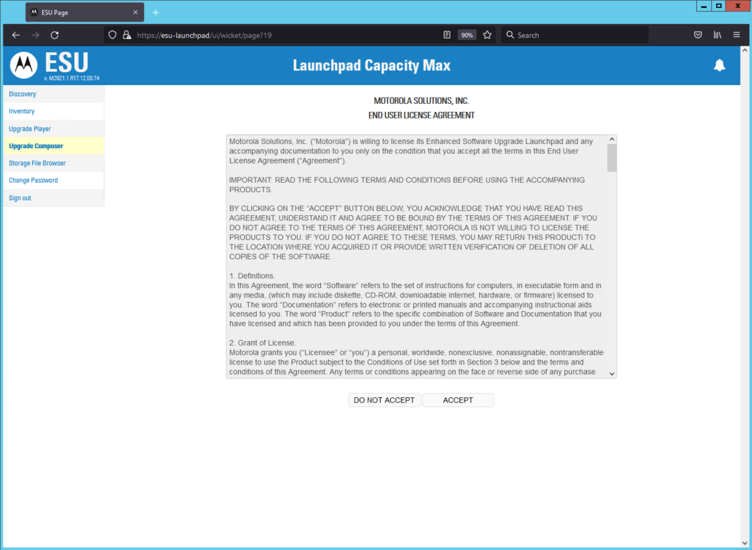
Capacity Max System Server Upgrade
Source:
https://docs.google.com/document/d/1ahVzb-v5UsyRgXJHkIraLp-I0D6pgXvJDqLyfEzFkdc/edit
Information for developer:
Use this image. I have an idea have the user be able to click on a link for the image to appear.
Composer screen:
End User License Agreement:
Step 13: Upgrade CMSS Application
Upgrade the Capacity Max System Server Application from M2020.x by performing the following actions:
Click Browse, and locate the cmss_upgrade_application_M2021.01.x.iso file.
Click Upload and Compose.
NOTE: The Status columns of the Upload Software table displays the progress of the upload and processing of the files. The process takes approximately 15 to 30 minutes.
C. When the Motorola Solutions, Inc. End User License Agreement screen appears, read the terms and conditions, and click Accept.
D. When the upload is complete, navigate to the application upgrade bundle tab section, and click Execute to start upgrading the ESU CM, Trunk Controller (TC), VRC Gateway, and System Advisor (SA) applications.
NOTE: The Status columns of the Upload Software table displays the progress of the upload and processing of the files. The process takes approximately 15 to 30 minutes.
If the upgrade is completed successfully, continue to the next step.
If the application upgrade failed, follow the section Rolling Back a CMSS Application Upgrade (M2021.01) on page 117 to reverse the upgrade.
If the application upgrade failed, do not proceed with ESXI hypervisor upgrade.
Let’s go ahead and apply the Windows MotoPatch on the CMSS by performing the following actions. Click Browse to find and locate the cmss_upgrade_application_M20xx.xx.x.iso file, then go ahead and click Upload and Compose. Next a dialog box will appear for the Motorola Solutions, Inc. End User License Agreement, read the terms and conditions, then click Accept. When the upload is complete, go ahead and navigate to the application upgrade bundle tab section, then click Execute. Which is going to start the upgrade process for the ESU CM, Trunk Controller (TC), VRC Gateway, and the System Advisor (SA) applications.

Slide 37
Capacity Max System Server Upgrade
Source:
Information for developer:
Step 14: Windows MotoPatch
Apply Windows MotoPatch on the CMSS by performing the following actions:
Navigate to Upgrade Composer tab.
Click Browse and locate the cmss_upgrade_motopatch_M2021.01.x.iso file.
Click Upload and Compose.
NOTE: The Status columns of the Upload Software table display the progress of the upload and processing of the files. The process can take approximately 10 to 15 minutes.
D. When the Motorola Solutions, Inc. End User License Agreement screen appears, read the terms and conditions, and then click Accept.
E. When the upload is complete, navigate to the Motopatch Upgrade tab, and click Execute.
NOTE: Windows Patched take between 6- and 9- minutes to install. MNIS restarts twice, If the Motopatch upgrade fails, follow Rolling Back Failed Motopatch Upgrade (M2021.01) on page 118 to reverse the upgrade.
Let’s go ahead and apply the Windows MotoPatch on the CMSS by performing the following actions. Navigate to the the Upgrade Composer tab, then click Browse. Next, let’s locate the cmss_upgrade_motopatch_M20XX.XX.x.iso file. Click Upload and then Compose. Next a dialog box will appear for the Motorola Solutions, Inc. End User License Agreement, read the terms and conditions, then click Accept. When the upload is complete, go ahead and navigate to the application upgrade bundle tab section, then click Execute.

Slide 38
Capacity Max System Server Upgrade
Source:
Information for developer:
Step 15: ESXi Hypervisor
Upgrade the ESXi hypervisor on the CMSS from M2020.x to M2021.01 by performing the following actions:
Navigate to Upgrade Composer Tab.
Click Browse, and locate the cmss_upgrade_hypervisor_M20121.01.x iso file.
Click Upload and Compose.
NOTE: The Status columns of the Upload Software table displays the progress of the upload and processing of the files. The process takes approximately 10 to 15 minutes.
D. When Motorola Solutions, Inc. End User License Agreement screen appears, read the terms and conditions, and click Accept.
E. When the upload is complete, navigate to the Hypervisor Upgrade bundle tab section, and click Execute.
F. When the status displays Waiting (1 out of 5), click Open.
G. In the Shutdown all virtual machines row, click Run.
H. When complete, click Back to the Upgrade Player Dashboard and click Execute. Wait for the upgrade to complete.
NOTE: If ESXi hypervisor upgrade failed, follow Rolling Back Failed ESXi Hypervisor Upgrade (M2021.01) on page 119 to reverse the upgrade.
Let’s go ahead and apply the Windows MotoPatch on the CMSS by performing the following actions. Navigate to the the Upgrade Composer tab, then click Browse. Next, let’s locate the cmss_upgrade_hypervisor_M20XX.XX.x.iso file. Click Upload and then Compose. Next a dialog box will appear for the Motorola Solutions, Inc. End User License Agreement, read the terms and conditions, then click Accept. When the upload is complete, go ahead and navigate to the Hypervisor Upgrade bundle tab section, then click Execute. When the status display Waiting (1 out of 5), go ahead and click Open. Next, in the Shutdown all virtual machines row, click Run. When that is complete, click Back and go to the Upgrade Player Dashboard and click Execute and wait for the upgrade to complete.

Slide 39
Capacity Max System Server Upgrade
Source:
Information for developer:
Steps 16-19: Stop ESU Backend
When the server upgrade is complete, log out of the ESU interface.
Navigate to the ESU Launchpad Control application GUI.
Click Stop ESU Backend and wait for the ESU backend status to show Stop.
To close the ESU Launchpad control application, click Quit.
NOTE: After the upgrade, you may be asked to change your System Advisor password. After changing the System Advisor password, you need to reopen the System Advisor client.
The last steps in the upgrade process, when the server upgrade is complete, go ahead and log out of the ESU interface. Next, navigate to the ESU Launchpad Control application GUI. Click Stop ESU Backen and wait for the ESU backend status to show Stop. Once Stop is displayed, go ahead and close the ESU Launchpad control application, by clicking Quit.

Slide 40
4
Capacity Max System Server Upgrade
Module 4: Basic Troubleshooting

Slide 41
Capacity Max System Server Upgrade
Source:
Information for developer:
Prerequisites
What to do if upgrade fails.
Rollback server, basic troubleshooting (If fail upgrade, rerun).
Use Rolling back in Upgrade Guide:
CMSS Application Upgrade: 9.3.3.5
Failed Motopatch Upgrade: 9.3.3.6
Failed ESXi Hypervisor Upgrade: 9.3.3.7
Here are a few prerequisites for basic troubleshooting if the upgrade has failed, and a walkthrough on how to rollback server.

Slide 42
Capacity Max System Server Upgrade
Source:
Information for developer:
Common Upgrade Failures
*If upgrade failure, consider rollback, before proceeding with upgrade.
Lost connection, connectivity to launchpad times out.
Check network connectivity/connections.
Check Discovery (window boxes, server can’t restart, etc.)
Here are some of the common upgrade failures that a typically have been noted by customers performing the system upgrades. For example, if you lose connection or connectivity while trying to connect to the launchpad or it times out. Also, be sure to check the network connectivity/connections. Lastly, go ahead and use check Discovery, which are the window boxes, or the server can’t restart.

Slide 43
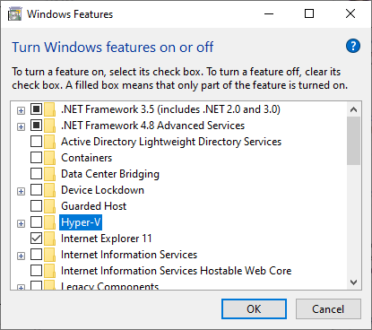
Capacity Max System Server Upgrade
Source:
Information for developer:
Make Hyper-V a link to this image:
What To Do When Upgrade Fails
If an upgrade fails, do not start an upgrade on top of it. Always rollback first, then start another one. (When you start a new upgrade, a rollback snapshot is created and only one can be created at a time.)
Make sure you use a unique IP address for ESU Launchpad and RHEL IP.
Verify Hard Drive space for ESU Launchpad and Virtual Machines.
Verify the bridge settings are correct in your network settings.
Make sure Hyper-V is not enabled in Windows features.
Here are a few things to keep in mind when going through the Capacity Max System Server upgrade and what to do when your upgrade fails.

Slide 44
Capacity Max System Server Upgrade
Source:
Information for developer:
Conclusion
Make sure you sure you keep your ESXi and VMware workstation licenses keys after the upgrade. ESXi key is used during installation.

Slide 45
Source:
Information for developer:
Rolling Back a CMSS Application Upgrade
Follow these steps to roll back an upgrade of an application on the Capacity Max System Server (CMSS).
Perform the procedure in one of the following cases:
• After a failed upgrade of the Trunk Controller (TC), System Advisor (SysAdv), MNIS, or ESU VM
• After the primary CMSS is upgraded to M2021.02 and configured, it is possible to test the functionality of M2021.02 features on the upgraded device. If the performance is unsatisfactory, a rollback to the M2020.x versions of the CMSS application is possible.
The process takes approximately 5 to 10 minutes.

Slide 46
Capacity Max System Server Upgrade
Source:
Information for developer:
Steps 1-4
Connect the laptop to the CMSS technician switch port.
Start the ESU Launchpad Control application, and run the ESU Launchpad tool by clicking Start ESU backend.
When the ESU Backend Status shows Started, click Start ESU GUI.
Re-login.
Let’s get started on the Rolling back of the CMSS Application Upgrade. Step One, we need to connect the laptop to the CMSS technician switch port. Next, go ahead and start the ESU Launchpad Control application, then run the ESU Launchpad tool by clicking on the Start ESU backend. When the ESU Backend Status shows Started, go ahead and click on Start ESU GUI, then Re-login.

Slide 47
Capacity Max System Server Upgrade
Source:
Information for developer:
Steps 5-8
Click on the Upgrade Player to access the list of executable upgrade tasks.
Click on the task tab for which the rollback is required.
Click on the Upgrade Flow, and select the upgrade which requires rollback.
Optional: If rollback on the upgrade failed, locate the failed application, and perform the following suggested Application rolling back failure actions:
Scroll down to the Rollback Phase, locate the failed application (TC, MNIS, SysAdv, or ESU).
Under Revert Application Snapshot, select Open Run.
When the rollback status appears as Completed, click Back.
If more than one application has failed, repeat step 8a for each application.
When failed rollback completes, skip to step 10.
Let’s go ahead and click on the Upgrade Player to access the list of executable upgrade tasks. Next, click on the task tab for which the rollback is required. Step 3, click on the Upgrade Flow, then select the upgrade which requires rollback. The last step is optional, if you rollback on the upgrade that failed, go ahead and locate the failed application and perform the following steps for the application rolling back failure actions. Scroll down to the Rollback Phase, and locate the failed application (TC, MNIS, Sysdv, or ESU). Next, under the Revert Application Snapshot, select Open, then Run. When the rollback status appears as Completed, go ahead and click Back. If more than one of the applications has fail, go back and repeat step 8a for each of the applications. When the failed rollback completes, go ahead and skip to step 10.

Slide 48
Capacity Max System Server Upgrade
Source:
Information for developer:
Step 9
For CMSS system rollback, perform the following actions:
Scroll down to Rollback Phase, locate Revert Trunk Controller (TC) Snapshot and select Open Run.
When the rollback status appears as Completed, click Back.
Under Rollback Phase, locate Revert System Advisor (SysAdv) Snapshot and select Open Run.
When the rollback status appears as Completed, click Back.
Under Rollback Phase, locate Revert MNIS Snapshot and select Open Run.
When the rollback status appears as Completed, click Back.
Under Rollback Phase, locate Revert ESU (UIS) Snapshot and select Open Run.
When the rollback status appears as Completed, click Back.
CMSS system rollback, perform the following actions.

Slide 49
Capacity Max System Server Upgrade
Source:
Information for developer:
Steps 10-13
When rollback is complete, log out of the ESU interface.
Navigate to the ESU Launchpad Control application GUI.
Click Stop ESU Backend and wait for the ESU backend status to show Stop.
To close the ESU Launchpad control application, click Quit.
Let’s finish the last three steps of the CMSS application upgrade rollback. When you finished with the rollback, go ahead and log out of the ESU interface. Navigate to the ESU Launchpad Control application GUI. Next, click Stop ESU Backend and then wait for the ESU backend status to show Stop. Go ahead and close the ESU Launchpad control application and click Quit.

Slide 50
Source:
Information for developer:
Rolling Back Failed Motopatch Upgrade
Follow these steps to revert a failed Motopatch Upgrade procedure. The process takes approximately 5 to 10 minutes.

Slide 51
Capacity Max System Server Upgrade
Source:
Information for developer:
Steps 1-4
Connect the laptop to the CMSS technician switch port.
Start the ESU Launchpad Control application, and run the ESU Launchpad tool by clicking Start ESU backend.
When the ESU Backend Status shows Started, click Start ESU GUI.
Let’s get started on the Rolling back a failed Motopatch upgrade. Step One, we need to connect the laptop to the CMSS technician switch port. Next, go ahead and start the ESU Launchpad Control application, then run the ESU Launchpad tool by clicking on the Start ESU backend. When the ESU Backend Status shows Started, go ahead and click on Start ESU GUI, then Re-login.

Slide 52
Capacity Max System Server Upgrade
Source:
Information for developer:
Steps 5-12
Click on the Upgrade Player to access the list of executable upgrade tasks.
Click on the task tab for which the rollback is required.
Click on the Upgrade Flow, and select the upgrade which requires rollback.
Scroll down to Rollback Phase to locate Revert MNIS Snapshot and select Open Run.
When the rollback is complete, log out of the ESU interface.
Navigate to the ESU Launchpad Control application GUI.
Click Stop ESU Backend and wait for the ESU Backend Status to show Stop.
To close the ESU Launchpad control application, click Quit.
Let’s get started on Steps 5 through 12. First click on the Upgrade Player, to access the list of executable upgrade tasks. Then we will click on the task tab for which the rollback is required. Again, click on the Upgrade Flow and then select the upgrade which requires rollback, then scroll down to Rollback Phase to locate the Revert MNIS Snapshot and select Open and Run. When the rollback is completed. Go ahead and log out of the ESU interface and then navigate to the the ESU Launchpad Control application GUI, click Stop ESU backend and wait for the ESU Backend Status to show Stop. Close the ESU Launchpad control application and click Quit.

Slide 53
Source:
Information for developer:
Rolling Back Failed Hypervisor Upgrade
Follow these steps to revert a failed ESXi Upgrade procedure. The process takes approximately 10 to 20 minutes.

Slide 54
Capacity Max System Server Upgrade
Source:
Information for developer:
Steps 1-4
Connect the laptop to the CMSS technician switch port.
Start the ESU Launchpad Control application, and run the ESU Launchpad tool by clicking Start ESU backend.
When the ESU Backend Status shows Started, click Start ESU GUI.
Let’s get started on the Rolling back a failed Motopatch upgrade. Step One, we need to connect the laptop to the CMSS technician switch port. Next, go ahead and start the ESU Launchpad Control application, then run the ESU Launchpad tool by clicking on the Start ESU backend. When the ESU Backend Status shows Started, go ahead and click on Start ESU GUI, then Re-login.

Slide 55
Capacity Max System Server Upgrade
Source:
Information for developer:
Steps 5-14
Click on the Upgrade Player to access the list of executable upgrade tasks.
Click on the task tab for which the rollback is required.
Click on the Upgrade Flow, and select the upgrade which requires rollback.
Locate the failed steps and their details of the operator rollback ID, and perform the suggested rolling back failure actions.
Scroll down to Rollback Phase to locate required rollback phase and select Open.
Click Run All.
When the rollback is complete, log out of the ESU interface.
Navigate to the ESU Launchpad Control application GUI.
Click Stop ESU Backend and wait for the ESU Backend Status to show Stop.
To close the ESU Launchpad control application, click Quit.
Let’s get started on Steps 5 through 14. Go ahead and click on the Upgrade Player, which will access the list of executable upgrade tasks, then click on the the task tab for which the rollback is required. Next, go ahead and click on the Upgrade Flow and select the upgrade which is required rollback, then locate the failed steps and their details of the operator rollback ID.
Next, go ahead and perform the suggested rolling back failure actions. Scroll down to the Rollback Phase to locate the required rollback phase and select Open, then click Run all. When the rollback is complete, go ahead and log out of the ESU interface. Next, Navigate to the ESU Launchpad Control application GUI, click Stop ESU backend and wait for the ESU Backend Status to show Stop. Go ahead and close the ESU Launchpad control application and then click quit.

