Slide 1
Current Version:
Previous version link from Google Drive (if applicable): https://drive.google.com/drive/folders/1rmDFx0rVhGWWMINCh440pmXw2tsTXC1f?usp=sharing
LXP Link (if applicable):
Critical SME: Sukhpal TheraSingh
SME(s): Sukhpal TheraSingh, Dave Nefzger
Sources: PCT2010
Tool access (if applicable):
Update scope (if applicable):
Course Description: MOTOTRBO Capacity Max System Design begins by covering the design process for a Capacity Max Radio system.
Target Audience: This training is intended for professionals responsible for designing, configuring, or deploying MOTOTRBO radio systems. This would include, but is not limited to: communication system technicians, technical system managers, technical support personnel, service technicians, and sales representatives.
PCT2031
Capacity Max System Design

Slide 2
Logistics
Source:
Information for developer:
Class hours
Break schedule
Facilities location
Emergency procedures
Contact number

Slide 3
Getting to Know You
Information for developer:
Your company
Your experience
Your expectations for this course

Slide 4
Course Structure
Provide the modules for the course
Course Introduction
Module 1: Capacity Max Review
Module 2: System Planning Consideration and Design
Module 3: Frequency Planning and RFDS
Module 4: Network Requirements
Module 5: RM Planning
Module 6: Dispatcher Solution
Module 7: Workshop (Design a system)

Slide 5
Course Objectives
State the Objectives
At the end of this course, you should be able to:
Design a simple Capacity Max system.
Calculate Capacity Max capacity and bandwidth using a case scenario and system design tools.
Create an equipment list, Licensing, frequency planning, and IP network plan.

Slide 6
Information for developer:
Module 1
Capacity MAX Review

Slide 7
Module 1 Objectives
State the Objectives
At the end of this module, you should be able to:
Review the hardware and software requirements for a Capacity Max system.
Review the key call types for a Capacity MAX system.
Review how a Capacity MAX system processes calls.

Slide 8
Module Map / Module Outline
Provide the sections for this module
Section 1: Hardware and Software Requirements
Section 2: Supported Call Types
Section 3: Capacity MAX Call Processing

Slide 9
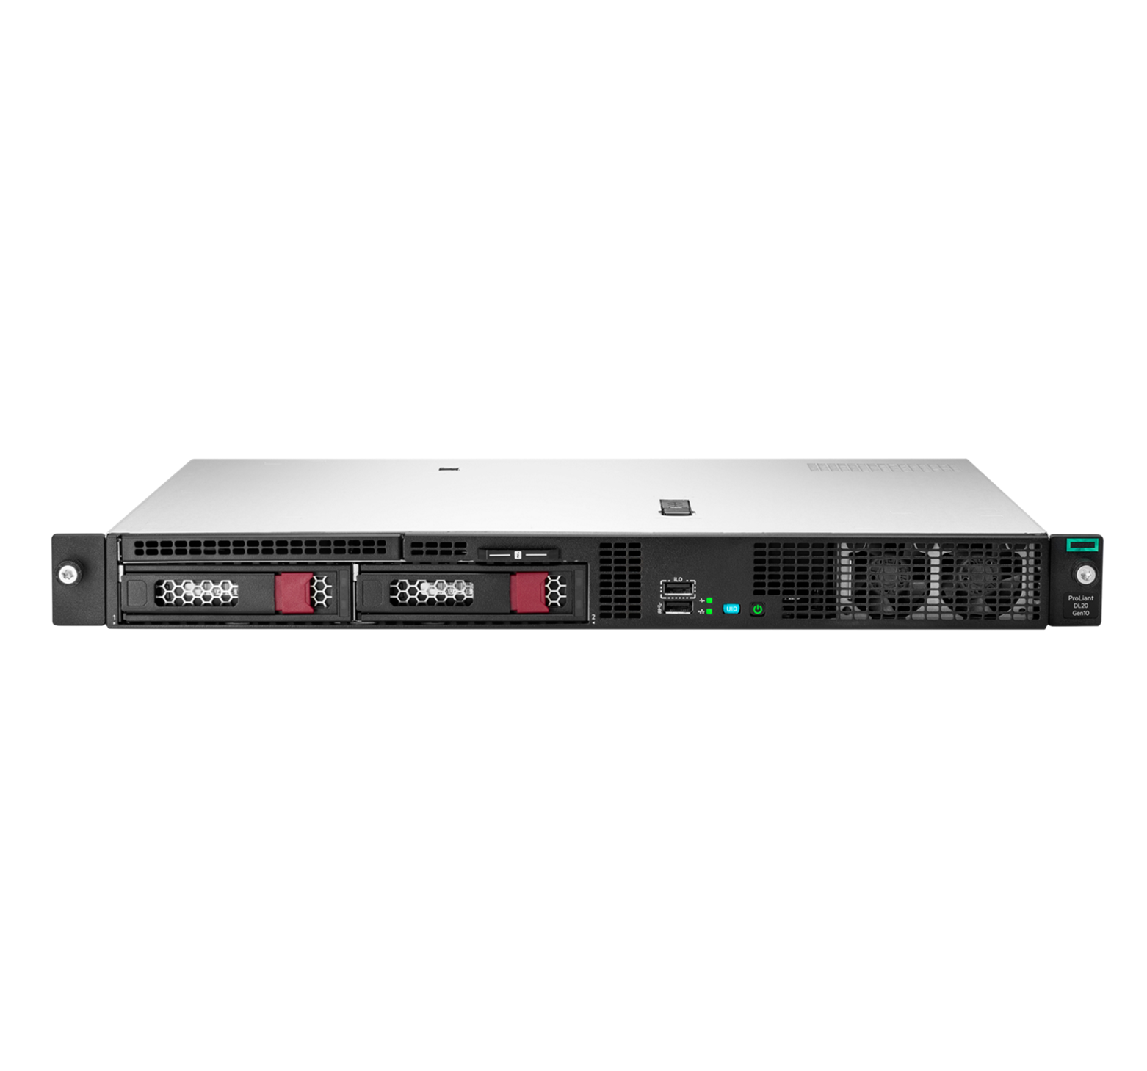
What is MOTOTRBO Capacity MAX?
Source:
Information for developer:
MOTOTRBO Capacity MAX systems are a next generation trunked radio solution built to provide coverage, capacity, and control of your voice and data communications.
The system control is centralized but the traffic routing is optimized to minimize cost and maximize performance.

Slide 10
Benefits of MOTOTRBO Capacity MAX System
Source:
Information for developer:
A MOTOTRBO Capacity MAX system features:
Centralized control of everything you need to manage your system.
All voice, data, and control traffic is encrypted within the IP network.
All radios are securely authenticated.
Capacity MAX systems are fully scalable for easy future growth.
Capacity MAX systems are DMR-Tier-III-compliant.
Capacity MAX systems are designed for high performance, high availability, and high resiliency.
Capacity MAX allows you to easily transition from other MOTOTRBO systems through a simple software upgrade.
Instructor reviews benefits of Capacity MAX systems with learners and points out these are the things which differentiate Capacity MAX from the other PCR system options and/or other manufacturers products.

Slide 11
MOTOTRBO Capacity MAX Technical Summary
Source:
Information for developer:
A MOTOTRBO Capacity MAX system provides:
Support for up to 250 sites.
Support for up to 3000 users per site.
A dedicated control channel on every site. A dedicated control channel is not required, but supports optimal performance.
Options for a redundant server which can be geographically separated.
Options for one redundant switch or router per physical site.

Slide 12
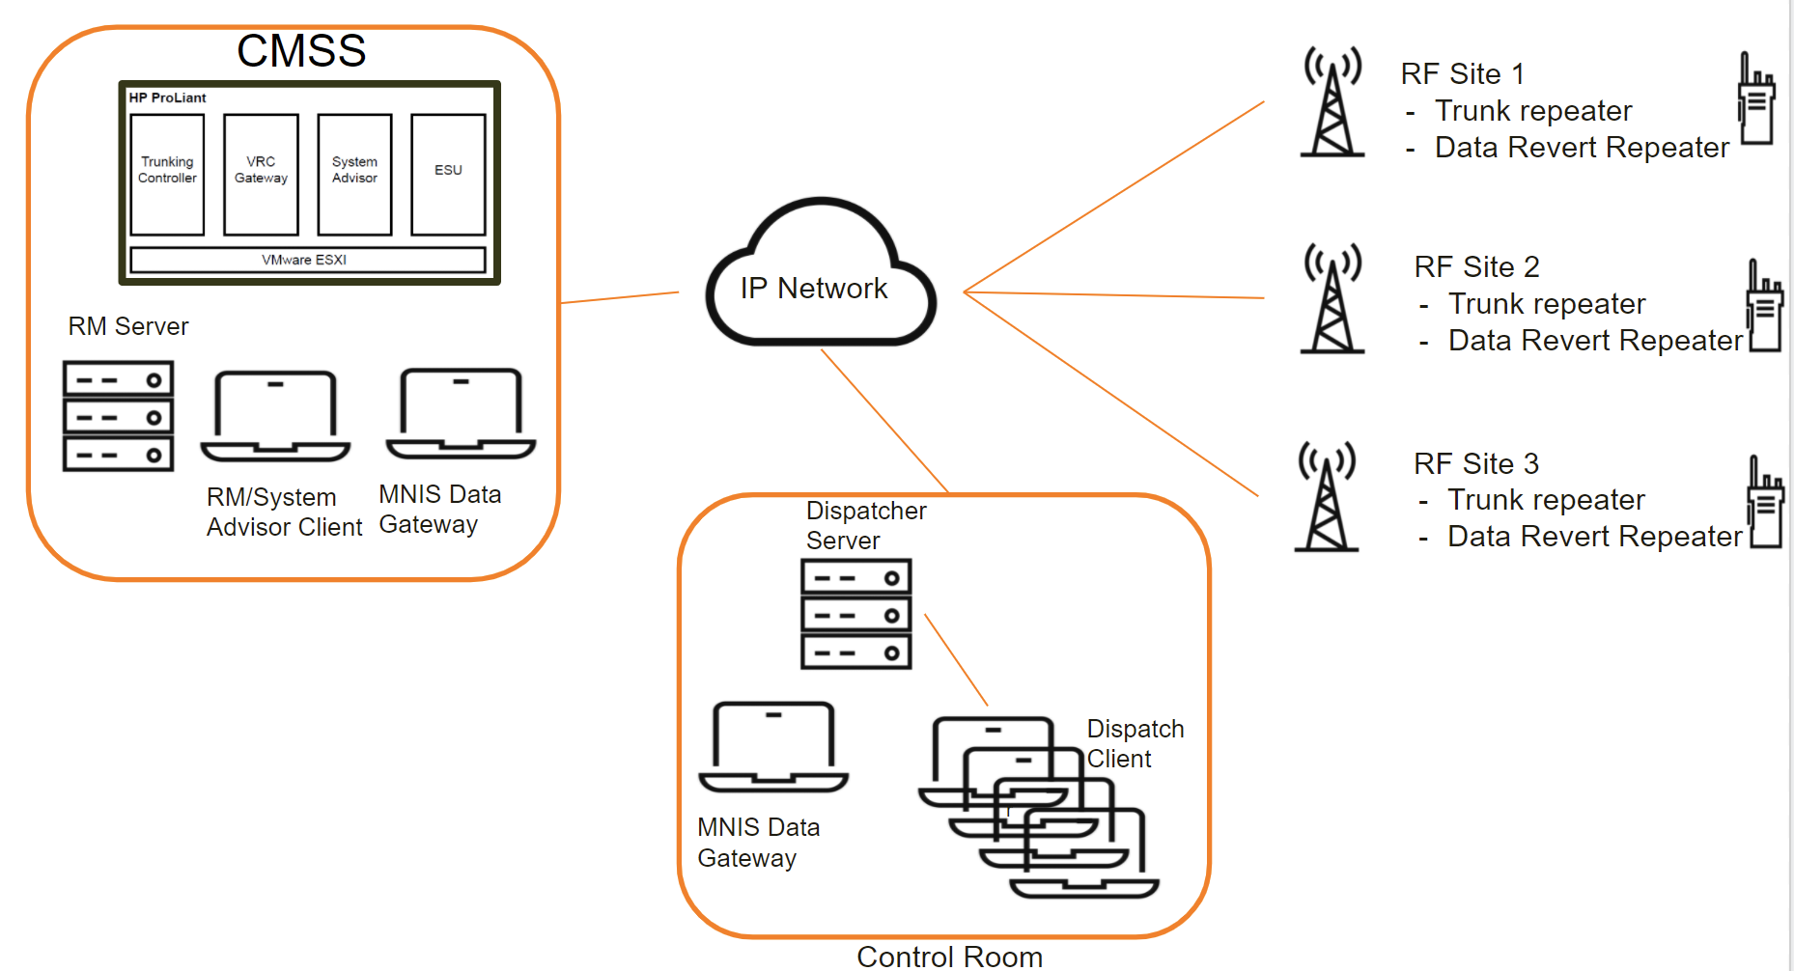
MOTOTRBO Capacity MAX High Level System Layout
Source:
Information for developer:

Slide 13
Information for developer:
Section 1
Hardware and Software Requirements

Slide 14
Hardware Components of a Capacity MAX System
Source:
Information for developer:
The following are mandatory hardware requirements that must be fulfilled in order to deploy a basic Capacity MAX system. A Capacity MAX system must have at least:
A CMSS (Capacity MAX System Server) with a licensed trunking controller.
One RF site with at least one trunking repeater, with a Capacity MAX system license.
The Radio Management application to program the equipment.
The switches and routers to connect the equipment within the site or sites where the CMSS, repeaters, and Radio Management are located.
Radios for the end users.
If appropriate, instructor can also supplement onscreen text with:
•Additional RF sites can be added for wider area operations and additional trunking repeaters can be added at sites to support more users per site.
•Data Revert repeaters can be added to sites when higher location update rates are required and/or to offload the data load from the trunking repeaters.
•When more than one RF site is in the system, a Capacity MAX Site license is required for each additional site beyond the first. The additional Data Revert repeaters will also require Capacity MAX system license.

Slide 15
Hardware Components of a Capacity MAX System
Source:
Information for developer:
Create a table
Hardware | Component | License/Quantity
CMSSS | TC | 1 TC Licence (1 RF site included) | 1 Mandatory
 | VRC | 1 VRC License Per server | Optional
 | SA | 1 SA Licence per server | Optional
Server/PC | MNIS Data | 1 MNIS Data License | Optional
RF Sites | Trunk Repeater | 1 Trunk Repeater Licence | 1 Mandatory
 | Data Revert Repeaters | Data Repeaters Licence | Optional
Radio Management | RM Server, Job Processors, Device Programmer, RM Client | No Licence but deployment size depends system size and RM server hardware | Mandatory
Network transport | Routers | Every Physical Site | Mandatory
 | Switch | Every Physical Site | Optional for RF Sites

Slide 16
Software Components of a Capacity MAX System
Source:
Information for developer:
The following are mandatory software requirements that must be fulfilled in order to deploy a basic Capacity MAX system. A Capacity MAX system must have at least:
The Radio Management application to program the equipment.
Other software applications which may be needed depending on which Capacity MAX configuration is being deployed.
The System Advisor which can be optionally added to monitor call activity and equipment status.
MNIS VRC Gateways and MNIS Data Gateways which can be added to support wire-line voice and data applications.
A Battery Management application to manage the health of the radio’s batteries in the system.

Slide 17
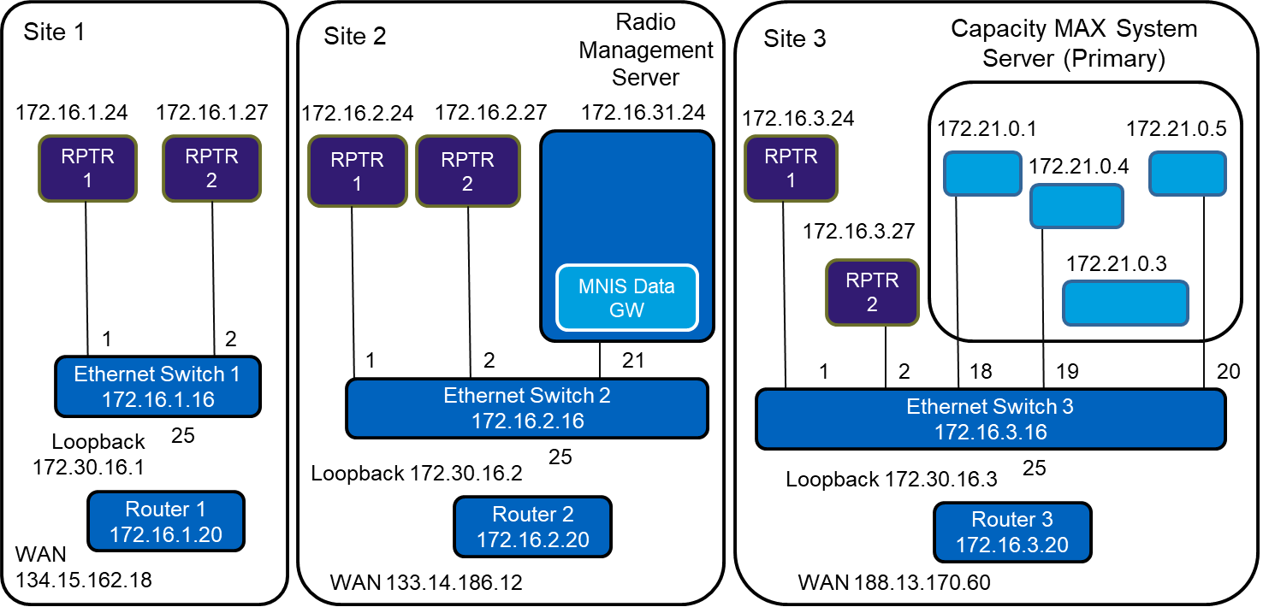
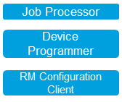
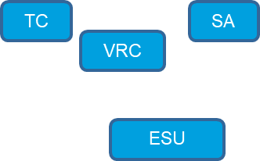
Capacity MAX Three Site System Example (2/2)
Source:
Information for developer:
Refer to the PPT slide deck.
Example of three site system with a single CMSS and 2 repeaters on each site. Assuming the learner completed all the course pre-requisites, this graphic should be used to quiz their knowledge of the different components, both hardware and software, that make up a Capacity MAX system. You should not lecture them but rather use questioning technique to review these concepts.
Note: Number 17 represents iLo connection.
Answers to previous slide now shown onscreen, review with learners as situation requires.

Slide 18
Capacity MAX Three Site System Example (2/2)
Source:
Information for developer:
Added a box over
Use as required if learners require more details about example on previous few slides.
*** Notes: The improved IP address efficiency feature is introduced in M2021.01 release. Therefore, starting from M2021.01 release, the repeater IP address formula in this slide is only true for device ID 1 to 18.

Slide 19
Information for developer:
Section 2
Supported Call Types

Slide 20
CAPACITY MAX Features - Voice Call
Source:
Information for developer:
Voice Call Features
Group Call
Side Wide All Call
Multi Site All Call
Multiple Multi Site All Call
System Wide All Call
Private Call
OACSU (Off Air Call Set Up)
FOASCU (Full Off Air Call Set Up)
Telephone call
Radio to Telephone
Telephone to Radio
Telephone to Talkgroup
Private call types:
OACSU (Off Air Call Set Up)
An individual call is set up after checking the availability of the destination radio.
FOASCU (Full Off Air Call Set Up)
An individual call is set up after checking the

Slide 21
CAPACITY MAX Features - Radio Commands
Source:
Information for developer:
Radio Command Features
Radio check
Call alert
Radio stun or revive
Radio kill
Remote Monitoring
Emergency alarm

Slide 22
CAPACITY MAX - Mobility and Registration (1/2)
Source:
Information for developer:
Registration and Access Control
Grant privileges to users/radio based on assigned profiles.
Mass Registration
Allows more radio registrations per minute whether from recovering from failure or all your employees powering on at the same time from a shift change.
Enhanced Handover/Roaming
Radios automatically switch to a better site with no user intervention and minimal audio loss.
All Start and Critical Site Assignment
Makes sure users do not miss audio.
Cover this slide at a high level.

Slide 23
CAPACITY MAX - Mobility and Registration (2/2)
Source:
Information for developer:
Site Restriction
Limit radio users and talk groups to be allocated channels at allowed sites.
Dynamic Site Assignment
Only allocate a channel at sites where call participating radios are present.’
Late Entry
Allow users to join a call in progress with minimal delay.
Site and Channel Extensibility
Add additional sites and channel without the need to reprogram radios.
Cover this slide at a high level.

Slide 24
CAPACITY MAX - Radio System Features
Source:
Information for developer:
Call Preemption
Tear down a call in progress to allow a higher priority call to go through.
Priority Call Queuing/Preemption
Handle calls in priority order if resources are not available immediately. If an idle channel is not available at one or more associated sites, a high priority call preempts and takes over the trunking channel occupied by a normal priority call.
Emergency Alarm
and Call
Alert users to a critical situation and preempt any other call if needed.
Voice Interrupt
Take control of a currently transmitting group or private call.
Priority Monitor
Allows the system to make Priority announcements on traffic channels during Group Calls in progress. This allows a radio involved in a voice group call to join a higher priority group voice call.
Cover this slide at a high level.

Slide 25
CAPACITY MAX - Radio System Features
Source:
Information for developer:
Confirmed Group Data Call
Data calls from a data application will be acknowledged by all group call members.
Enhanced Channel Access
Improve the reliability of voice transmissions by preventing talk-over.
Status Call
Control channel-based status messaging, to/from radio and dispatcher.
Dynamic Group Number Assignment (DGNA)
Allows a dispatcher to replace a radios currently selected talk group with a temporary talk group.
Inband Location
Inband Location feature provides a solution for transmitting radio to send location updates during voice call. The Console is able to receive and display the updated location from the caller while in a call.
Inband Caller Alias
Inband Caller Alias feature provides a solution for users to configure an alias name which would be sent during voice call transmission, and be displayed on all receiving components (radio/console).
Cover this slide at a high level.

Slide 26
Information for developer:
Section 3
Capacity MAX Call Processing

Slide 27
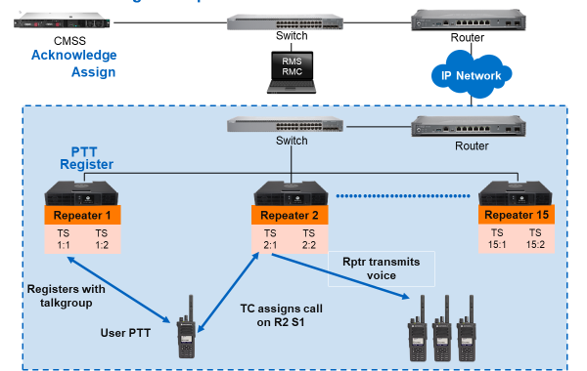
Call Processing: Example
Source:
Information for developer:
Check original slide deck for animation.
This slide is animated.

Slide 28
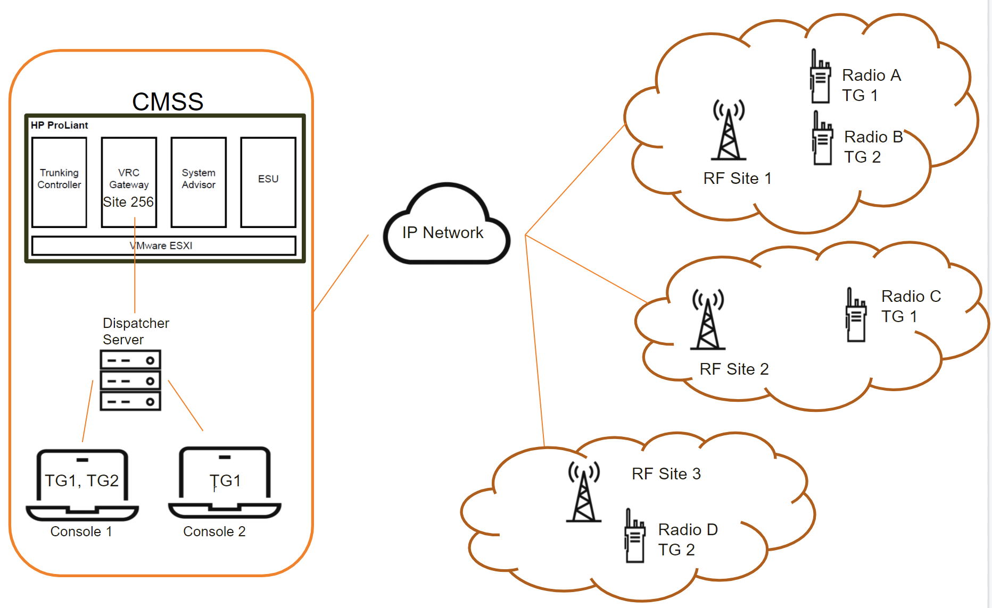
Call Processing: Example (Multi Site)
Source:
https://docs.google.com/presentation/d/1lv7CykcT_xkDZDbT9D5umNVdNOB90k5z/edit#slide=id.p11
Information for developer:
Explain to participants the TC hold the registration information in affiliation database.
Site Radio TG
1 Radio A TG 1
1 Radio B TG 2
2 Radio C TG 1
3 Radio D TG 2
256 Console1 TG 1, TG 2
256 Console2 TG 1
Call Made on TG 1 will be routed to Site 1, Site 2 and Site 256 (Dispatcher server will route the audio to Console 1 and Console 2)
Call Made on TG 2 will be routed to Site 1, Site 3 and Site 256 (Dispatcher server will route the audio to Console 1 only)

Slide 29
Information for developer:
End of Module
You should now be able to:
Review the hardware and software requirements for a Capacity MAX system.
Review the key call types for a Capacity MAX system.
Review how a Capacity MAX system processes calls.

Slide 30
Information for developer:
Module 2
System Planning Consideration and Design

Slide 31
Module 2 Objectives
State the Objectives
At the end of this module, you should be able to:
Develop an awareness of regulatory licensing requirements.
Review Motorola Solutions licensing for the Capacity MAX products.
Be able to successfully use the MOTOTRBO System Designer Tool as part of the design process for a Capacity MAX system.
Identify the appropriate system topology.
Complete a basic fleetmap.

Slide 32
Course Structure
Provide the modules for the course
Course Introduction
Module 1: Capacity Max Review
Module 2: System Planning Consideration and Design
Module 3: Frequency Planning and RFDS
Module 4: Network Requirements
Module 5: RM Planning
Module 6: Dispatcher Solution
Module 7: Workshop (Design a system)

Slide 33
Module Map / Module Outline
Provide the sections for this module
Section 1: Planning Considerations
Section 2: RF Channel Plan
Section 3: Networking Requirements

Slide 34
System Design Considerations (1/2)
Source:
Information for developer:
As part of the system design, the following need to be considered and studied.
Review the Customer’s operational requirements.
Present installation plan.
Present preliminary cutover plan and methods to document final cutover process.
Present configuration and details of sites required by system design.
Validate that Customer sites can accommodate proposed equipment.
Provide approvals required to add equipment to proposed existing sites.
Review safety, security, and site access procedures.
Present equipment layout plans and system design drawings.

Slide 35
System Design Considerations (2/2)
Source:
Information for developer:
Provide heat load and power requirements for new equipment.
Provide information on existing system interfaces.
Provide frequency and radio information for each site.
Complete the required forms required for frequency coordination and licensing.
Ensure that frequency availability and licensing meet project requirements, and pay licensing and frequency coordination fees. Verify FCC License provided by the customer is valid
Review and update design documents, including System Description, Statement of Work, Project Schedule, and Acceptance Test Plan, based on Design Review agreements.
Provide minimum acceptable performance specifications for customer provided hardware, software, LAN, WAN and internet connectivity.

Slide 36
Site Deployment Considerations
Source:
Information for developer:
Provide adequate HVAC, grounding, lighting, cable routing, and surge protection based upon Motorola Solutions’ Standards and Guidelines for Communication Sites (R56)
Ensure the resolution of environmental and hazardous material issues at each site including, but not limited to, asbestos, structural integrity (tower, rooftop, water tank, etc.), and other building risks.
Ensure that electrical service will accommodate installation of system equipment, including isolation transformers, circuit breakers, surge protectors, and cabling.
Provide obstruction-free area for the cable run between the demarcation point and system equipment.
Provide structure penetrations (wall or roof) for transmission equipment (e.g. antennas, microwave radios, etc.).
Supply interior building cable trays, raceways, conduits, and wire supports.
These are the responsibilities of the partners to ensure the site deployment is carried out accordingly.

Slide 37
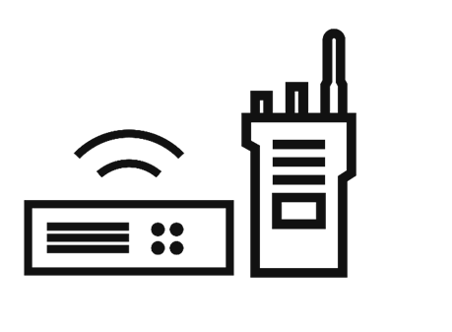
High Level Capacity Max System Planning
Source:
Information for developer:
This module will describe the key elements of how to plan a Capacity Max system.
Correctly sizing the Capacity Max system is an important part of the planning process.
The following items need to have the required quantities defined as part of the planning process:
–Radios
–RF Sites
–Trunked repeaters
–Data revert repeaters
–Voice gateway talk paths
–Number of CMSS servers (TC, VRC and SA)

Slide 38
Capacity Max System Design Outcome
Source:
Information for developer:
The following design outcome is expected for Capacity Max system deployment/installation:
Number of RF Sites
Number of Trunk or Data Repeaters per site
Number of CMSS servers
Number of MNIS Data
Site, CMSS, VRC talkpath and Radio Licenses
Dispatcher Solutions (Voice and Data)
Radio Management Topology Deployment
System Layout
System IP network plan
Fleetmapping

Slide 39
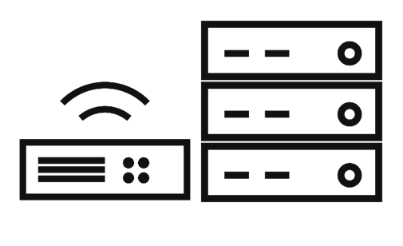
High Level Capacity Max System Planning
Source:
Information for developer:
Motorola Solutions has created a the following tool and document to assist in the planning for MOTOTRBO systems
MOTOTRBO System Design Tools (SDT)
CAPACITY Max System Planner
The MOTOTRBO SDT tool is based on system planner document and is provided to help customers to design some part of the system.

Slide 40
High Level System Planning
Source:
Information for developer:
The MOTOTRBO SDT is provided to assist you in:
Estimating the number of repeaters, trunked or data revert, needed at each Capacity Max site.
Estimating the site link bandwidth need for each site in the system.
Determining the number of MNIS VRC Gateways needed in the system.
Estimating the number of talkpath licenses needed for each MNIS VRC Gateway.

Slide 41
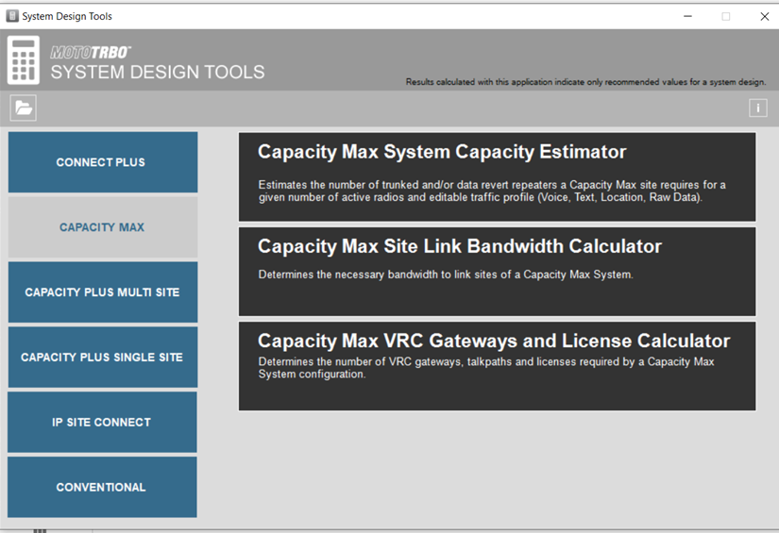
High Level System Planning
Source:
Information for developer:
In order to effectively use the MOTOTRBO System Design Tools (SDT), there are some basic planning considerations you must first understand.
We will use the MOTOTRBO System Design Tools later in this module once we have reviewed the basic planning considerations for a Capacity Max system.

Slide 42
High Level Capacity Max System Planning
Source:
Information for developer:
The CAPACITY Max System Planner provides all the information covered by MOTOTRBO SDT and additionally covers the following :
System IP plan and layout
Number of CMSS server
MNIS Data gateway consideration
Dispatcher Solution consideration
RF Frequencies planning
The RM topology deployment is covered in Radio Management Planner document.

Slide 43
Information for developer:
Section 1
Planning Considerations

Slide 44
Regulatory Licenses
Source:
Information for developer:
Regulatory Licensing Considerations help to determine the number of frequency licenses required for a Capacity Max system:
Capacity Max Control Channel normally requires an exclusive use license for a frequency pair.
If you have an exclusive license, the downlink to the Control Channel will transmit continuously.
Optimum performance for features like call grant or roaming is achieved when using an exclusive license.
As of MOTOTRBO Release 2.9, an option for a Shared Frequency Control Channel is available if you do not have an exclusive license.
As many as four repeaters per site may be designated as control channel capable.
4 channels per site.
Note that each repeater can have a backup (using the same freq pair), so 8 repeaters can be control channel capable using 4 licenses.
Note that only 1 active control channel per site is supported, but control channel capable can be designated.
For feature licenses, use the Capacity Max VRC Gateway and License Calculator which will be discussed later in the course.

Slide 45
Motorola Solutions Licensing Considerations
Source:
Information for developer:
A Capacity Max system requires at least one CMSS.
A Capacity Max System Server comes pre-installed with the following components and need to be licensed individually:
Trunking Controller
MNIS VRC Gateway
System Advisor server
Each RF site in the system requires a Capacity Max Site License to enable it to attach to the system. Each CMSS (primary or backup) that hosts the Trunking Controller requires the appropriate number of Capacity Max Site Licenses.
Information in MOTOTRBO System planner pg 135/136.

Slide 46
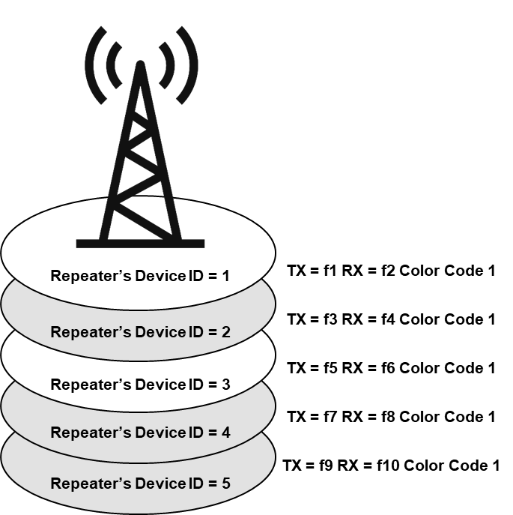
Single Site Considerations
Source:
Information for developer:
Site Considerations include the following:
Capacity Max systems support 15 trunked repeaters and 6 data revert repeaters per site.
Each repeater may have a backup repeater.
Normally, site frequencies must be in the same RF band.
In two RF band systems, the sites can be co-located but must have different site IDs.
All frequencies must be unique with no re-use in the same site.
Site repeaters must have the same coverage footprint.
Trunking repeaters must have the same color code within a site.
Review the site considerations. Mention that we will discuss color codes momentarily.

Slide 47
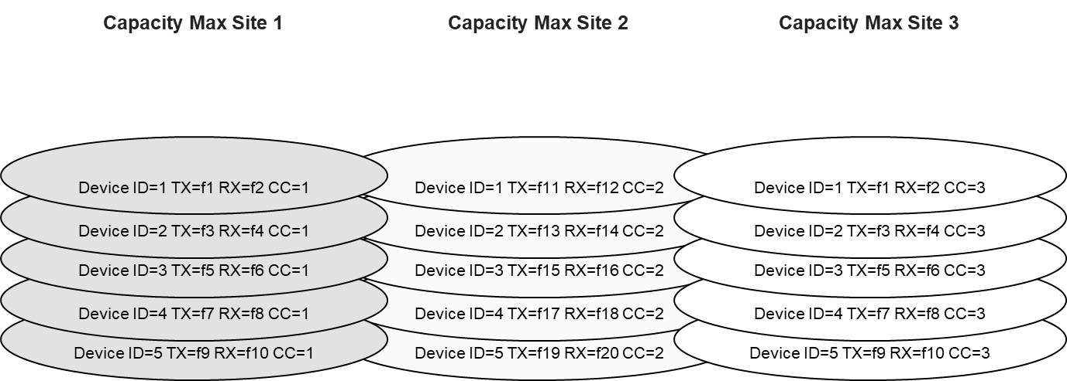
Multi-Site Considerations
Source:
Information for developer:
Circles represent areas of RF coverage.
Multi-Site considerations include the following:
Frequencies may be reused at different sites where coverage does not overlap.
Any time a frequency is reused, different color codes must also be used.
For call processing to function, all trunking repeaters at a site must be in the same color code. Data revert repeaters may have different color codes.
For multiple network sites accessed by a single SU, the sites would usually be in the same RF band. The exception to this is the Dual Band 800/900 SU.
Review multi-site considerations.

Slide 48
Sources of Information to Predict Usage
Source:
Information for developer:
Add lines below text for user to be able to write on.
What are the sources of information we can use to predict usage?
In the space below, list some considerations which can help determine system usage levels.
An important part of planning for a Capacity Max system is properly sizing the system. The size of a system is often determined by the quantities of: radios, RF sites, trunked repeaters, data revert repeaters, and voice talk paths for dispatch, telephony and voice logging. The first step to determine these quantities is to predict the system usage. If hard data is not available, you should use estimates.
System usage came be predicted by considering some or all of the following:
•The number of simultaneously active radio users in the system and at each site
•The radio user’s call rate and call duration
•The average number of sites participating in a call
•The voice console call rate and call duration
•The number of outbound data application transmissions per hour
•The inbound periodic location transmissions per user

Slide 49
Sources of Information to Predict Usage
Source:
Information for developer:
Sources of Information which can be used to Predict Usage:
Interviewing the customer.
Reviewing log files of any existing radio system.
Reviewing typical usage profiles.
If replacing a system, this number might be easy to acquire, but if installing a new system a series of customer interviews with pointed questions will be necessary.
The total number of radios purchased for a system does not mean all will be active at any given time (for example shift workers). Use the peak number of simultaneous active users by reviewing log files. Also consider future radio system expansion or usage during special events.

Slide 50
Typical Usage Profiles
Source:
Information for developer:
What are typical usage profiles?
If historic call logs are not available from the customer, typical usage profiles can be used to help product predicted usage levels for system planning purposes.
Motorola SoIutions Engineering has done extensive research and has attempted to create "typical" usage profiles and charts to provide guidance in determining a prediction of typical usage levels.
It is possible to create additional usage profiles based on customer requirement, if there’s such a need.

Slide 51
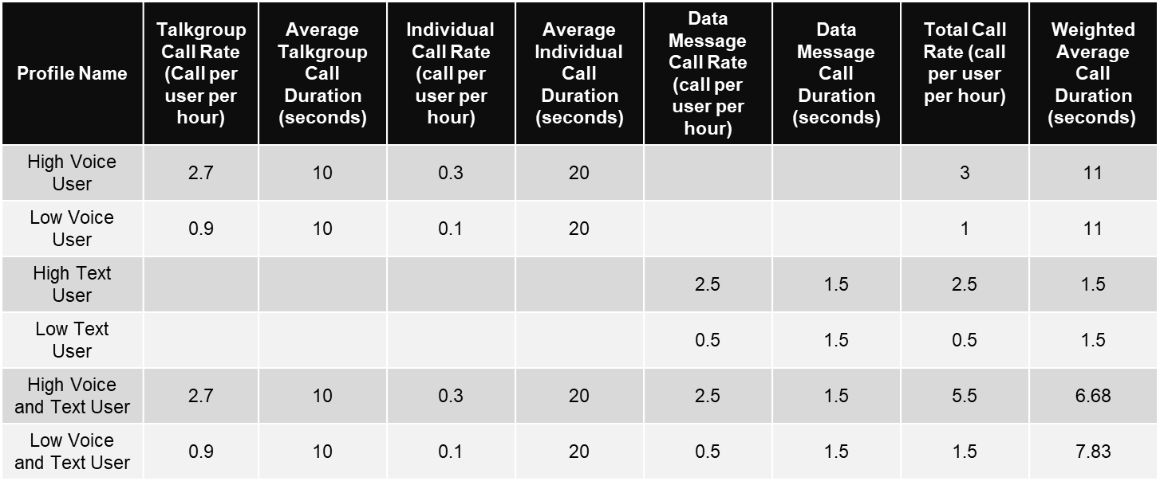
Typical Usage Profiles
Source:
Information for developer:
Instructor reviews meaning of values and how to use chart with learners.
Highlighted data goes into tool
If replacing a system, this number might be easy to acquire, but if installing a new system a series of customer interviews with pointed questions will be necessary.
The total number of radios purchased for a system does not mean all will be active at any given time (for example shift workers). Use the peak number of simultaneous active users by reviewing log files. Also consider future radio system expansion or usage during special events.

Slide 52
Determining the Quantity and Location of Physical RF Sites
Source:
Information for developer:
Site selection for RF sites can vary depending on whether the system is:
A new system.
An update to an existing system.
Constrained by requirements from the customer.
Predicting coverage for an RF site can be complicated. Use you preferred RF propagation model or RF prediction software to help.

Slide 53
Determining the Quantity and Location of Non-RF Sites
Source:
Information for developer:
Non-RF Site selection can vary depending on:
Required physical location of the CMSS, console, and data applications.
User access and operational needs.
The setup and/or configuration of the IP network.

Slide 54
Network Model: Site ID for RF and Non-RF Site
Source:
Information for developer:
The selection of network model type will determine the Site ID range (for RF and non-RF site) and the network ID range.
The Installation and Configuration Capacity Max manual and the network transport template supplied by MSI follows the ‘Huge’ network model.
Model | Network ID | Site ID Range (RF and Non-RF Site)
Tiny | 0 to 511 | 7
Small | 0 to 127 | 31
Large | 0 to 15 | 255
Huge | 0 to 3 | 1023

Slide 55
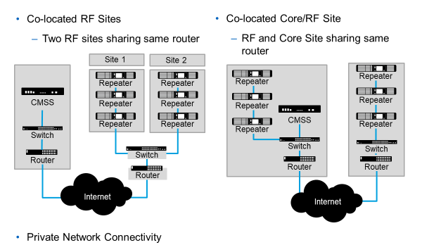
Examples of System Topologies
Source:
Information for developer:
It will be up to the customer to decide which of these two topologies will best meet their needs. Although the Co-Located Core/RF Sites is the most common configuration, some Customers may decide to have the CMSS in a different site (perhaps located in their shop) and push changes over the air.
Identify to learners that additional topology examples are available in the MOTOTRBO System Planner

Slide 56
System Resilience Considerations
Source:
Information for developer:
Capacity Max systems support redundancy option for the following:
Repeaters (each repeater can have a redundant repeater)
15 MNIS VRC (15 Redundant VRC)
15 MNIS Data Gateways (15 Redundant Data Gateway)
Both Active and Redundant Data Gateway deployed on different machine
5 System Advisor Servers.
2 SA selected as active SA by active TC
Remainder SA as inactive SA by active TC
Trunking controller redundancy (1 Active and 4 Alternate )
Number of TC deployed depends on IP network topology
For private networks, the trunking controllers can be at five different physical locations.
For public networks, using HPE transport solution (routers) the trunking controllers need to be at the same physical location as the ADVPN hub routers.
Data Gateway Redundancy:
• Capacity Max supports primary and one secondary data gateway
• Automatically switch to secondary data gateway when primary data gateway goes off-line (disconnected, hardware failure, stopped)
•Automatically switch back to primary data gateway when it comes on-line
•Switchover of the data gateway is transparent to the subscriber and the data applications
•The solution requires the primary/secondary data gateway to be on the same LAN
•The primary and secondary data gateway are configured to have same data gateway radio ID. Switching over to the active gateway (primary to secondary or vice-versa) is transparent to the subscribers

Slide 57
Trunking Controller Resilience
Source:
Information for developer:
In the event of a Trunking Controller failure in a Capacity Max system with redundancy:
The redundant Trunking Controller can assume control without required re-registration of subscribers.
Redundant Trunking Controllers can quickly build a registration database and recover network elements.
Capacity Max systems support up to 5 trunking controllers but only 1 will be active at any given time and the others will act as redundant units.

Slide 58
Choosing the Number of Trunked Repeaters
Source:
Information for developer:
Use the System Planner to describe use of these and other charts. Over the Air Call Rate Limit - 12,000cph Outbound Announcement Call Rate Limit - 20,000cph

Slide 59
Data Transmission on Cap Max
Source:
Information for developer:
Channels used
For Location: Radio can use the EGPS data Revert Channel to offload the traffic from trunked channel.
Only the inbound GPS traffic from radio
For Text or any data (GPS trigger, sensor etc. ) : Use the trunked channel
Control Channel : Text (DMR Tier3 IOP Standard- 23 characters) and status message
Note : Sending data on the control channel is not recommended since it may degrade performance and capacity.
NOTE : Capacity Max system do not support Data Revert Channel (only EGPS data Revert Channel is supported)
DMR Tier 3 IOP
Sent on the control channel; while other protocols are sent on the trunked channels. Sending data on the control channel is not recommended since it may degrade performance and capacity.
DMR Standard (using port 5016)
The DMR Standard protocol is recommended in most cases.
Proprietary (using port 4007)
MSI proprietary TMS.

Slide 60
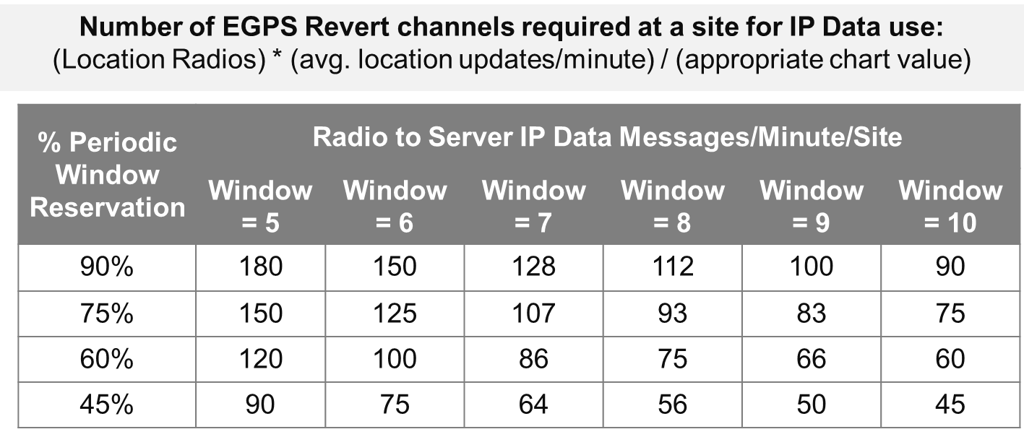
Enhanced GPS Revert (1/2)
Source:
Information for developer:
Enhanced GPS (EGPS) Revert Channel with IP Data
The table below illustrates the number of updates per minute a time slot supports for various Periodic Window Reservation and Window Size settings.
Enhanced GPS (EGPS) Revert Channel with IP Data supports a large number of location updates (both indoor and GNSS) with rich location parameters.

Slide 61
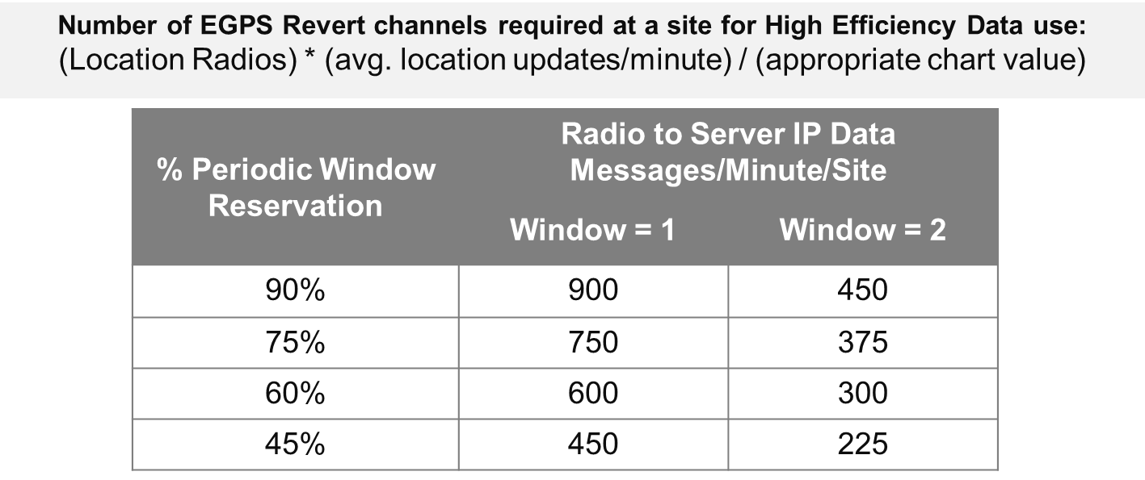
Enhanced GPS Revert (2/2)
Source:
Information for developer:
Enhanced GPS (EGPS) Revert Channel with High Efficiency Data
The table below illustrates the number of updates per minute a time slot supports for various Periodic Window Reservation and Window Size settings.
The Enhanced GPS Revert Channel with High Efficiency Data supports a very large number of GNSS location updates or Option Board data but it supports a limited set of location parameters.

Slide 62
Enhanced GPS Revert Summary
Source:
Information for developer:
Create a table
 | IP data | High Efficiency
Privacy | Supported | Not Supported
Indoor/Outdoor | Indoor/Outdoor | Outdoor
Update Rates | 30 seconds, 1 minute, 2 minutes, 4 minutes, and 8 minutes | 7.5 seconds, 15 seconds, 30 seconds, 1 minute, and 2 minutes
Window Size | 5-10 | 1-2
GPS Information | Full | Limited
Max Data minute/site | 180 | 900
The Enhanced GPS Revert Channel with High Efficiency Data supports a very large number of GNSS location updates or Option Board data but it supports a limited set of location parameters.

Slide 63
Radio Identifiers (IDs)
Source:
Information for developer:
Each radio in the system, as well as each data gateway and each console position when deployed, is required to have a unique MOTOTRBO Radio ID.
Capacity Max supports the DMR defined Mobile Subscriber Identifier (Radio ID) addressing range as defined below.
00000116 – FFFCDF16 (1 – 16,776,415)
Recommendation in the installation for the radio ID for data and voice:
The MNIS Data Gateway should be configured with a Radio ID from 3000000 to 3999999. The voice console be configured with a Radio ID from 4000000 to 4999999.
Motorola SolutionsD = Mobile Subscriber ID
Unique Radio ID of a Sourcing Entity in the System
An entity that acts as a source of a call must have a unique Radio ID. Radios require a unique Radio ID. The range of Radio ID is 1 – 16,776,415.
Each Radio in the system requires a unique Radio ID. The Radio ID of the radio is configurable in the Radio View (radio icon) within Radio Management.

Slide 64
Talkgroup Identifiers (TGID)
Source:
Information for developer:
DMR Talk Group Identifier
1 – 16,776,415 (00000116 – FFFCDF16)
Site All Call ID: 16,777,213 (FFFFFD16)
Multi-Site All Call ID: 16,777,214 (FFFFFE16)
System-Wide All Call ID: FFFFFF
Multiple-Multi Site All Call: FFFF60 – FFFFDF (128 IDs)
Short Talk Group Identifier
1 – 1020 (00000116 – 0003FC16)
Reduces message latency and improves signaling efficiency
Note from SME: If more details are needed, point out that Short Talk Group Identifier manifests itself to an end user by improving late entry performance.

Slide 65
Device Identifiers
Source:
Information for developer: See comment for Instructor notes, if not get from Module 2 slide deck, slide 27.
Infrastructure devices need a device ID which is unique to the site to which it belongs.
The range of device ID for a repeater is 1 to 21. It is highly recommended to number sequentially.
Note: Starting from M2021.01 release, the assignment of device ID number for repeaters will defer base on the site subnet mask.
For redundant repeaters, the Device ID of the primary and the redundant repeaters should be same and their Redundancy Group ID should be different.
For other devices (CMSS, MNIS Data Gateway, RMDP) the Device ID must be unique, but it may duplicate with repeaters. The range of device ID for these devices is 1 to 63.
It is recommended that the primary CMSS be configured with a Device ID of 1 and the alternate CMSS be configured with a Device ID of 2 to 5. Note: Capacity Max can support up to 4 alternate CMSS boxes with a trunking controller.
The Trunking Controllers that reside on the CMSSs acquire their Device ID and Redundancy Group ID from the CMSS configuration.
See posted comment for full Instructor Notes

Slide 66
MOTOTRBO System Design Tools: Capacity Max
Source:
Information for developer:
A set of tools to help you plan the estimates for the needed infrastructure in your Capacity Max system.
The tools have the ability to Save/Load your estimates.
Tools for Capacity Max includes
Capacity Max System Capacity Calculator
Capacity Max Site Link Bandwidth Calculator
Capacity Max VRC Gateways and License Calculator
Let the participants know that in the System Planner, three strategies are addressed:
Simple which is a rule of thumb
Better which uses some actual data before the system is implemented.
Best which uses actual hard data over time. The Best is used to optimize a system.
The tool addresses the better strategy.

Slide 67
Workbook Activity
Source:
Information for developer:
Download and Launch the Capacity Max System Design Tool
Instructor Demo:
Capacity Max System Capacity Estimator
Capacity Max Site Link Bandwidth Calculator
Capacity Max VRC Gateways and License Calculator
Tell the participants that there will be an opportunity for them to work with the tool later in the course. The purpose of this activity is to help the participants on downloading the tool onto their PCs (if they haven't done so already) and to give them a quick demo.

Slide 68
Information for developer:
Section 3
Networking Requirements

Slide 69
Physical Location Requirements for a Capacity Max System
Source:
Information for developer:
Each physical site requires an Ethernet switch and a router.
If your system is using a Public ISP, a modem connected to an Internet Service Provider (ISP) is required.
If your system is using a Private Enterprise network, the appropriate IP based microwave, leased line or fiber equipment will be required.
Emphasize that Motorola SoIutions recommends: HPE MSR2003 router and HPE 2300 switch that are specified for PCR systems are going end-of-life mid-2020. After that, Motorola SoIutions will be recommending the Juniper SRX300/SRX345 routers and EX2300-24 switches
However, you do not have to use the Motorola Solutions recommended switches and routers and you do not have to use the IP plan from the example Configuration Files.
Network requirements when not using recommended gear:
Dealer may choose to use their own network gear if it meets requirements
The requirements are listed in the System Planner (Documentation Part Number: MN002732A01)
This is when a customer wants to provide their own switch and router.

Slide 70
Motorola-Solutions-Recommended Equipment
Source:
Information for developer:
Motorola-Solutions-Recommended Equipment for Capacity Max Systems.
The switches and routers which Motorola Solutions currently recommends for Capacity Max systems are manufactured by HPE and Juniper.
Motorola Solutions provides a “Network Quick Setup Reference Guide” for a number of the most common system configurations and recommend IP plans.
Emphasize that Motorola SoIutions recommends: HPE MSR2003 router and HPE 2300 switch that are specified for PCR systems are going end-of-life mid-2020. After that, Motorola SoIutions will be recommending the Juniper SRX300/SRX345 routers and EX2300-24 switches
However, you do not have to use the Motorola Solutions recommended switches and routers and you do not have to use the IP plan from the example Configuration Files.
Network requirements when not using recommended gear:
Dealer may choose to use their own network gear if it meets requirements
The requirements are listed in the System Planner (Documentation Part Number: MN002732A01)
This is when a customer wants to provide their own switch and router.

Slide 71
Replicator
Source:
Information for developer:
Any CMSS with a Trunking Controller has replicator functionality.
There is one replicator active in a system at a time.
No license required.
Used (on a as needed basis) when:
Talkgroup Call requires 16 or more sites.
Individual voice calls or Talkgroup calls to 3 or more sites where at least 1 site is configured for centralized distribution.
Reduces link bandwidth requirements at centralized distribution site.
It increases bandwidth requirements at the site with the replicator.
Supports up to 400 simultaneous talk paths.
If the 2 radios are in an individual call at different sites and voice recording is occurring at another site, then the call requires 3 sites.

Slide 72
Site Bandwidth Requirements
Source:
Information for developer:
There are a number of factors that determine the bandwidth requirements for a site. These include:
The number of trunked repeaters at the site.
The number of data revert repeaters at the site.
The average number of other repeaters sites associated with talkgroup calls.
The number of hardware redundant repeaters located at the site.
The number of System Advisors Servers/Clients present at the site.
The number of VRC Gateways present at the site.
The number of Data Gateways present at the site.
The number of RM clients present at the site.
The use of a centralized distribution site.

Slide 73
Inter-Site Bandwidth Requirements
Source:
Information for developer:
Bandwidth requirements for any given system are primarily determined by the following:
The number of voice slots at the site(s).
The number of data revert slots at the site(s).
Total number of trunked sites.
Type and technology of the network.
Use of VPN tunneling protocols.
Physical Network location(s).
Location and quantity of CMSS, VRC Gateways, Data Gateways, and System Advisor servers.
Use of third party systems that monitor airtime and system usage.

Slide 74
Site Link Bandwidth Requirements
Source:
Information for developer:
Use the calculator to calculate bandwidth requirements.
Direct learners to tools on their Flash drive
Provide link to download from MOL as required

Slide 75
Type/Level of Secure Virtual Private Network (VPN) and Bandwidth Requirements Impacts
Source:
Information for developer:
Site link bandwidth requirements are impacted based on whether or not VPN is used.
The baseline requirements assume GRE (Generic Routing Encapsulation) tunneling without security.
Absence of tunneling decreases the baseline by 12%, but is not recommended.
Complicates inter-site configuration.
Invalidates recommended IP Plans.
GRE IPsec AH and ESP is not recommended due to large bandwidth impact (+40%) and is largely unnecessary due to high level of security provided by using IPsec ESP(Encapsulating Security Payload) without AH (Authentication Header).
Refer users to the Capacity Max System Planner and MOTOTRBO Bandwidth calculator for accurate info.

Slide 76
Information for developer:
End of Module
You should now be able to:
Develop an awareness of regulatory licensing requirements.
Understand Motorola Solutions licensing for Capacity Max products.
Be able to successfully use the MOTOTRBO™ System Designer Tool as part of the design process for a Capacity Max system.
Determine the appropriate system topology.
Determine the infrastructure device ID map.
Define the networking equipment requirements for a Capacity Max system.

Slide 77
Information for developer:
Module 3
Frequency Planning and RFDS

Slide 78
Module 3 Objectives
State the Objectives
At the end of this module, you should be able to:
Develop a channel plan.
Identify the RFDS components on sites.

Slide 79
Module Map / Module Outline
Provide the sections for this module
Section 1: RF Channel Plan
Section 2: RFDS

Slide 80
Information for developer:
Section 1
RF Channel Plan

Slide 81
What is a Channel Plan?
Source:
Information for developer:
The DMR trunking protocol uses an identifier to represent a pair of transmit and receive frequencies.
The DMR trunking protocol also uses a number between 1 and 4094 inclusive to represent a channel or Channel ID.
This one-to-one mapping between channel number and frequency pair is called a Channel Plan.

Slide 82
What Information is used in a Channel Plan?
Source:
Information for developer:
Channel Numbers
Transmit and Receive Frequencies

Slide 83
Types of Channel Plan
Source:
Information for developer:
There are two types of Channel Plan for Capacity Max systems:
Fixed plan where a channel number is mapped to absolute transmit/receive frequencies.
Flexible plan provides a more dynamic option when you may need to map channels to different transmit/receive frequencies in your Capacity Max system.
We’ll look at examples of when it is best to use the two different types of channel plan later in this section.
Note from SME: If more details are needed, point out:
Flexible Channel Plan – Each frequency pair in the plan is configured to a channel number.
Fixed Channel Plan – Control channel capable repeaters and data revert repeaters must be configured in the system, but traffic channel repeaters do not need to be configured in the system. This is typically utilized in a band that has a single TX/RX frequency offset throughout the band. This is extremely useful when adding traffic channels to sites as the radios do not need to be reprogrammed to make use of the new channel.

Slide 84
Creating a Fixed Channel Plan for Capacity Max
Source:
Information for developer:
The DMR Trunking Protocol provides two ways to specify the mapping between the Channel Numbers and the frequency pairs. The two ways are Fixed and Flexible.
"Channel and Site Extensibility" This means that channels and sites can be added to the system without reprogramming radios. ONLY if using Fixed.

Slide 85
Fixed Channel Plan Example
Source:
Information for developer:
Example 1 Multiband Radio:
Tx ranges:
800 MHz Band: 806–824 MHz
900 MHz Band: 896–901 MHz
Channel Separation:
800 MHz Band: 12.5 kHz
900 MHz Band: 12.5 kHz
Duplex Split:
800 MHz Band: 45 MHz
900 MHz Band: 39 MHz
Reason for Segments:
The difference between the minimum (i.e. 806 MHz) and maximum (i.e. 901 MHz) Tx frequencies is 95 MHz, which is greater than the 51.1625 (= 12.5 kHz * 4093) MHz.
The duplex splits of both the bands are different.
To finish the configuration, channel numbers need to be assigned to the frequency pairs in such a way that the 800 MHz channel numbers and the 900 MHz channel numbers are not overlapping. One way to arrange the channels would be as follows:
800 MHz Band: channels 1-1440
900 MHz Band: channels 1441-1841

Slide 86
Creating a Flexible Channel Plan for Capacity Max
Source:
Information for developer:
Used in the following scenarios:
The mapping requires more than four segments.
One or more frequency pairs are beyond the range of frequency pairs covered by all the four segments.
One or more frequency pairs are within the range of segments but cannot be mapped by them.
Note:
Any Channel Number not used by a frequency in the system can be used for the Flexible Channel Plan.
Combinations of Fixed and Flexible Mapping is supported.
To overcome the limitations of fixed mapping, a Capacity Max system allows flexible mapping. It should be used to map all the frequency pairs that are exception cases of the fixed mapping. The flexible mapping does not have rules. All the frequency pairs are individually specified with corresponding channel numbers.

Slide 87
Information for developer:
Section 2
RFDS

Slide 88
RFDS (RF Distribution System)
Source:
Information for developer:
The depending the on licensed frequencies, this would impact the RFDS components at the site.
The repeaters will need to deployed with the following components to ensure optimum coverage for radio performance and provide protection to the site:
Duplexer
Combiner
Multicouplers (or Low Noise Amplifier - LNA)
Tower Top Amplifiers (TTA)
Antennas
Coaxial surge suppressors
Cables and connectors

Slide 89
Why Design with Standard Practices?
Source:
Information for developer:
Stable and consistent designs require proper and consistent design practices.
The Motorola Standard Practices for RF Design outline the most recognized design practices to:
Reduce risk
Lead to successful system operation and customer satisfaction.
Derived from decades of engineering and interference mitigation experience.
Using Standard practices will ensure the design works the first time and performs as required.

Slide 90
What is a RF Link Budget?
Source:
Information for developer:
Sum of static gains and losses
Outbound- from the fixed end transmitter to the subscriber receiver
Inbound- from the subscriber transmitter to the fixed end receiver
Gains minus losses
Link Budgets provide only static estimates of system range.
If higher power in talk out (fixed end transmitter to subscriber) verses talk in (subscriber to fixed end transmitter) is talk back limited.
Gain and loss in all stages of an RF system (feed line, filters, amplifiers) is multiplicative (if it were not, that would be nonlinearity), and therefore is typically written in dB so that the total gain or loss may be computed by adding, rather than multiplying, all the individual values together.
If you add a value in dB to a value in dBm, the result is in dBm. (Adding two dBm values is not usually meaningful since it would correspond to power squared.)

Slide 91
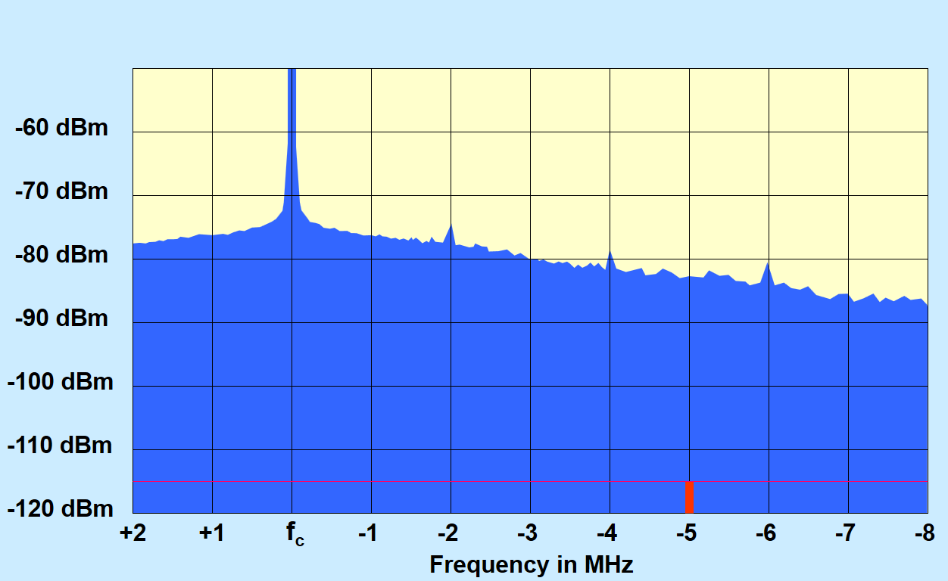
RF Basics - Sideband Noise (SN)
Source:
Information for developer:
Undesired noise generated in an FM transmitter that radiates above and below assigned center frequency
Sideband Noise stated in –dB below carrier
Each transmitter type has different Side band noise characteristics
Requires transmitter sideband noise curves to predict interference potential
SN curves can be obtained from transmitter manufacturer

Slide 92
Sensitivity
Source:
Information for developer:
Minimum signal level at which a receiver can reliably recover voice or data
Analog systems measure sensitivity using 20 dBq* or 12 dB sinad tests
Digital systems measure sensitivity using BER tests
Sensitivity normally stated in –dBm or microvolts
*dBq = dB quieting

Slide 93
Myths on Sensitivity
Source:
Information for developer:
Several Myths of Sensitivity that confuse engineers
The higher the gain the better the sensitivity
More gain results in lower sensitivity because it amplifies the external noise
Lower gain will provide better operation
The interference risk is increased with more gain
High gain amplifiers cause interference
Sensitivity myths cause engineers and technicians to make mistakes that reduce coverage and affect overall operation. These myths need to be understood to evaluate their risk.
The higher the gain the better the sensitivity – This misunderstanding is derived from the fact that to a certain extent gain does determine sensitivity. This occurs because the gain of the amplifiers overcome the losses after the amplifiers. If the gain is low the sensitivity is poor. Gain in early stages before the receiver establish the best sensitivity possible but will only be seen if the gain is sufficient to overcome the losses. When the gain is over 10 dB the losses after the amplifier are washed out by over 10:1. This means that a 10 dB loss after the amplifier will produce only a 1 dB sensitivity change.
More gain results in degradation because it amplifies the external noise – External noise and desired signals are amplified equally. The only addition the amplifier provides is added noise from internal noise figure. This is why noise figure is important.
Lower gain will provide better operation – Lower gain will only deteriorate the delivered sensitivity. Lower gain is not necessary as long as the signals are controlled into the receiver.
The interference risk is increased with more gain – Testing has shown that the interference risk is the same with and without gain.

Slide 94
Selectivity
Source:
Information for developer:
Receivers ability to reject signals close in frequency to receivers assigned frequency
Normally stated in –dBm @ adjacent channel
Receiver selectivity is primarily achieved in the receiver IF section

Slide 95
Receiver Degradation (RD)
Source:
Information for developer:
Reduction of receivers ability to receive signals due to overloading of receivers circuits from high level off channel in-band signals
Normally stated as the difference in dB between receivers bench sensitivity and measured effective sensitivity
Each receiver type will have different receiver degradation characteristics
Requires receiver degradation curves to predict interference potential
RD curves can be obtained from receiver manufacturer

Slide 96
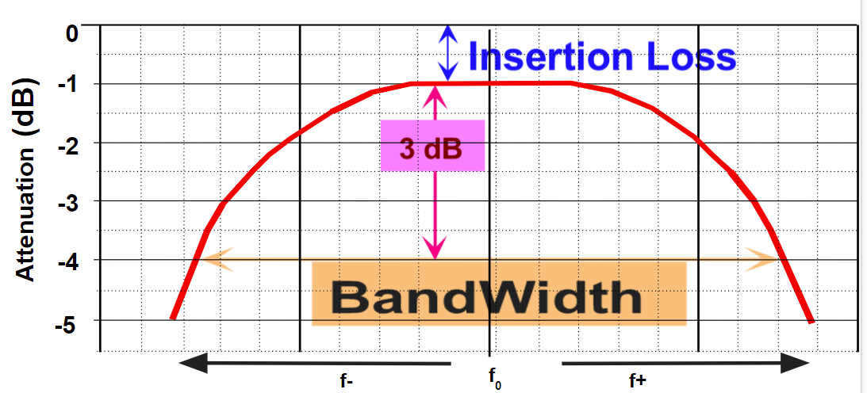
Filter Bandwidth
Source:
Information for developer:
The lowest attenuation available occurs at the f0, or the center frequency used to align the filter. The Bandwidth of a filter is determined by identifying the frequencies where the attenuation is 3 dB below the normal insertion loss. The difference in frequency between the low and high frequency points is the bandwidth.

Slide 97
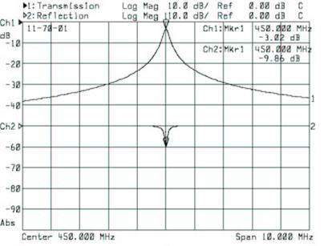
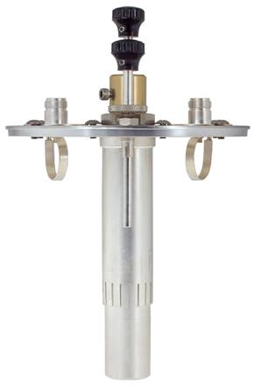
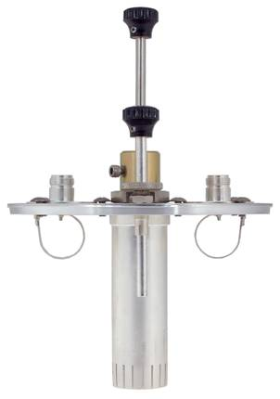
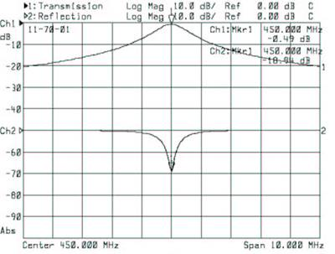
Coupling Loops
Source:
Information for developer:
Min coupling
Max loss (50%)
Max selectivity
Max coupling
Min loss (10%)
Min selectivity
The orientation of the loops with respect to the electro-magnetic field within the cavity will determine the cavities overall insertion loss and its’ selectivity.
When the loops are more perpendicular to the center line of the cavity, the coupling is reduced and the insertion loss in increased. This causes the cavity to have greater selectivity.
When the loops are parallel to the center line of the cavity, the coupling is maximized. This results in lower insertion loss but also lower selectivity. This is the trade off when using a band pass cavity, higher selectivity requires a higher insertion loss

Slide 98
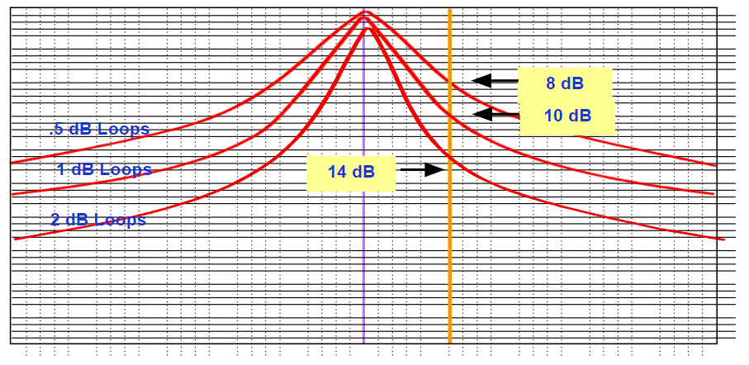
Band Pass Cavity
Source:
Information for developer:
In this example a band pass cavity that provides 8 dB of attenuation at a given frequency with 0.5 dB of insertion loss might provide 10 dB of loss at the same frequency when adjusted for 1 dB of loss and 14 dB if the loops are set to 2 dB of insertion loss.

Slide 99
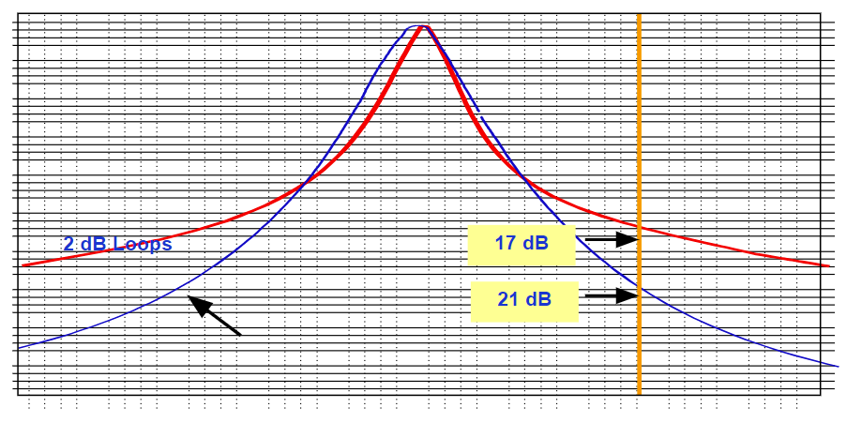
Band Pass Cavity
Source:
Information for developer:
If a single cavity will not provide the attenuation required, additional cavities can be added in series to improve selectivity. Another factor you should have noticed is that a multi-cavity combination is more efficient than a single cavity. For example, two cavities adjusted to 1 dB insertion loss each can provide over 5 dB-10 dB more selectivity than a single cavity adjusted to 2 dB insertion loss. In the example above the selectivity of a single cavity adjusted to 2 dB insertion loss is less than 17. Joining two filters together adjusted to 1 dB insertion loss each produces over 20 dB of attenuation at the same frequency and insertion loss.

Slide 100
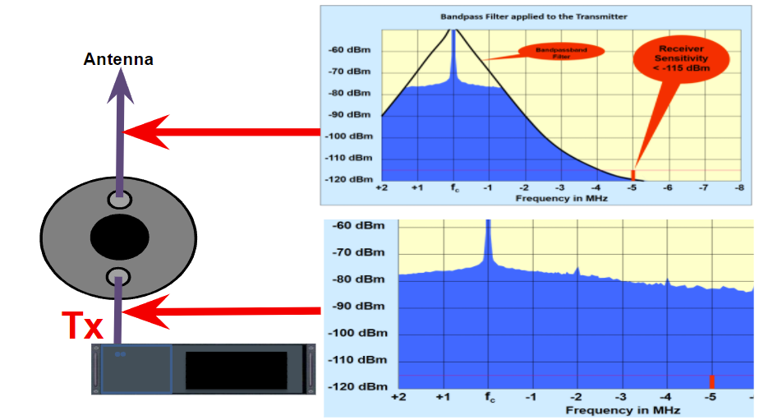
Band Pass Cavity
Source:
Information for developer:

Slide 101
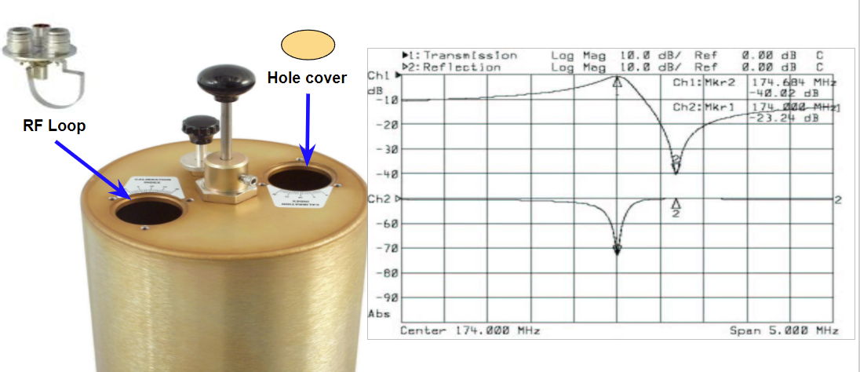
Pass/Reject Cavity
Source:
Information for developer:
Pass/Reject cavities are very popular for the construction of duplexers as it’s response curve will allow us to optimize the pass response on one frequency while optimizing the rejection on another frequency within the same cavity filter.
The frequency response curve of the Pass/Reject shows that the band pass characteristics are not as pronounced as a true band pass cavity but some off frequency attenuation is provided. In addition the notch depth is somewhat greater than a simple series notch, often exceeding 40 dB. The operation of the loop allows us to adjust the frequency of both the band pass and notch somewhat independently.

Slide 102
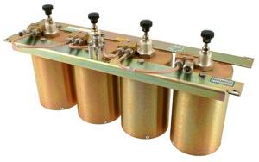
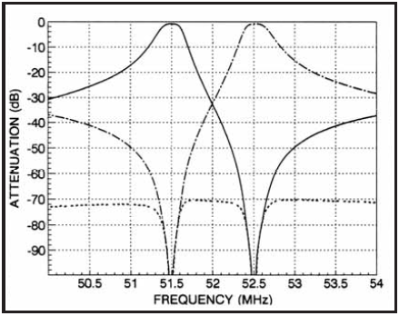
Pass/Reject Duplexer
Source:
Information for developer:
The most common duplexer is made up of between 2 and 6 Pass-Reject cavities. On one side they are tuned to pass the transmit frequency while rejecting the receiver’s frequency. This is primarily to protect the receiver from transmitter sideband noise. On the other side, the cavities are tuned to pass the receiver’s frequency and reject the transmitter’s frequency. This is to protect the receiver from the transmitters high power output. The high output from the transmitter would, at best, overload the receiver desensitizing it and in the worst case cause, actual damage. The isolation required must be sufficient to protect the receiver from the potential interfering transmitter and its’ sideband noise.
There other types of duplexers, some common configurations are: bandpass only, using cavities with only a bandpass response, and reject only using cavities with only a reject or notch response. The type of duplexer used will depend on the application and frequencies at the site.

Slide 103
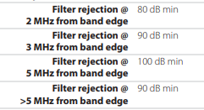
Duplexer Isolation
Source:
Information for developer:
60dB minimum rejection for Tx to Rx isolation for the duplexer
Need to look at the transmitter and receiver characteristics for single channel operation to determine isolation needed to reduce the transmitter sideband noise below the receiver's sensitivity
The more Tx to Rx rejection the better. The trade off is cost and insertion loss. There is a point of diminishing returns. Evaluating the Tx noise and the Rx selectivity (noise or interference rejection) will help determine how much rejection is needed. Typically 130dB is a good total rejection.

Slide 104
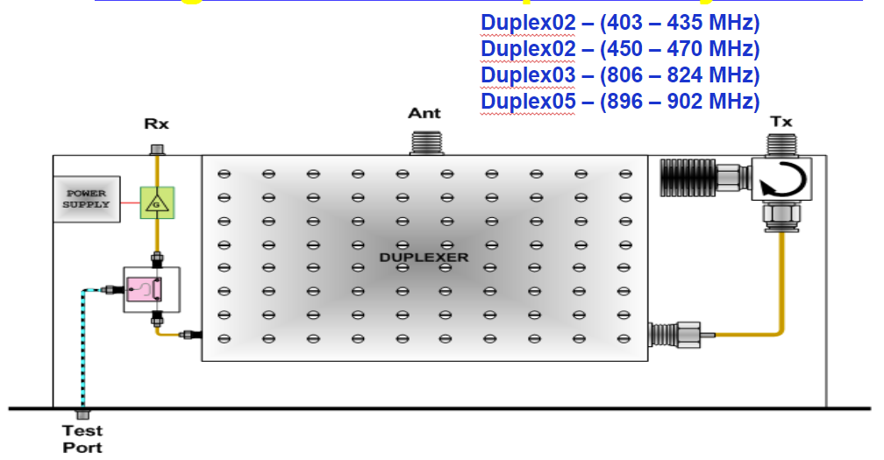
Single Channel Duplexer System
Source:
Information for developer:
Single Channel Duplex systems included not only the advanced duplexer but also an isolator in the transmit network and an amplifier in the receive network. A standard test port is provided for non-intrusive sensitivity testing and benchmarking. The amplifier and advanced filtering in the receive network allows significantly improved sensitivity. Depending on the environment the sensitivity improvement may be over 6 dB as compared with a standard duplexer.
Low Noise Amplifier
Isolators Standard
>80 db of selectivity
<5.5 db of insertion loss
Test port
PIM Tolerant
No Tx-Tx freq requirements

Slide 105
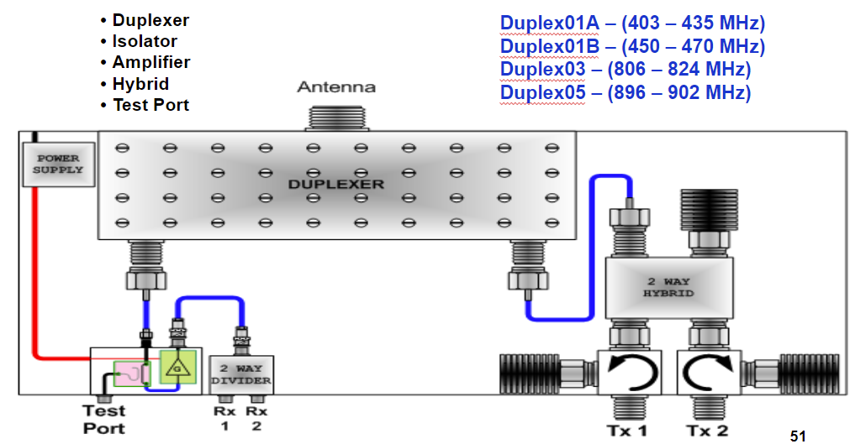
Two Channel Duplexer System
Source:
Information for developer:
Each Two channel Duplexer also includes transmit isolators to prevent transmit IM and protect each transmitter from high level carriers. This allows the Two channel Duplexer to be compatible with collocated transmitters or high density sites without concern of interference.
The Low Noise amplifier included will reduce the noise figure of the system by over 6 dB to allow maximum sensitivity. The amplifier is designed to provide the highest immunity to interference by utilizing a Quadrature design with very high 3rd order Intercept Point (3IP). A test port is included in each design to allow for testing without interfering with system operation.
Utilizing a 7-16 DIN connector on the antenna port as well as very high design requirements allows the Two channel Duplexer to be PIM tolerant.
Low Noise Amplifier
Isolators Standard
>80 db of selectivity
<5.5 db of insertion loss
Test port
PIM Tolerant
No Tx-Tx freq requirements

Slide 106
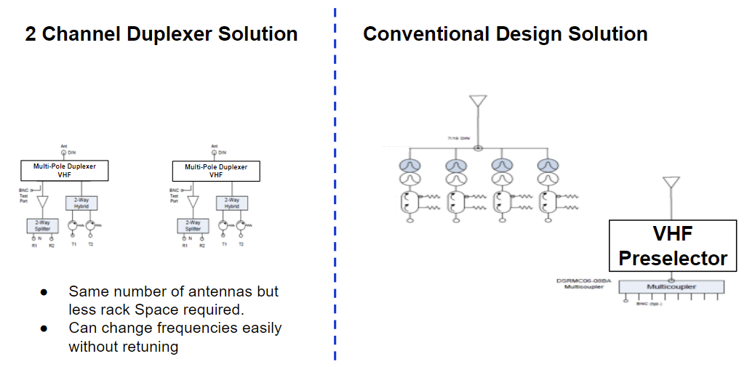
VHF (4 Frequency Solution)
Source:
Information for developer:
Utilizing a Two channel Duplexer allows the same two antennas required for a standard design but improves the flexibility of operation and racking. The Two Channel Duplexer will require less rack space.

Slide 107
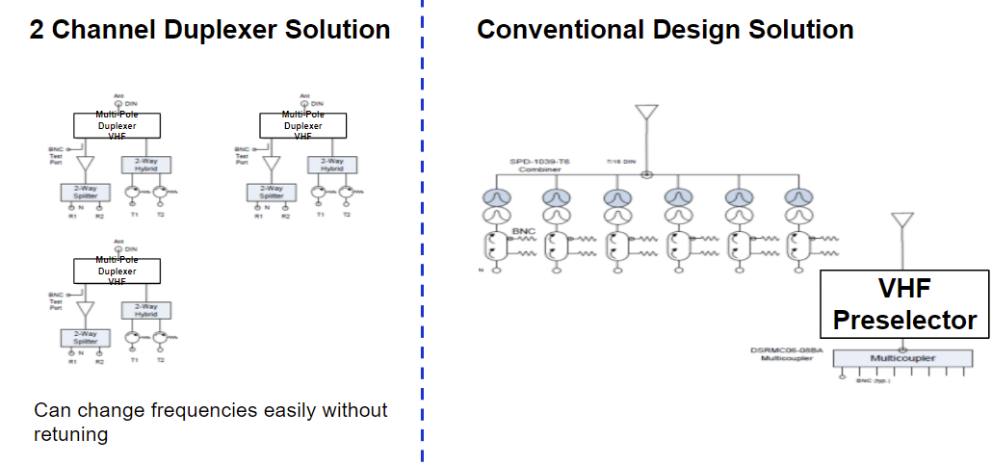
VHF (6 Frequency Solution)
Source:
Information for developer:
Multiple two channel duplexers can be used to replicate a complex custom design for VHF and UHF. The major advantage is the ability to change frequencies easily with no retuning required.

Slide 108
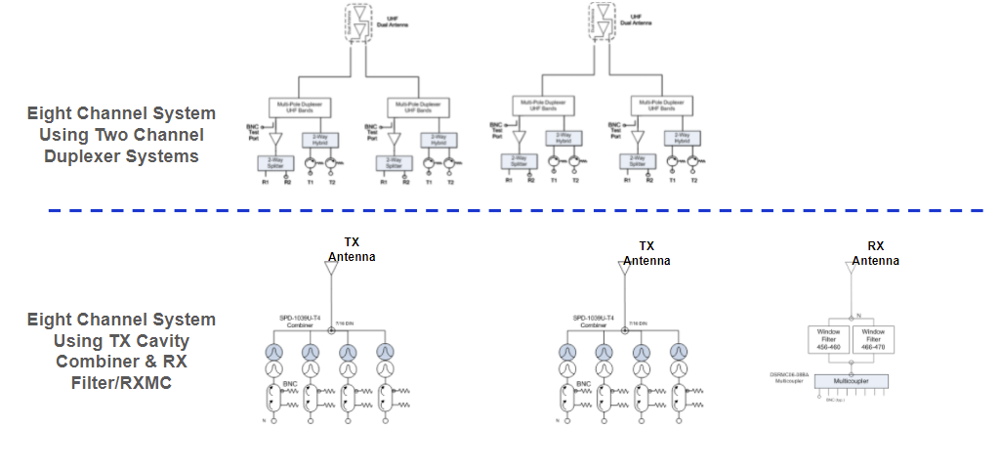
UHF (8 Frequency Example)
Source:
Information for developer:
When utilizing the Two Channel Duplexer for 8 channels you will need four antennas compared with three for a conventional design. These can be combined into a Dual or Triple antenna arrangement to reduce the actual number of physical antennas required.

Slide 109
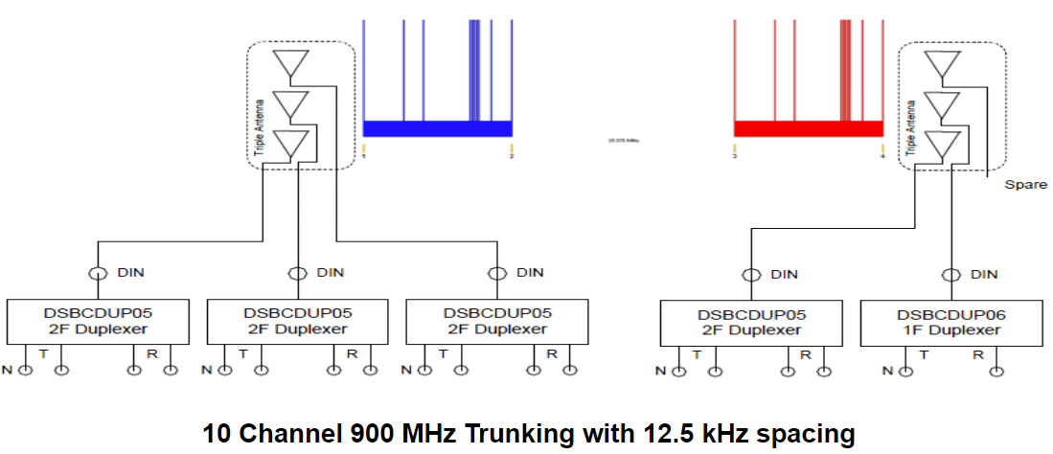
900 MHz (10 Channel Example)
Source:
Information for developer:
10 Channels of 900 MHz trunking that have transmitters as close as 12.5 kHz can be combined onto two physical antennas (Triple Element) with less than 5 dB insertion loss on the transmit and full sensitivity on the receive. This compares with previous designs that required over 11 dB of IL for the same number of physical antennas. Three dual antenna can also be used to allow higher gain and improve operation even more. Two channel duplexers do not have to be retuned if the frequencies are changed.

Slide 110
Filter and Duplexer Summary
Source:
Information for developer:
The Bandpass of a filter includes the IL of the filter
There are two distinct types of filters: Bandpass and Notch
There are two ways to improve the Q of a filter: Electrical Q and Mechanical Q
A pass/notch combines both a notch and pass to obtain aggressive filtering
A pass/notch duplexer should be used with a bandpass filter (when possible) when collocated with other transmitters at the site in the same band
Bandpass duplexers should be used whenever possible
Milled filters provide the best performance when the frequency plan allows
The Bandpass of a filter includes the IL of the filter – The electrical bandpass of a filter is measured at the 3 dB point but the absolute IL at the bandpass includes the IL of the filter also.
There are two distinct types of filters: Bandpass and Notch – Most filters will include characteristics of Bandpass and Notch to develop selectivity.
There are two ways to improve the Q of a filter: Electrical Q and Mechanical Q – The electrical Q is obtained by adjusting the loops and increases the IL of the filter. The Mechanical Q is obtained by design and using better conductivity and size of filters to obtain higher Q.
A pass/notch combines both a notch and pass to obtain aggressive filtering – To obtain very close selectivity a combination of Pass and Notch must be utilized. This allows the strategic location of notches to enhance selectivity.
A pass/notch duplexer should never be used when collocated with other transmitter in the same band – A Pass/Notch Duplexer is optimized for a single frequency and will not protect the receiver for other carriers collocated.
Milled filters provide the best performance when the frequency plan allows – Milled Filters are optimized for a specific bandpass and guardband. When these can be use the selectivity, IL, and cost are optimum.
Isolators are used to prevent External RF energy from entering a transmitter – Energy applied to a transmit antenna from other transmitters will feed back into a transmitter and create IM if isolators are not utilized.

Slide 111
Transmit Combiner
Source:
Information for developer:
Transmit Combiners are used to combiner two or more transmitters to a single antenna. It is important to understand the Tx – Tx separation required. In most cases the transmit frequencies used on a common transmitter combiner cannot be closer than 150 kHz on a single antenna but models exist that can be used at 100 kHz with some increase insertion loss. Improved insertion loss models can be ordered if the frequency plan of the combiner can be configured to conform to a Tx – Tx separation of 250 kHz within the combiner.
Point out that 2 combiners phased together make it a single combiner to a single Tx antenna and that the frequency spacing rule applies to all channels on the Tx antenna.

Slide 112
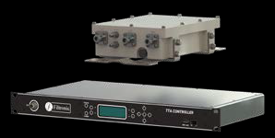
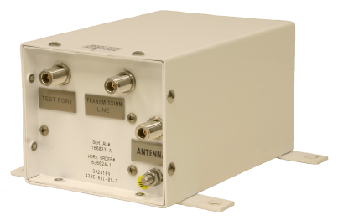
Tower Top (Tower Mounted) Amplifier Design
Source:
Information for developer:

Slide 113
Filter Design
Source:
Information for developer:
TnRd is not adequate for Multi-carrier systems – Numbers used for duplex systems not Multi-Carrier designs
Selectivity design – Definition of the selectivity used must focus on closest spacing of Tx and Rx
Multiple guardbands require multiple components– When multiple guardbands are used, multiple applications of selectivity requirements are needed, resulting in more cost and space.
Always consider the Worst Case situation – For Public Safety it is important to consider the Worst Case situation when all transmitters are active and every channel is being used. This would model an EMERGENCY or Mission Critical situation.
TnRd is not adequate for Multi-carrier systems
In the past RF Conditioning equipment was designed using TnRd (Transmitter Noise Receiver desense). These numbers were defined decades ago by manufacturers to help design duplexers for a single transmitter and receiver combination. Today with multiple transmitters and receivers combined into a single network the isolation required cannot be focused on a single receive/transmit pair. The minimum isolation or selectivity provided is based on the closest transmit/receive separation. The separation between the closest transmit/receive separation is called guardband. When multiple guardbands exist due to complex frequency plans, each band must have the required isolation provided. 45-45-65 is the standard isolation MSI requires for each guardband. We consider this the worst case situation. Other frequencies within the guardband may have more than this isolation but all frequencies will have a minimum of 45-45-65 isolation

Slide 114
Site Design
Source:
Information for developer:
Evaluate all transmitters that are in-band and all high-level carriers in the RF Design
Always use solid shielded cable on high-level multicarrier transmission networks like the output of the Tx combiner.
Always use 4.3-10 or 7-16 DIN connectors on the multicarrier side of the Transmit combiner
For UHF and VHF systems avoid using more than 6 Transmit channels within the same antenna and combiner.
For 700/800 MHz keep the number of channels below 12 within the same antenna and combiner to prevent PIP issues and the risk of IM.
All transmitters on site that are within the same frequency band should be evaluated for IM and RF filtering . Other RF carriers can interfere with a receiver without being connected to the antenna. High level transmitters on other tower and other locations on the tower can cause IM and interfere with operation. It is important to understand all high-level carriers and transmitters on site.
RF Cable has a degree of leakage and can radiate RF Energy. To protect the site and provide maximum immunity to interference all cables on the multicarrier side of combiners should use solid shielded cable such as Helix. Flexible cable such as braided cable and Superflex should be avoid to ensure maximum site protection and isolation.
N-Type connectors can produce PIM and do not provide the interference stability required on the output of combiners. 7-16 DIN connectors should always be used on high-level (> +10 dBm) distribution networks such as transmitter cables to antennas. 7-16 DIN connectors have very stable PIM characteristics even after they have been disconnected and re-connected numerous times.
Combining more than 6 VHF or UHF high-power transmitters (> +10 dBm) can cause unstable operation when all transmitters become active simultaneously. This interaction can cause not only interference to the associated receivers but also to any in-band receiver on site. Above 6 channels the risk increases exponentially. The only way to reduce this risk is to keep the number of transmitters below 6 or significantly reduce the power per channel.
Combining more than 12 700/800 MHz transmitters is risky because of Peak Instantaneous Power (PIP) and PIM. The antennas specified for TDMA operation are designed to accept PIP up to 12 channel combining. Beyond this point the antennas and RF Distribution components may be limited and can cause operation al problems.

Slide 115
Duplex Design
Source:
Information for developer:
1-channel and 2-channel duplex systems should be used as the first choice for duplexing because of their component size, filtering provided, PIM tolerance, and low cost.
When more than two channels require Duplexing, consideration should be given to utilizing more than one 2-channel duplex system. A standard Transmit combiner and receive multicoupler utilizes two antennas. Using more than one 2-channel duplex system will also require only two antennas for up to 4 channels of operation.
When multiple antennas are required and space is a consideration, use dual and triple collinear antennas.
Multicarrier (> 2 channels) High Level Duplexing (Power ratings over +10 dBm or 10 mWatt per carrier) should not be done
Multicarrier Duplexing for DAS should only be done at low levels (<0 dBm or 1mWatt).
Duplex systems differ from standard duplexing in that the unit contains the complete system and is designed with Bandpass filters. Duplex systems provide the best filtering, receive sensitivity, and IM protection. The Duplex systems will also accommodate any frequency within the bandwidth without tuning.
When two or more channels require duplexing the use of multiple duplex systems allows all of the frequencies to be combined without complex RF Distribution designs. Simply by using multiple network the design can accommodate 2, 4, or higher in 2 channel increments.
When multiple networks are used the use of multiple element radomes (Dual, and Triple) will simplify the antenna mounting and loading. Dual antennas provide two antennas within a single collinear radome and has antenna isolation between the elements. This is a perfect consideration when multiple antennas are needed but space, loading, and isolation are not available.
Duplexing more than two carriers should be avoided at full power. The IM risk is extreme because of the lack of antenna isolation. IM can and will occur when all of the transmitters are active and can cause severe degradation to the system receive frequencies and others on site.
In some cases multicarrier duplexing beyond two channels is required for Distributed Antenna Systems (DAS). In this design it is important to reduce the power to below 0 dBm before duplexing. This can be done with directional couplers or inline power attenuators. After duplexing the levels can be regulated and amplified for distribution.

Slide 116
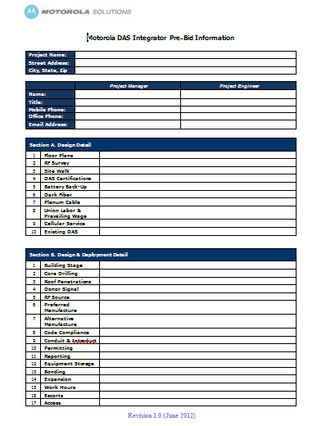
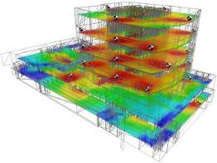
Design Process
Source:
Information for developer:
The deployment begins by contacting the facilitator and making them aware of the need. At that time they will become the point in getting the project proposed, designed, and implemented after award. There are no costs associated with requests and no costs until award is provided. All costs and resources are the responsibility of the facilitator.

Slide 117
DAS Design- What is Needed to Get Started?
Source:
Information for developer:
Frequency band and number of channels needed
Donor (Macro) signal strength outside the building
Donor (Macro) signal strength inside the building (requires site walk)
Building characteristics
Size
Interior wall materials
Areas needing coverage
Floor plans

Slide 118
Pre-Sale
Source:
Information for developer:
Site Survey
Donor Signal Assessment – measure strength (RSSI) & quality (Ec/Io, C/I, SQE) of donor signal(s) to determine ideal RF donor sites
Spectrum Snapshots – identify potential interference and noise floor design considerations
In-Building Transmitter Tests (When Warranted) – analyze complex RF environment path losses using Praxsym transmitters and Anritsu spectrum analyzers or actual system radiation
Installation Considerations & Pictures – document key equipment locations, installation concerns, and notes directly on the building floor plans for easy reference and design translation
Code & Safety Documentation – maintain client, industry & government safety regulations
Scope Confirmation – confirm end user expectations match customer scope
While the Site Survey is very important it is up to the facilitator whether it is performed. If the facilitator feels they have enough information without a site survey then it may not be performed. It is totally optional at the facilitator’ discretion. Normally the most important information obtained in the Site Survey is the penetration of the outside host signal. This is critical in complex modulation communication such as Astro Phase 2.

Slide 119
Information for developer:
Module 4
Network Requirements

Slide 120
Module 4 Objectives
State the Objectives
At the end of this module, you should be able to:
Identify the networking equipment requirements for A Capacity MAX system.
Describe deploying Capacity MAX on a Virtual Private Network (VPN).
Describe deploying Capacity MAX without VPN and using a Customized IP Plan.
Identify networking considerations that are common to deployments with and without a VPN.

Slide 121
Course Structure
Provide the modules for the course
Course Introduction
Module 1: Capacity Max Review
Module 2: System Planning Consideration and Design
Module 3: Frequency Planning and RFDS
Module 4: Network Requirements
Module 5: RM Planning
Module 6: Dispatcher Solution
Module 7: Workshop (Design a system)

Slide 122
Module Map / Module Outline
Provide the sections for this module
Section 1: Deploy Capacity MAX with a VPN.
Section 2: Deploy Capacity MAX without a VPN and using a Customized IP Plan.
Section 3: Network Considerations Common to all Capacity MAX Deployments

Slide 123
What is an IP Plan?
Source:
Information for developer:
An IP plan is a document, sometimes requiring assistance from network engineers, to show how the IP addresses will be distributed among the radio network devices based on the network architecture or topology.
As there is a number of different ways to deploy MOTOTRBOTM Capacity Max systems, the IP plans for the different types of systems will also vary. This module will review the key considerations on how to determine the correct IP plan for your Capacity Max system.

Slide 124
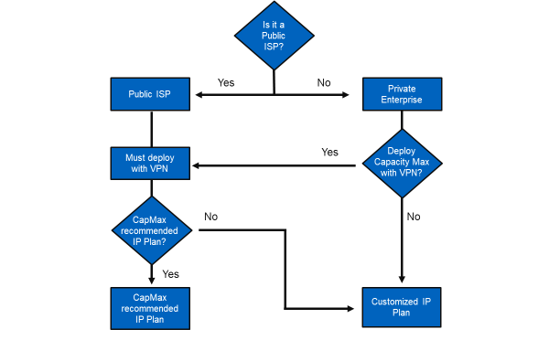
Determine IP Plan
Source:
Information for developer:
Explain to learners that Motorola Solutions expects most Capacity Max systems will be deployed over a public ISP. It is also assumed that most systems that use VPN tunnels will use the Capacity Max recommended IP plan. This course will teach you how to deploy a Capacity Max system under these assumptions.
Emphasize to learners the options that they have with respect to switches and routers. For example, they have the option of using Motorola Solutions ’s recommended routers and switches along with the Configuration Files or they can bring their own equipment and own customized configuration files. They also have the option of using our recommended routers and switches and creating their own customized Configuration files.
Explain that a VPN is sometimes called a “tunnel.” IPsec is a specific type of VPN that adds security features to the VPN. GRE is also a type of VPN that does not have security.
Instruct the learners to download the most recent version of the Capacity Max Installation and Configuration Manual. Next, using the manual, spend some time explaining the IP address scheme on the whiteboard.

Slide 125
Information for developer:
Section 1
Deploy Capacity MAX with a VPN

Slide 126
Virtual Private Networks (VPN)
Source:
Information for developer:
A virtual private network (VPN) extends a private network across a public network, such as the Internet.
In Capacity Max this VPN is called the “Overlay Network”.
It’s not a truly “private” network (thus, the term “virtual”), but provides a private LAN experience for the hosts on the network.
Provides high levels of security.
Traffic is encapsulated by secure tunnels created between the routers.
Traffic may be encrypted.
Detection of attempts to intercept traffic.
Individual hosts (repeaters, PCs) are unaware that the network is not actually private.
Requires the use of compatible secure routers at each end of the network.
Note: The main objective is to build a full mesh of VPN tunnels between all sites.

Slide 127
Capacity MAX Network Topology: Underlay and Overlay Networks (1/2)
Source:
Information for developer:
Two Networks: Physical, or “Underlay Network” and VPN, or “Overlay Network.”
Underlay Network:
The actual IP links and the addressing scheme between physical router interfaces comprise the “underlay” network. The actual IP addresses of the underlay network are assigned by the network provider, not Motorola Solutions. If they are provided by an Internet Service Provider, these IP addresses are routable.
At least one router at one of the sites must have a static IP address (Motorola Solutions suggests physical location 1).
For higher availability from a networking perspective, a second site router should also have a static IP address (Motorola Solutions suggests physical location 2).
Explain to participants that VPN (Virtual Private Network) is the same as Tunneling. System Planner uses the term tunneling.
The Dealer/Technician must set-up the Cap Max network as a VPN. Other MOTOTRBO system have mostly used NAT (Network Address Translation) routers. VPNs simplify remote access to sites which makes maintaining a system easier.
We recommend at least GRE (Generic Routing Encapsulation) tunneling for all Cap Max deployments.
We would recommend GRE w/ IPsec ESP for deployments using a public ISP.
Private enterprise may consider No Tunneling, but use of our recommended IP plan is not guaranteed (may require modification).
For higher availability from a networking perspective, a second physical location should have a static IP address ( Motorola Solutions suggests physical location 2). Beyond that the Dealer doesn’t have to worry about tunneling.

Slide 128
Capacity MAX Network Topology: Underlay and Overlay Networks (2/2)
Source:
Information for developer:
Overlay Network:
A Virtual Private Network (VPN) overlay utilizing the Physical Network. This is a tunneled scheme that is built “on top of” the underlay network.
The overlay network uses its own IP space. Typically using IP addresses from RFC1918 specification for Private IP Spaces. The creator of the overlay (Motorola Solutions or the customer, in this case) assigns IP addresses to hosts within the overlay network.
Explain to participants that VPN (Virtual Private Network) is the same as Tunneling. System Planner uses the term tunneling.
The Dealer/Technician must set-up the Cap Max network as a VPN. Other MOTOTRBO system have mostly used NAT (Network Address Translation) routers. VPNs simplify remote access to sites which makes maintaining a system easier.
We recommend at least GRE (Generic Routing Encapsulation) tunneling for all Cap Max deployments
We would recommend GRE w/ IPsec ESP for deployments using a public ISP
Private enterprise may consider No Tunneling, but use of our recommended IP plan is not guaranteed (may require modification)
For higher availability from a networking perspective, a second physical location should have a static IP address ( Motorola Solutions suggests physical location 2). Beyond that the Dealer doesn’t have to worry about tunneling.

Slide 129
GRE Tunneling (Overlay Network)
Source:
Information for developer:
Get graphic from PPT.
Customers may provide their own switch and router (for example Juniper), however, in this class we will exclusively work with the Motorola Solutions recommended equipment. For networking information on other vendor switch and routers, refer to the System Planner.
The case shown is an IP address for the repeater and an IP address for payload role (Data Revert Channel, or Payload Channel),
Discuss the physical interfaces and the tunnel interfaces. Discuss the need for the Static Routes to direct the desired traffic to the Tunnel Interfaces. May also discuss the concept of encapsulation in general, and the fact that the GRE tunnel can be further encapsulated into other tunnels such as IPSEC.

Slide 130
Features of Note for Motorola-Solutions-Recommended Equipment
Source:
Information for developer:
Previous slide shows a VPN where all VPN tunnels are statically created by the system programmer.
Note: For ADVPN – Since HPE only supports up to 2 ADVPN hub routers in a system, the trunking controllers must reside at no more than 2 physical locations. Cisco supports more than 2 Hubs.
When greater than 100 sites, the ADVPN hub router(s) must be HPE MSR3012.
A Capacity Max system requires at least 1 Trunking Controller, and can have a maximum of 5.
When deployed in a private network the system supports up to four alternate Trunking Controllers. Alternate Trunking Controllers may be placed at up to four different physical locations, different than the location of the primary Trunking Controller.
When deployed using the dynamic VPN protocol, all Trunking Controllers should reside at physical locations with hub routers. Spoke site with Trunking Controller will require WAN connection with at least the same bandwidth like hub site, when this Trunking Controller becomes the active Trunking Controller.
For more information on ADVPN, refer to the Capacity Max System Planner or HPE Documentation.

Slide 131
Juniper Auto Discovery ADVPN
Source:
Information for developer:
Auto Discovery Virtual Private Network (ADVPN) Hub-to-Spoke Functionality for Juniper
ADVPN is a technology that allows the Hub site router to dynamically inform Spoke site routers about a better path for traffic between two Spokes when using Juniper networking equipment.
ADVPN allows for :
Simple and small configuration in central router to connect many remote sites.
No need to reconfigure central router in case of remote site adding.
One template configuration for remote site router.
Separate IP network for CapMax system with own IP plan.
Central site router do not need to handle 100% of remote sites bandwidth.
Less overhead of routing protocol traffic in the network vs static mesh tunnels configuration.

Slide 132
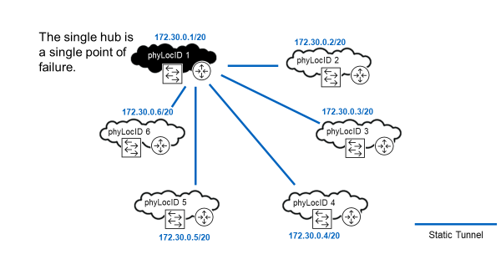
ADVPN - Single Hub Router
Source:
Information for developer:
Get graphic from PPT.
Possibly remind students what a /20 subnet is.
Site 1 is a single point of failure for the overlay network. Sites 2-6 cannot discover each other without the assistance of the router at site 1 because dynamic WAN IP addresses are used at sites 2-6.
A Capacity Max network assumes that physical location 1 has a statically allocated IP address in the underlay network and therefore physical location 1 provides a hub router for the Capacity Plus network. A static IP address is needed at least at one site.
The hub router is a single point of failure for the initial creation of the overlay network; therefore, it is recommended to additionally request a static WAN IP address for physical location 2 from the ISP provider and config the router at physical location 2 as an alternate hub router.

Slide 133
ADVPN - Dual Hub Routers: Higher Availability
Source:
Information for developer:
Get graphic from PPT.
Explain to student that:
172.30.0.phyLocID is used to configure VPN tunnels between physical locations.
172.30.16.phyLocId is the router's loopback address which is used for remote login and SNMP trap reporting.
Highlight that both sites 1 and 2 use static WAN IP addresses
Sites 1 and 2 provide redundancy for the overlay network.
When site 1 is unreachable, site 2 takes over the role of hub
If more than two hubs are desired, use Cisco. Cisco supports more than 2 hubs. Sites 1 and 2 provide redundancy for the overlay network. When site 1 is unreachable, site 2 takes over the role of hub. Highlight that both sites 1 and 2 use static WAN IP addresses.

Slide 134
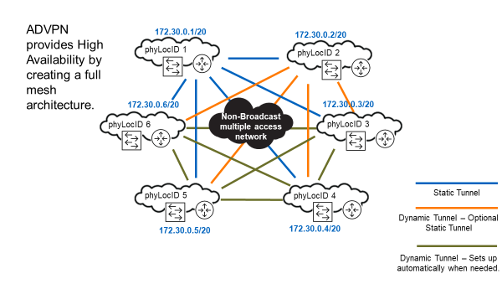
ADVPN - Two Hub Routers Utilizing DMVPN (ADVPN): High Availability
Source:
Information for developer:
Get graphic from PPT.
Dynamic Tunneling Enables Routers to Build Full Mesh of Tunnels AUTOMATICALLY. Alternatively, the “Full Mesh” could be created MANUALLY with static tunnels.
Point out that trunk traffic payload (e.g., voice and data) flows through a tunnel from the source site directly to the destination site – this is decentralized audio distribution. The main advantage is that it is not necessary to have a centralized site process all the audio for the system (high link BW would be required and the site router would need to be capable of handling all that traffic).
Note that 1 Hub and dynamic tunnels are possible (normal availability) and 2 Hub and dynamic tunnels gives the higher availability.
Point out that trunk traffic payload (e.g., voice and data) flows through a tunnel from the source site directly to the destination site - this is decentralized audio distribution. The main advantage is that it is not necessary to have a centralized site process all the audio for the system (high link BW would be required and the site router would need to be capable of handling all that traffic).
Note that the dynamic tunnels are setup as needed "on demand" and remain up for a "long" time (subject to a configurable tunnel inactivity timer"). “Long" is manufacturer dependent, but can be around 1 day or more.

Slide 135
IPv6 Tunneling
Source:
Information for developer:
If customer is using IPv6 tunneling, Internet access from Capacity Max system for external services, for example License server, is possible, but HUB router will need IPv4 WAN IP address as well since the license server does not support IPv6 communication.

Slide 136
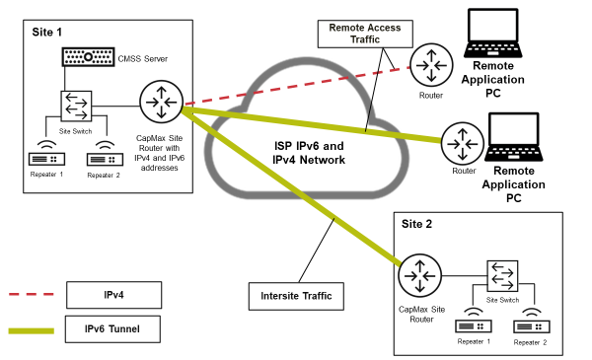
Remote Access Traffic (IPv6 Tunneling)
Source:
Information for developer:
Remote Application in diagram refers to applications such as:
System Advisor Client
Battery Management Client
WAVE Access

Slide 137
Information for developer:
Section 2
Deploy Capacity MAX Without a VPN and Using a Customized IP Plan

Slide 138
Using Custom IP Plans with Capacity MAX Systems (1/4)
Source:
Information for developer:
This slide and the next summarize the rules that a knowledgeable IT professional needs to follow when deploying a Cap Max system on an enterprise network.
The word “require” means that a particular Capacity Max system deployment shall comply (i.e., is compelled to comply, or is obliged to comply) with the described technical item or constraint. Failing to comply with a required item results in a non-functional system and Motorola Solutions assumes no responsibility for supporting the non-compliant system deployment.
Explain:
Motorola-Solutions -provided Capacity Max equipment does not make use of IP multicast; therefore IP multicast need not be supported by the network. However, products provided by third parties may require IP multicast, so third party documentation should be reviewed to determine their networking requirements.

Slide 139
Using Custom IP Plans with Capacity MAX Systems (2/4)
Source:
Information for developer:
This slide and the next summarize the rules that a knowledgeable IT professional needs to follow when deploying a Cap Max system on an enterprise network.
The word “require” means that a particular Capacity Max system deployment shall comply (i.e., is compelled to comply, or is obliged to comply) with the described technical item or constraint. Failing to comply with a required item results in a non-functional system and Motorola Solutions assumes no responsibility for supporting the non-compliant system deployment.
Explain:
Motorola Solutions -provided Capacity Max equipment does not make use of IP multicast; therefore IP multicast need not be supported by the network. However, products provided by third parties may require IP multicast, so third party documentation should be reviewed to determine their networking requirements.

Slide 140
Using Custom IP Plans with Capacity MAX Systems (3/4)
Source:
Information for developer:
The word “recommend” means that a particular Capacity Max system deployment should attempt to comply with the described technical item or constraint; however, deviation from a recommended technical item is permitted to the extent that the network designer understands the reason for the deviation and is able to provide an alternate design that works sufficiently well. Because the number of possible deviations is very large, Motorola Solutions does not verify or test deviations from recommended technical items.

Slide 141
Using Custom IP Plans with Capacity MAX Systems (4/4)
Source:
Information for developer:
The word “recommend” means that a particular Capacity Max system deployment should attempt to comply with the described technical item or constraint; however, deviation from a recommended technical item is permitted to the extent that the network designer understands the reason for the deviation and is able to provide an alternate design that works sufficiently well. Because the number of possible deviations is very large, Motorola Solutions does not verify or test deviations from recommended technical items.

Slide 142
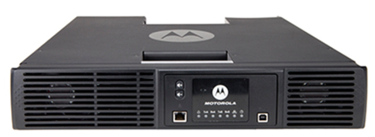
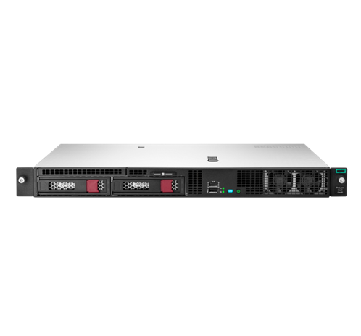
Repeater and CMSS Host IP Addresses - Example
Source:
Information for developer:
Repeater Site subnet
Subnet Address = 10.0.1.0/25
Default Gateway = 10.0.1.1
Site Base IP Address = 10.0.1.8 and derived IP addresses:
Intermediary Agent = 10.0.1.9
Control Channel Manager = 10.0.1.10
Reserved for system use = 10.0.1.11 – 10.0.1.23
Reserved for network device = 10.0.1.24 – 10.0.1.31
21 Primary Repeaters = 10.0.1.32 – 10.0.1.94
CMSS subnet
Subnet Address = 10.100.0.0/26
Default Gateway = 10.100.0.1
CMSS IP Address = 10.100.0.8 and derived IP addresses :
Trunking Controller = 10.100.0.9
Reserved for ESXi= 10.100.0.10
Enhanced Software Update (ESU) = 10.100.0.11
MNIS Voice and Radio Command Gateway = 10.100.0.12
System Advisor = 10.100.0.13
Reserved = 10.100.0.14 – 10.100.0.23
This is an important concept to explain especially for enterprise deployments.
Explain. Motorola Solutions recognizes that some IT organizations prefer to locate their default gateways (i.e., routers) at “subnet address +1”. Capacity Max supports this common IT policy by allowing the repeater site base IP address or CMSS IP address to be different from the allocated subnet address.

Slide 143
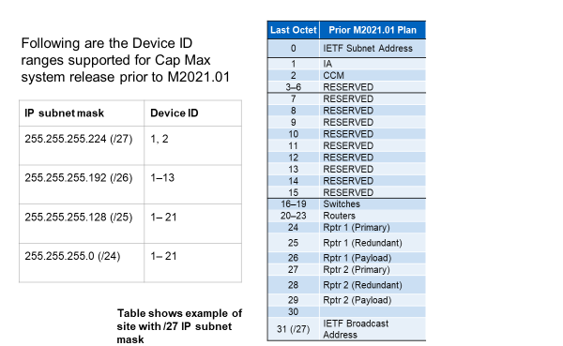
Repeater Device ID and IP Addressing Prior M2021.01
Source:
Information for developer:

Slide 144
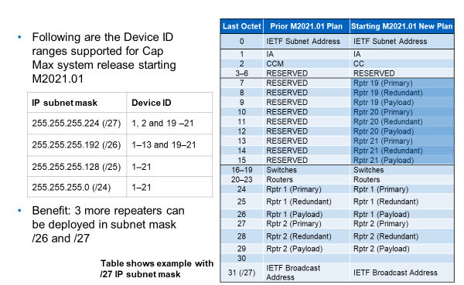
Repeater Device ID and IP Addressing Starting M2021.01
Source:
Information for developer:

Slide 145
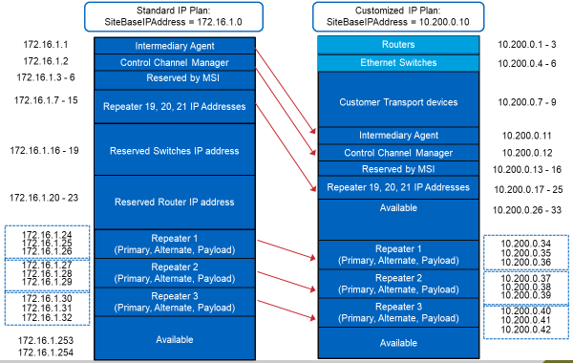
Customized IP Plan for Repeater Site - Example
Source:
Information for developer:
Get graphic from PPT.
Some customers’ IT Departments prefer to locate network routers and switches at the LOWEST IP addresses in a subnet. Capacity Max accommodates this (for repeater sites) by setting the siteBaseIPAddress to be different from the subnet address. The recommended IP plan is shown on the left. The customized IP plan is shown on the right, where the first 10 IP addresses in the subnet are available for the customer’s routers and switches.
Some customers’ IT Departments prefer to locate network routers and switches at the HIGHEST IP addresses in a subnet. Capacity Max accommodates this (for repeater sites) with the recommended IP plan. The switch and router can simply be moved to 10.200.0.253 and 10.200.0.254 of this /24 subnet (not shown).
Note also that a customized IP plan could relocate the repeaters into an entirely different IP space, such as 10.200.0.0/24 or 192.168.20.0/24. The size of the subnet can even be changed, if desired.

Slide 146
Information for developer:
Section 3
Network Considerations Common to All Capacity Max Deployments

Slide 147
Virtual Local Area Network (VLAN) (1/2)
Source:
Information for developer:
Routers are used to partition a network into broadcast domains (i.e. subnets).
VLANs are used to partition a physical switch to support multiple independent logical (or virtual) switches.
Normally, a switch in its default configuration contains a single, default VLAN.
All devices plugged into the switch are part of the same Broadcast Domain and belong to the same subnet.
If a site has ONLY repeaters or ONLY one CMSS or ONLY one MNIS Data Gateway, VLANs are not absolutely necessary (and a managed switch isn't necessary). But, the default/recommended IP plan assumes that co-located equipment is likely and we recommend VLAN
The same functionality can be achieved without VLAN technology, but one would require a separate router/switch pair for EVERY subnet at a physical location. So, VLAN saves a lot of money on equipment cost and in general simplifies the network in terms of minimizing box count – fewer devices to configure, install, and maintain.

Slide 148
Virtual Local Area Network (VLAN) (2/2)
Source:
Information for developer:
Capacity Max requires that the site switches are configured with specific VLANs:
Tagged and Untagged packets
Switch ports can be configured to either Tag packets with the VLAN ID, or leave them Untagged.
Untagged packets do not say which VLAN ID they belong with.
A physical port is configured to belong to a single VLAN and the packets are not tagged with a VLAN ID. A port can be an untagged member of only one Port-Based VLAN. The ports you’ll plug the Capacity Max devices into will be Untagged.
Tagged packets do identify the VLAN they belong to.
The connection between the router and the switch is TRUNKED and carries traffic for multiple VLANs, so the packets are tagged so that their VLAN may be identified.
The switch receives the tagged traffic from the trunk port and sends the traffic to the appropriate switch interface (and vice versa).
Tagging/untagging is configurable. The physical interface is configured to belong to a single VLAN and the packets are not tagged with a VLAN ID.

Slide 149
Networks of a Capacity MAX System
Source:
Information for developer:
The Capacity Max network is comprises three networks which serve to isolate and manage different types of network traffic.
Radio Network is comprised of your repeaters, switches, routers, etc at the site.
Gateway Network is comprised of the CMSS and its switch and router.
MNIS Data and VRC Gateway are part of the Gateway Network but not covered in this class.
External Network will not be covered in this class.
Note: the Radio Network and the application network cannot talk to each other. This is done for security reasons through our default configurations. Not obligated to do this but if Dealer does not follow our recommendation, it does make troubleshooting a network more difficult.
NAPT (Network Address Port Translations) – If you use our default configurations.
The radio infrastructure network has all access blocked going to and from the public internet gateway network and Application Network – allow PCs to access the public internet.

Slide 150
Network to Subnet Mapping (1/2)
Source:
Information for developer:
Primary and redundant VRC gateway must use the SAME site ID.
Primary and redundant RC Gateway must use DIFFERENT subnets.
Explain to participants:
A physical location ID (mnemonic phyLocID) is defined and set equal to the lowest valued siteID used at a physical location. If the physical location has no Repeaters, MNIS VRC Gateways, or MNIS Data Gateways present (i.e., there is no siteID at the location), then the Physical Location ID may be set to any unique value in the range 1 ≤ phyLocID ≤ 255.
However, be advised that Repeaters, MNIS VRC Gateways, and MNIS Data Gateways must use a site ID in the range 1 ≤siteID ≤ 40, so physical locations that are likely to never have these devices present (including a CMSS with no VRC Gateway) will preferably select a physical location ID the range 41 ≤ phyLocID ≤ 255. The ID range for redundant VRC is 41<=siteId+5<=46.
There are a couple of special situation relating to the CMSS. When a CMSS has no MNIS VRC Gateway license (i.e., it has only Trunking Controller and/or System Advisor licenses), it does not have a siteID and is therefore not covered by the table above.

Slide 151
Network to Subnet Mapping (2/2)
Source:
Information for developer:
The table above describes an IP plan for CMSSs that do not have a VRC GW license. In these cases, a quasiSiteID is conceptually allocated to each CMSS for the purposes of defining and implementing an IP plan, but the quasiSiteID is not actually provisioned into the CMSS.

Slide 152
VLANS Single Site with Colocated Redundant CMSS Example
Source:
Information for developer:
A physical location ID (mnemonic phyLocID) is defined and set equal to the lowest valued siteID used at a physical location. If the physical location has no Repeaters, MNIS VRC Gateways, or MNIS Data Gateways present (i.e., there is no siteID at the location), then the Physical Location ID may be set to any unique value in the range 1 ≤ phyLocID ≤ 255; however, be advised that Repeaters, MNIS VRC Gateways, and MNIS Data Gateways must use a site ID in the range 1 ≤siteID ≤ 40, so physical locations that are likely to never have these devices present (including a CMSS with no VRC Gateway) will preferably select a physical location ID the range 41 ≤ phyLocID ≤ 255.

Slide 153
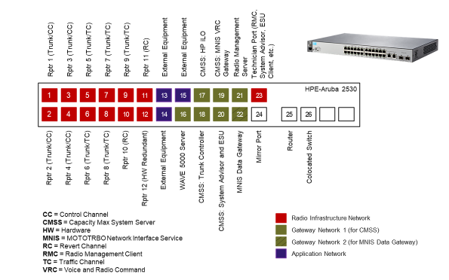
Content Slide Title
Source:
Information for developer:
Grab from current PPT.
Emphasize once again that the customer can either use our switch or not use our switch. If they use our switch, they can either use the default/recommended configuration or they can create their own config. Please highlight this flexibility. Also explain that in the classroom, the HPE-Aruba Switch is the one they’ll be working on.
Note that the System Installation module has diagrams for HP and CISCO switches. Refer to documentation for updated information.

Slide 154
Juniper EX2300 Switch Layout
Source:
Information for developer:
Grab from current PPT.
Emphasize once again that the customer can either use our switch or not use our switch. If they use our switch, they can either use the default/recommended configuration or they can create their own config. Please highlight this flexibility. Also explain that in the classroom, the HPE-Aruba Switch is the one they’ll be working on.
Note that the System Installation module has diagrams for HP and CISCO switches. Refer to documentation for updated information.

Slide 155
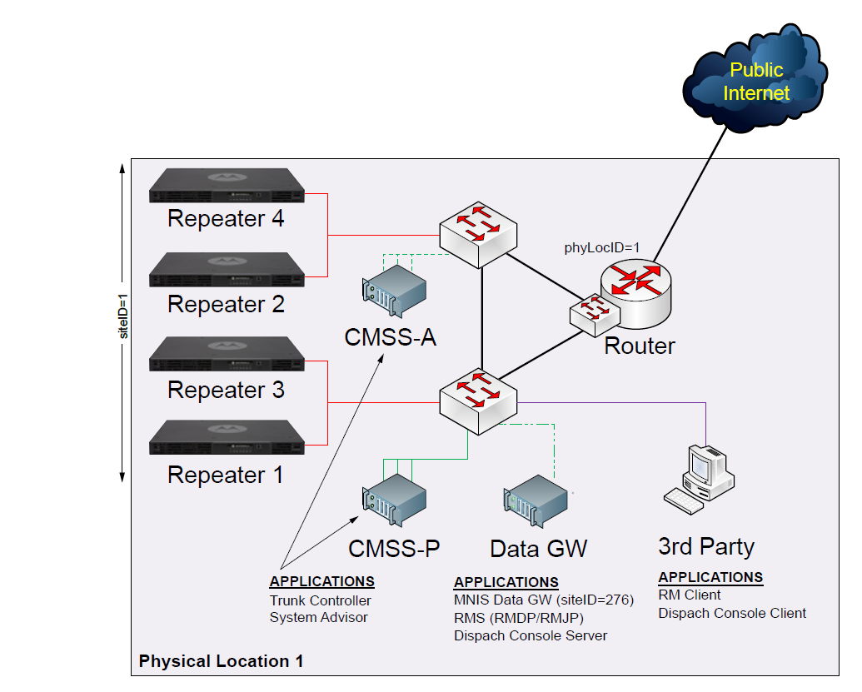
Switch Redundancy Consideration
Additional switch on the site can be considered to support :
Additional LAN ports required for Application, repeaters etc
Co-located CMSS server deployed

Slide 156
SRX Router Redundancy –Chassis Cluster Configuration
The Junos OS provides high availability on SRX Series devices by using chassis clustering.
Motorola Solutions recommends chassis cluster configuration with at minimum SRX345 Services Gateway hardware.

Slide 157
Network Topologies in Capacity Max
The system planner, installation document and the transport network templates covers the following types of network topologies:
Single Site Topology
Multi-Site Topology
- Topology without Tunnels
- Topology with Static Tunnels
- Topology with Dynamic Tunnels – ADVPN
Note : Juniper SRX implementation of ADVPN protocol requires PKI (Private Key Infrastructure) for Identity
Management. Because of this requirement, before each SRX router can set up a VPN tunnel with any
other SRX in the system, it must be equipped with a private certificate signed by the same CA. This
is a crucial point of creating the transport network infrastructure for any Capacity Max system when
ADVPN is in use.
MSI provides Certificate Authority (CA) server and this need to be setup on a PC to generate certificates for Juniper devices for ADVPN function.

Slide 158
Networking Task Checklist
Source:
Information for developer:
Explain to students: “Open Shortest Path First” (OSPF) is a routing protocol that enables routers to exchange information about attached subnets and path routing information.

Slide 159
Workbook Activity
Source:
Information for developer:

Slide 160
Information for developer:
End of Module
You should now be able to:
Describe deploying Capacity Max on a Virtual Private Network (VPN).
Describe deploying Capacity Max without VPN and using a Customized IP Plan.
Identify networking considerations that are common to deployments with and without a VPN.
Determine the IP address of a specific Capacity Max component by using the Standard IP map.
Describe the standard Capacity Max Subnet Mapping scheme.

Slide 161
Information for developer:
Module 5
RM Planning

Slide 162
Module 5 Objectives
State the Objectives
At the end of this module, you should be able to:
Describe the overall purpose of the Radio Management (RM) Application.
Describe the components that make up the RM Application.
Describe the different RM deployment topologies and examples.

Slide 163
Module Map / Module Outline
Provide the sections for this module
Section 1: Radio Management (RM) Overview
Section 2: Radio Management Deployment Topologies

Slide 164
Information for developer:
Section 1
Radio Management (RM) Overview

Slide 165
Radio Management Description
Source:
Information for developer:
Radio Management (RM) is a suite of applications that allows the user to centrally manage their fleet of radios, and in the case of Capacity Max, their entire system.
The following devices are configured and managed using RM:
Repeaters
Subscribers
Capacity Max System Servers (CMSS)
Capacity Max MNIS Data Gateways

Slide 166
Radio Management Key Concepts
Source:
Information for developer:
Scheduled read and write operations via flexible delivery methods:
Over the Air (OTA).
Subscriber radios only.
Requires MNIS Data Gateway installed on a PC (can cohab with RM).
Over the IP network.
Repeaters and Capacity Max System Servers.
Over the air via WiFi.
Compatible subscriber radios only.
Direct USB connection.
Radios and repeaters only.

Slide 167
Radio Management Server
Source:
Information for developer:
The RM Server is the main hub of the RM.
The RM database resides on the RM Server.
All other RM components (Client, Device Programmer, Job Processor) contact the RM Server to interface with the RM database.
RM Server
Contains the RM Database.
RM Client
Used to edit and manage configuration data in RM.
RM Job Processor
Processes scheduled jobs for targeted devices.
RM Device Programmer
Programs subscribers, repeaters and CMSS with scheduled jobs from RM

Slide 168
Radio Management Client
Source:
Information for developer:
The RM Client is the tool that users work with to manage the devices in the RM Database and schedule programming jobs.
All RM data is created and managed using the RM Clients.
An RM system can have multiple RM Clients connected to the same database.

Slide 169
Radio Management Job Processor
Source:
Information for developer:
On Device writes, the Job Processor combines the programming elements from the RM database into a single package that is sent to the Device Programmer.
On Device reads, the Job Processor deconstructs the information read from the radio into all the programming elements managed in the RM Database.
A Radio Management system can have multiple Job Processors.

Slide 170
Radio Management Device Programmer
Source:
Information for developer:
The Device Programmer (DP) completes programming jobs scheduled in the RM Client.
The Device Programmer supports and be configured to allow the following programming method:
- USB,
- Over The Air programming (OTAP)
- IP programming.
- WiFi Programming
A Radio Management system can have multiple DPs to enable remote programming stations.
The Device Programmer installation includes the RM Device Monitor.
The Device Monitor displays the settings for the DP and also displays the status of jobs currently running in the DP.

Slide 171
Radio Management Device Programmer (cont…)
Source:
Information for developer:
Having multiple Device Programmers in distributed locations allows devices to be programmed conveniently near to their current location.
For example, an operator can schedule a job at a central location (such as the Dealer’s Office). The radio programming can then be handled by the Device Programmer PC located at the customer location.

Slide 172
Information for developer:
Section 2
Radio Management Deployment Topologies

Slide 173
RM Deployment - Topologies
Source:
Information for developer:
All In One Deployment – RM server, RM DP , RM JP and RM Client Installed in on the same PC
Distributed Deployment – This deployment is scalable. The PC specification to support this deployment type depends on the components deployed on the PC.
NOTICE: Deployment of Radio Management on Cloud/VM environments is currently not
supported.

Slide 174
All in One Deployment
Source:
Information for developer:
The following are some requirements and considerations:
• All radio programming is perform on a single computer
• All radios are physically accessible to the single computer
• Fleet size is small or requires minimal programming time

Slide 175
Distributed Deployment
Source:
Information for developer:
This deployment method allows the customer to deploy an RM system across a large geographical area to support a large fleet of radios.
• Only one RM server is supported in an RM system.
• Additional RM Job Processors enable more computing resources for processing jobs. It is
recommended to install the RM Job Processors on the same computer as the RM Server.
• Colocating additional RM Job Processor with the RM Server machine is recommended to improve performance and reduce traffic across the whole LAN.
• Multiple RM Clients (CPS with RM and RM Configuration Client) enable radio configuration editing and job scheduling by multiple people in remote locations.
• RM Device Programmers can be deployed remotely to enable programming of radios from different locations convenient to the location of the radios.
• For distributed deployments, it is recommended to enable the AutoUpdate feature, either from the install program or from within the RM Server utility. AutoUpdate upgrades remote RM client components (RMC, RM Device Programmer, or RM Job Processor) to the latest version
automatically over the network.
In a distributed deployment, all installed RM components must have a network connection to the RM Server.
This may require network configuration changes to allow network connectivity through routers and firewalls.

Slide 176
Hardware Specifications for Radio Management
Source:
Information for developer:

Slide 177
Radio Fleet Topology Recommendations
Source:
Information for developer:
If > 2,000 configurations or > 20,000 radios, using SQL Server Standard Edition is recommended.
• 1 GB Ethernet for all configurations is required.
• Recommendations are for codeplug programming only, firmware upgrades increase the time
significantly.
• Time to program radios vary depending on when radios are connected to the system.
• Assumes medium size codeplug, 500 Contacts, 100 Channels.
.

Slide 178
RM Deployment – Example 1- All in One
Source:
Information for developer:
Ask the participants if the OTAP or IP programming is possible in this deployment ?
Answer : the OTAP would not be possible but the IP programming would be possible from the RM DP.
To make OTAP possible, one of the additional setup below is required:
Additional MNIS Data gateway software installed on RM server (this will require additional MNIS Data licence)
Or RM DP (configure with OTAP option) deployed on the Dispatcher Server.

Slide 179
RM Deployment – Example 2 – Distributed RM (with OTAP and Wi-Fi)
Source:
Information for developer:
Note the WIFI deployed at remote site can enabled with SSID-MOTOTRBO and Password-Radio Management since this Wi-Fi information is included in the radio (out of the box) which have Wi-Fi option

Slide 180
Questions (True or False)
Source:
Information for developer:
Once all MOTOTRBO Components in Cap Max been configured, RM Server can be switched off.
More than 1 RM server can be deployed on the Capacity Max system with CMSS redundancy.
If RM server fails, the Capacity Max system will stop working.
Only one RM Job Processor can be deployed in RM topology
Each RM Device Programmer can program 16 radios simultaneously.
True. However, the RM server will be required to be powered on and connected to the Capacity system for any future programming.
False. Only 1 RM server is deployed in a Capacity Max system regardless of number of CMSS in the system.
False. Capacity Max system continue to work without RM but any programming/configuration to system would not be possible.
False. Depending on the fleet size and number jobs need to be executed at a time from RM client, additional job processor or CPU processing might be required.
True. Device Programmer in the RM system can program up to 16 radios simultaneously. If
using a USB hub, ensure that it is a powered USB hub. Also, each radio must have a different accessory IP address configured.

Slide 181
Information for developer:
End of Module
You should now be able to:
Discuss and describe the major characteristics of Radio Management 2.0.
List the Radio Management Components.
Describe the overall purpose of the Radio Management (RM) Application.
Describe the components that make up the RM application.
List the Capacity Max devices that are managed by RM.

Slide 182
Information for developer:
Module 6
Dispatcher Solution

Slide 183
Module 6 Objectives
State the Objectives
At the end of this module, you should be able to:
Identify the MNIS VRC Voice Solution.
Identify the MNIS Data Gateway Solution.
Explain a Third-Party Solutions.

Slide 184
Module Map / Module Outline
Provide the sections for this module
Section 1: MNIS VRC Voice Solution
Section 2: MNIS Data Gateway Solution
Section 3: Third-Party Solution Examples

Slide 185
Information for developer:
Section 1
MNIS VRC Voice Solution

Slide 186
MNIS VRC Gateway
Source:
Information for developer:
Software service which resides in the Capacity Max System Server (CMSS)
Connects to Capacity Max repeaters over an IPv4 network.
Wireline voice applications:
Voice dispatch
Voice recorders
Telephone gateway
Non-voice wireline applications:
Emergency alarm monitoring
Stun or revive of radio
Radio Check
Remote Monitoring

Slide 187
Supported Applications - VRC Gateway
Source:
Information for developer:
Applications can send or receive the following types of calls via MNIS VRC Gateway:
Group voice calls, broadcast calls, site all calls, multi-site all calls, system wide all calls, and emergency calls
OACSU and FOACSU individual voice calls, remote monitor voice calls.
Telephone initiated group calls and individual telephone calls.
Radio check, call alert, radio stun or revive, radio kill, and emergency alarm
Status Messages
Receive Individual voice calls for recording or monitoring. All audio is monitored/recorded by external voice applications such as the voice dispatch, telephony, and audio logging (including Discreet Listening).

Slide 188
Supported Applications - VRC Gateway (cont…)
Source:
Information for developer:
Secure voice communication between radios and the application.
Applications can interrupt a transmitting radio and transmit over the radio.
Transmission request during hang time from an application has higher priority than a transmission request from radios.
System administrator can set the higher priority for the application’s call requests that are waiting for channels.
Voice and Radio Command (VRC) Gateway service in CMSS with a TC supports a voice packet replication service.

Slide 189
Gateways Architecture
Source:
Information for developer:
Capacity Max system supports a maximum up to 15 MNIS VRC Gateways.
Number of VRCs in the system is licensed, One license is required for:
Each standalone MNIS VRC Gateway
Each pair of primary and alternate MNIS VRC Gateway
Talkpath Licences are assigned to TC and these licenses are allocated to VRC in RM configuration
Each VRC is assigned with site ID. The Primary and Alternate VRC will have the same site ID.

Slide 190
VRC Capacity
Source:
Information for developer:

Slide 191
VRC Wireline
Source:
Information for developer:
IP Network
Supports up to 10 independent applications
Voice dispatch
Voice recorders
Telephone gateways
Client-server architecture
Server connects with the MNIS VRC Gateway
Multiple operator positions connect to the server as clients.
Server accounts as one of the ten applications.
Consoles

Slide 192
VRC Gateway Licenses
Source:
Information for developer:
Multiple VRC Gateways is required in the following scenarios:
• Capacity Max system is shared by a set of agencies and each agency has its own set of voice applications.
- In this scenario, a separate VRC Gateway is required for each agency because either they are at different locations or they want independent deployment of their VRC Gateway and applications.
• If the total capacity required by the system is greater than what is provided by one single VRC Gateway.

Slide 193
VRC Active Talkpath License Calculation (example)
Source:
Information for developer:
- A system has 5 sites and 50 total trunking repeaters.
- The number of historical sites per group call for a 5 site system (single talkgroup affiliation) is 2.65.
Let us assume that there are
- 90% group calls,
- 9% individual radio to radio calls, and
- 1% individual radio to/from console or telephone calls.
- And let us assume that 90% of group calls are either routed to the console or logged by a logging recorder, and 90% of the individual radio to radio calls are logged.

Slide 194
VRC Active Talkpath License Calculation (example)
Source:
Information for developer:

Slide 195
VRC Active Talkpath License Calculation (example)
Source:
Information for developer:
Calculations:
The ultimate peak number of active talkpaths is (50x2)-5 = 95.
The talkpaths required for groups calls is (95 / 2.65) x 0.9 x 0.9 = 29.04.
The talkpaths required for individual radio to radio calls is (95 / 1.5) x 0.09 x 0.9 = 5.13. The talkpaths required for individual radio to/from console or telephone calls is (95 /1) x 0.01 x 1 = 0.95.
And the total number of required talkpaths is 29.04+5.13+0.95 = 35.12.
We round up to 36 talkpaths.
Since 1 VRC Gateway supports 100 talkpaths, only one VRC Gateway is required.

Slide 196
Talkpath Licenses and VRC Gateway
Source:
Information for developer:
- the CMSS server with a TC license (it can be a primary or a backup TC) contains
licenses for other elements of the system.
If the system has more than CMSS server with TC license, then each server must have the same set of licenses.
Count the number of VRC Sites in the system.
Two VRCs with the same Site ID, where one is primary and the other is redundant, are considered to be ONE site.
• The number of VRC Gateway Licenses in each TC [primary and alternate(s)] = Number of VRC Sites.
• The number of Talkpath Licenses in each TC [primary and alternate(s)] = Talkpaths.
Count the number of TCs in the system.
Each TC [primary and alternate(s)] must be equipped with the number of licenses for total VRC Gateway and total talkpath licences.

Slide 197
Information for developer:
Section 2
MNIS Data Gateway Solution

Slide 198
MNIS Data Gateway Solution
Source:
Information for developer:
Utilizing high efficiency data format can be deployed (with different data gateways).
Location updates (with high efficiency data format) from radio are sent to all the data gateways that are designed to receive location with high efficiency data format.

Slide 199
MNIS Data Gateway Solution
Source:
Information for developer:
Software service, resides in a Windows-based PC
Connects with other Capacity Max system components over IPv4 network.
Connects with repeaters over IP Network
Wireless control stations are not required by the application when using the MNIS Data Gateway.
MNIS Data is deployed
- for Data Application server
- For RM-DP OTAP operation
IP Network
MNIS Data Gateway
(Standalone or on Data Application Server )

Slide 200
Applications Deployment with the MNIS Data Gateway
Source:
MO002732A01-AN CapMax System Planner
Information for developer:
While the MNIS Data Gateway (single primary data gateway or primary and backup data gateway pairs) can support multiple data applications:
• Text Messaging Messages
• Location Server
• XCMP Data
• Battery Management
• Telemetry
• Option board raw data.

Slide 201
MNIS Data Gateway Licences and Redundancy
Source:
MO002732A01-AN CapMax System Planner
Information for developer:
Capacity Max supports up to 15 MNIS Data Gateways.
Each one may have a paired redundant MNIS Data Gateway.
Multiple MNIS Data Gateways are required when two or more agencies are sharing a Capacity Max system and they require data applications.
The Status Agent is installed on the MSI application server to support the redundant MNIS Data Gateway configuration. Designed to be used with MSI applications such as Radio Management Device programmer and Battery Management
For 3rd party applications, refer to the vendor to determine if the application supports the redundant data gateway configuration

Slide 202
Common Air Interface - CAI
Source:
Information for developer:
- For non-group data transmission, the IP addressing for data packets in the MOTOTRBO system is based in CAI network, which is set to 12 by default.
- The addresses are Class A addresses using the network IDs such as CAI Network, CAI Network+1, and CAI Network+2.
- Internal Network Address - Radio IP 12.x.x.x (CAI Network=12)
- External Network Address – Application IP 13.x.x.x (MNIS data or Data PC connected to radio) (CAI Network=13)
- Bluetooth Network Address. 14.x.x.x (CAI Network=14)
For group data transmission, Group CAI network value is used which by default is 225.
The CAI and Group CAI value is user per the default unless the radio IP addresses resulting from the default setting would conflict with IP addresses of other devices on the customer’s network.

Slide 203
Deployment of Data Application on Separate Computers
Source:
Information for developer:
- In general the MNIS data gateway is deployed on same machine as the Data Application server. However, depending on the Application server network, it is possible to deploy the MNIS data gateway on another machine using port forwarding settings.

Slide 204
MNIS Data Deployment Example
Source:
Information for developer:

Slide 205
Information for developer:
Section 3
Third-Party Solution Examples

Slide 206
Dispatch Consoles and Telephony
Source:
Information for developer:
Dispatch consoles
Sold and supported by Motorola Solutions
SmartPTT PLUS
Advanced wireline solution from Elcomplus LLC
TRBOnet PLUS
Advanced wireline solution from Neocom Ltd
SIP Telephony
Capacity Max supports Centralized SIP Telephony via SmartPTT PLUS and TRBOnet PLUS
AVTEC Scout
Integrated dispatch capabilities with Capacity Max

Slide 207
SmartPTT Plus (1/2)
Source:
PCT2005.03 Module 1 Slide 19
Information for developer:

Slide 208
SmartPTT Plus (2/2)
Source:
PCT2005.03 Module 1 Slide 24
Information for developer:

Slide 209
TRBONET Plus
Source:
PCT2006 Module 3 PPT
Information for developer:

Slide 210
Avtec
Source:
https://docs.google.com/presentation/d/1HKU65NAEKeXqWsp8EcGRuO0la1VItBLZ/edit#slide=id.p3
Information for developer:

Slide 211
Information for developer:
End of Module
You should now be able to:
Objective 1
Objective 2
Objective 3

Slide 212
Information for developer:
Here is the lab documentation: https://docs.google.com/document/d/1J7Vb8a0vOe-9Eo_kE1fTiW1I_6l8M9Ed/edit#heading=h.gjdgxs
Module 7
Workshop (Design a system)

